Slide 1
Brazos Valley Runs On Water Campaign Recommendation
Presented by Ashley Seelig
Multi-Media Marketing Consultant
Cell: 979-220-5215 I Email: ashley.seelig@gray.tv

Slide 2
Meeting Recap
customer
Brazos Valley Groundwater Conservation District has partnered with the Texas Water Foundation to spread the value of Texans conserving water
for generations to come.
01
The Texas Water Foundation has launched a statewide campaign called Texas Runs on Water that our community needs to learn more about.
02
research
Our campaign goal is to reach as many people in the Brazos Valley Groundwater District region as possible and reinforce the message on as many platforms as possible.
We can utilize the toolkit and assets provided by the Texas Water Foundation, but we need to make it relevant to our local community – Brazos Valley Runs on Water.
03
04
idea
plan

Slide 3
objectives
customer
To reach the masses - increasing awareness, engagement, and community education.
The Key Objective
idea
plan

Slide 4
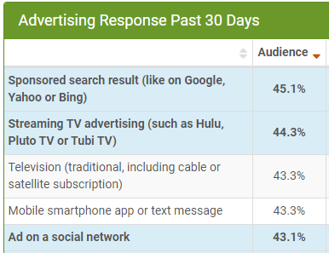
There are between 9,000 and 14,000 people watching KBTX news. Broadcast TV and streaming TV make up a large portion on where people get their news and there is over 600,000 available places to run our ads in front of just our residents.
Locals 18+
Reaching Your Audience in BCS & Robertson County
objectives
Where thousands of people in your target market are spending their time and consuming content.
customer
15000
“Local television stations remain one of the primary sources of news for most Texans (43%) but is statistically tied in its saturation with “social media, like Facebook, Twitter, Instagram, Reddit, [and] TikTok” (42%).”
10000
5000
0
Brazos Valley This Morning
News at 5 News at 6 News at 10
Source: Comscore – Demo Series Report (July 2023)
APRIL 2023 -A SNAPSHOT OF MEDIA AND SOCIAL MEDIA USE AMONG TEXAS VOTERS
idea
627,296
Ad placements available to get in front of Homeowners in Robertson County and Brazos County alone.
plan
Premion Avial pulled 8.15.2023
According to the 2023 AudienceSCAN® survey, 15.8% of US adults [*]
regularly support environmental causes with their time or more
4

Slide 5
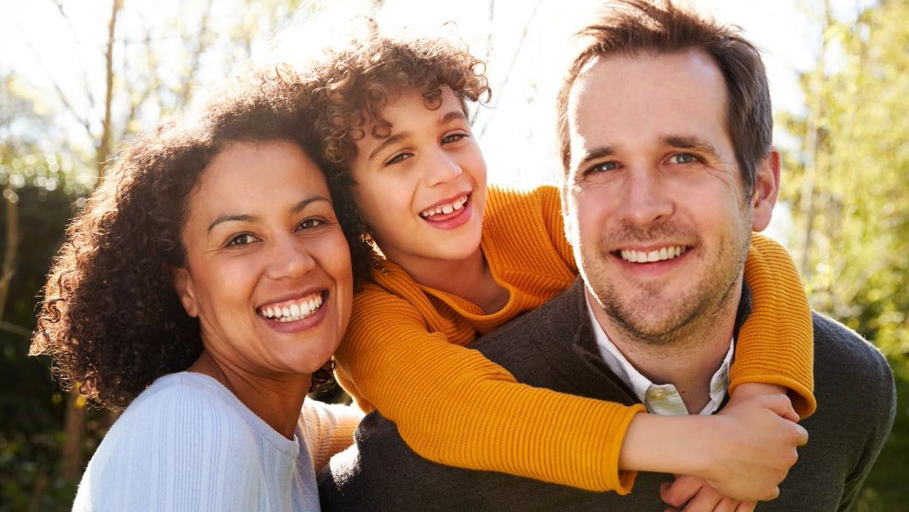
How do we capture this audience?
objectives
customer
The Idea
research
plan

Slide 6
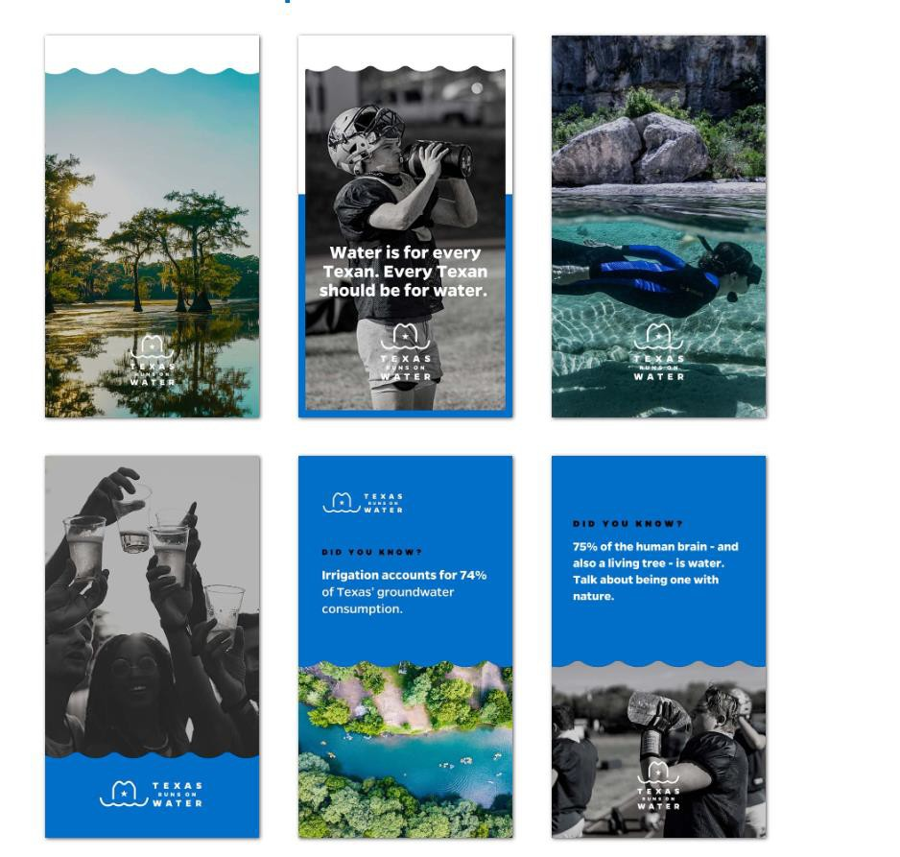
V i d e o C r e a t i v e
KBTX will utilize the toolkit that TROW provides to create 15-second and 30-second videos that will tell our community about water and why it is important. They will utilize local landmarks to personalize these ads to our market.
objectives
customer
research
plan

Slide 7
objectives
THE SOLUTIONS
customer
The Plan
Summary The Solutions
research
idea

Slide 8
STRATEGY
There are different ways to come up with the campaign. The main point of the ad will to make them aware of water, however there will also be links or QR codes to allow them to go to our website (Facebook at first) to get more information about us.
objectives
THE SOLUTIONS
customer
A t t r a c t ( T o p o f F u n n e l )
55-65%
Making people aware of why conserving water is important
Making consumers aware of a solution to their needs.
The key
marketing
strategy needed
to maintain
brand equity
and gain an edge
in long-term
consumer cycles
Video
research
E n g a g e ( M i d d l e o f F u n n e l )
20-30%
Providing people opportunities to self-educate
Providing consumers with opportunities to self-educate.
Interactive
idea
C o n n e c t ( B o t t o m o f F u n n e l )
5-10%
Linking your organization with people who are ready to act
Linking your business with consumers who are ready to buy.

Slide 9
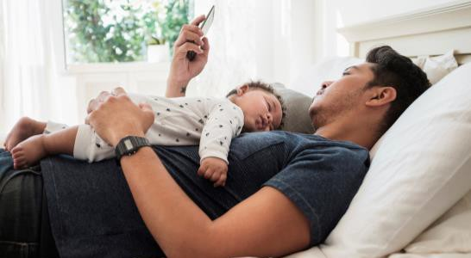
Broadcast Television
These are all the different places our ads will run. Depending on the one chosen, depends on the length, call to action, etc.
Premion OTT
objectives
THE SOLUTIONS
Local News
OTT Streaming Apps
Local News
Website
Local News
Mobile Apps
customer
Audience Targeting
research
YouTube
Social Media
Targeted Email
idea
plan
Search Engine
Optimization
Paid Search
Landing Pages

Slide 10
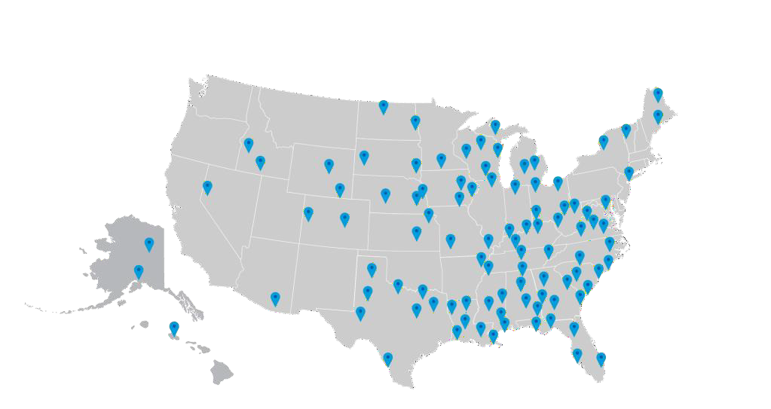
Gray Digital Media
Since KBTX is owned by Gray Media, they do all the design and marketing work in house instead of having a different company develop things and just run it on tv/social.
Who We Are
We understand and appreciate the challenges in running a local, regional, national, or global business and we have designed our solutions to deliver return on your marketing investment.
We bring national quality digital marketing services to the local marketplace.
customer
Expertise
Our certified specialists are Facebook and Google Premier partners.
research
Review
Live and narrative reporting gives you constant and detailed updates on your campaign.
From the top of the consumer funnel to the bottom, KBTX Media can provide everything you need from production to holistic campaign management. We are the one stop shop you can rely on.
idea
Conversions
Transparency, expertise and optimizations that impact your ROI
plan

Slide 11
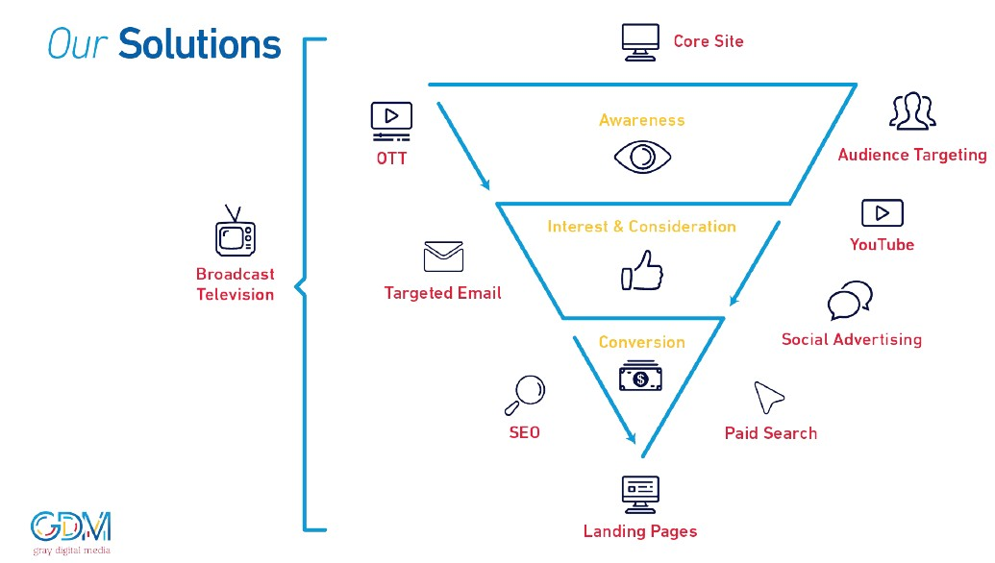
Our Solutions& The BuyingCycle
Based on what you are trying to accomplish with the ad depends on where you might run it. However, anything you do will all eventually lead to the landing page (i.e.- Facebook page or website)
customer
research
idea
plan

Slide 12
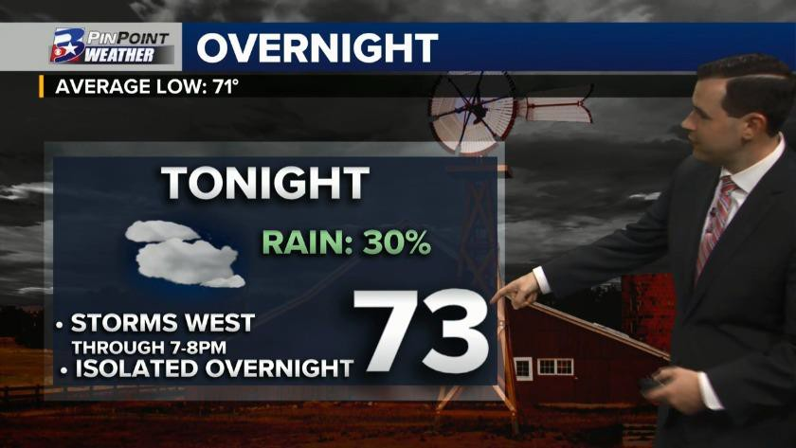
BROADCAST
Broadcast tv through KBTX is the easiest way to get in front of people. Same concept as our BV
WaterSmart campaign ads
attract
objectives
TELEVISION
THE SOLUTIONS
Trusted Reach: Maximize Your Visibility
Increase awareness and brand recall with our well-informed and engaged audience
customer
Leverage the most influential and trusted advertising medium.
Reach consumers quickly and efficiently using our local broadcast channels.
Massive Reach
Engaged and Affluent Audience
Trusted Source for News, Weather, Sports, and Traffic.
Historically embedded into the local community.
research
idea
plan
Video

Slide 13
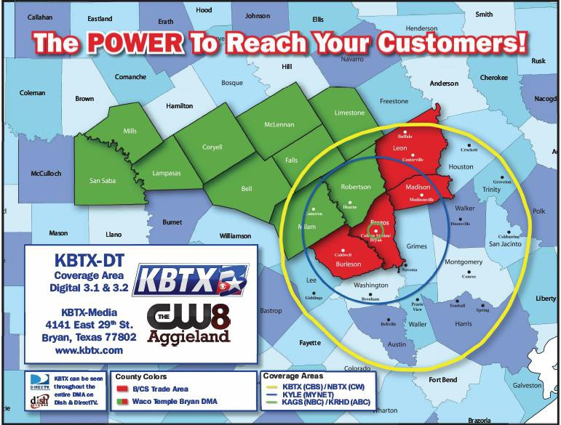
BROADCAST COVERAGE
Your message will reach thousands of people in over 17 counties
(500,000 + Households)!
Your message will be served on Dish, DirectTV, 40 + cable companies, and over the air!
As the only full power broadcast TV station in the market, we can amplify your message maximizing your marketing investment!
objectives
THE SOLUTIONS
customer
research
idea
plan

Slide 14
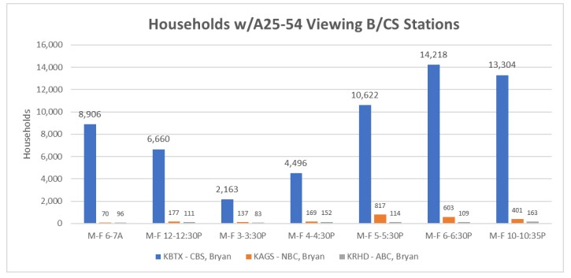
objectives
THE SOLUTIONS
customer
research
idea
plan

Slide 15
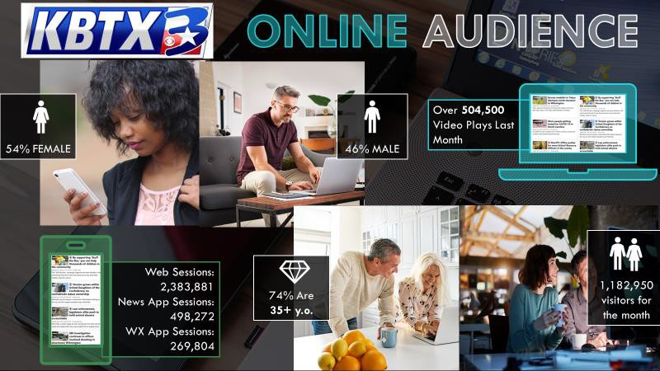
Online marketing is starting to be even more important
JULY 2023 ONLINE STATS
objectives
THE SOLUTIONS
customer
research
idea
plan

Slide 16
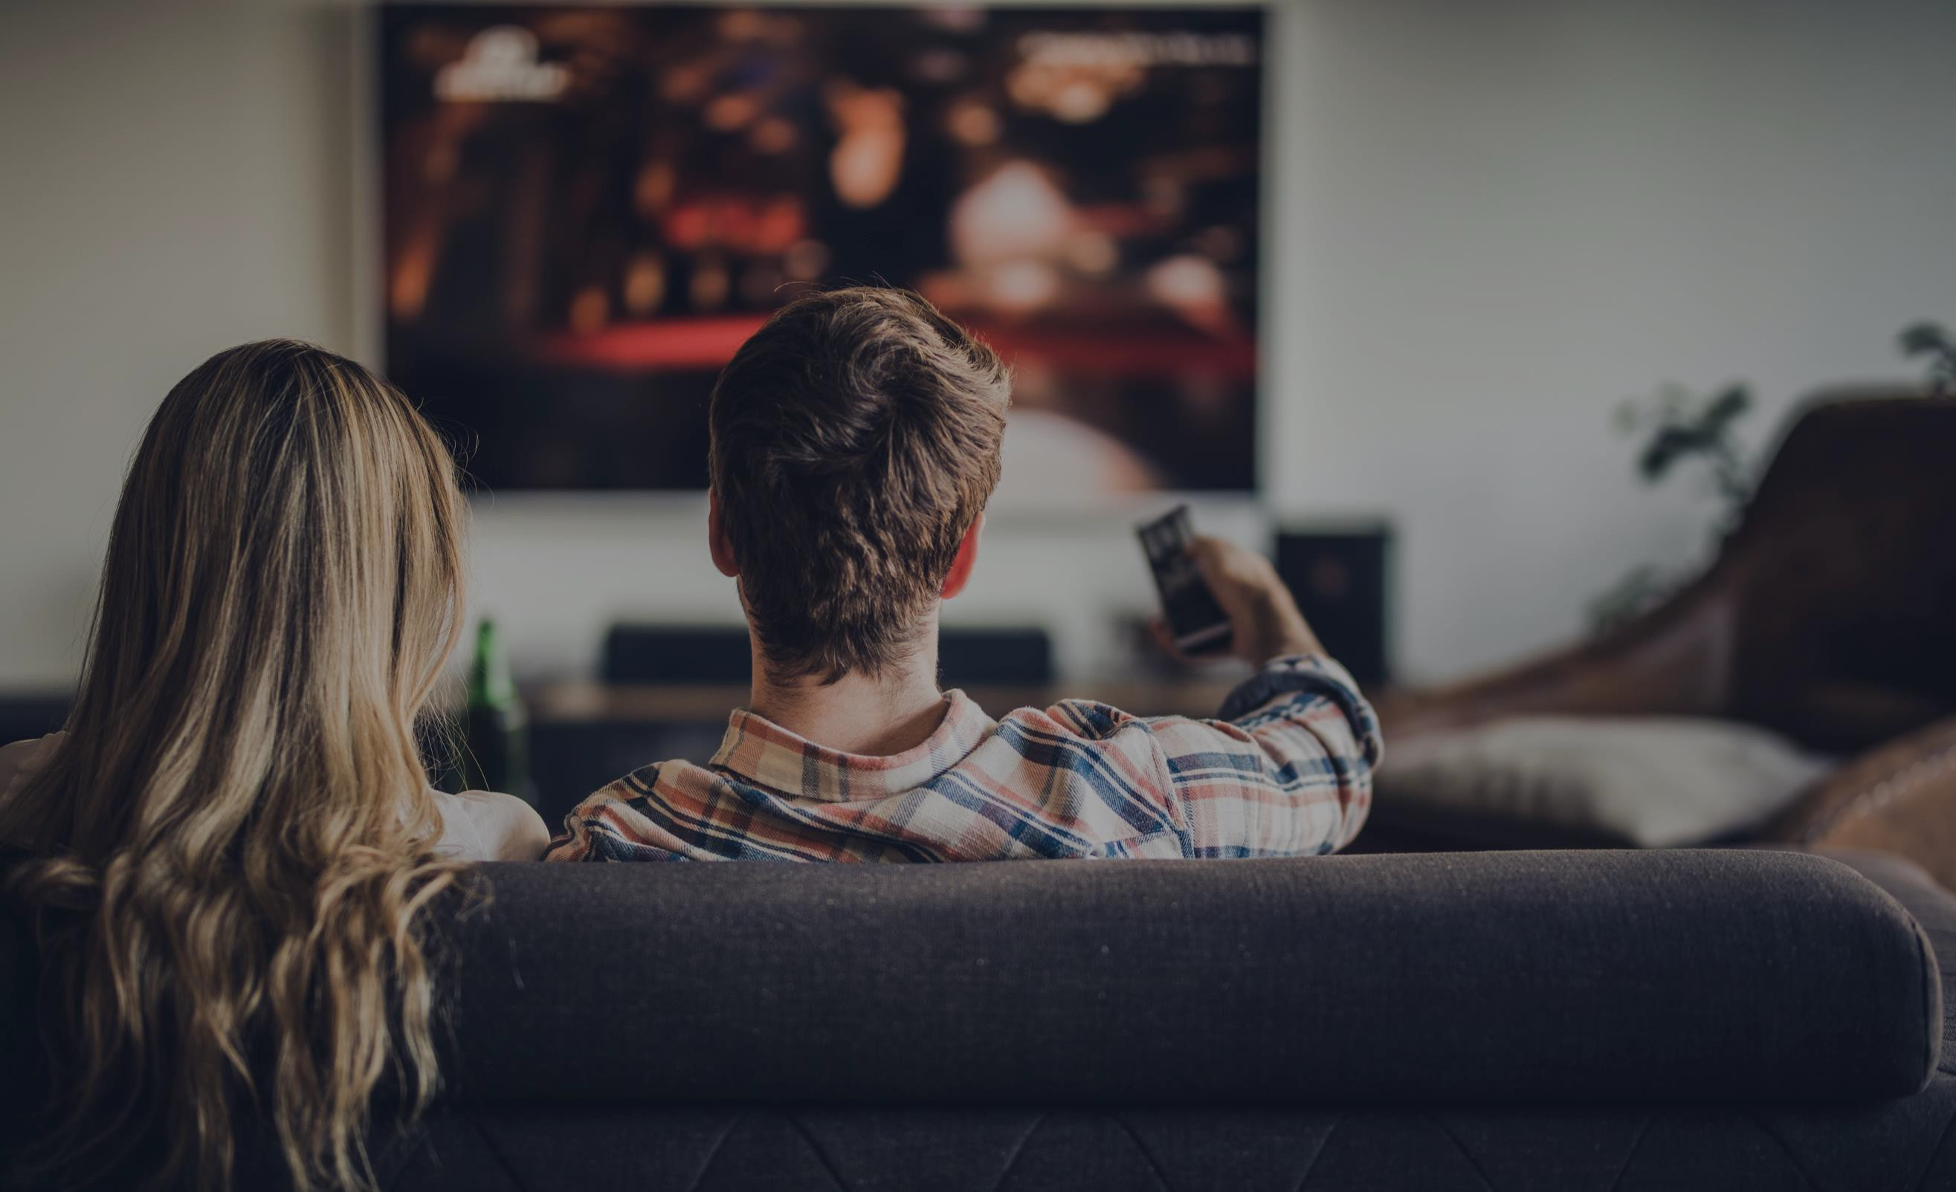
People are switching from traditional tv to streaming. Streaming tv has its own ads and this allows them to place ads in front of those people as well
attract
OTT
Premium OTT: First Run On The Best Content
100% Direct Access Delivering Premium Content, Premium Reach, Premium Reporting
objectives
THE SOLUTIONS
Geography:
From State-Wide down to the Zip Code
Demographic:
Gender: Adults, Male, Female
Ages: 18+, 18-34, 18-49, 25-54, 35+, 55+
Household:
Homeowner/Renter, Presence of children, Income, Home value, Education, Marital status, Political
Consumer:
Interest, In-Market shoppers, Intenders
Sports:
Ads only shown on sports content
Spanish Language:
Ads shown on Spanish language content and to Spanish speaking households
customer
Utilize the leading OTT advertising platform.
research
Reach streaming video viewers through 125+ premium direct publishing partners on all devices.
idea
TAG certified against fraud, with
NO open-exchange inventory.
plan
Video

Slide 17
attract
OTT
Premium OTT: First Run On The Best Content
100% Direct Access Delivering Premium Content, Premium Reach, Premium Reporting
objectives
THE SOLUTIONS
customer
Gender/Age: Both/18+ Consumer: None
Household: DEMO Homeowner Max Impressions: 627,296
research
In Texas, 91% of people are OTT viewers.
idea
plan

Slide 18
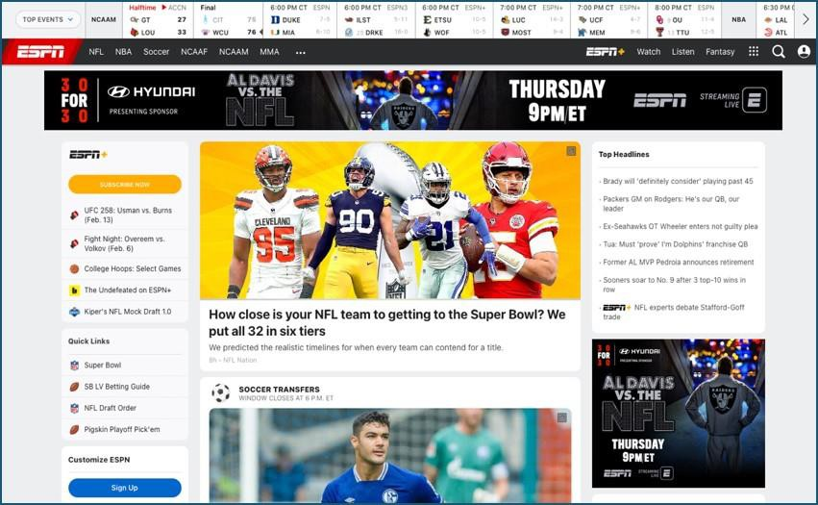
Banner ads/photo ads that show up on other websites based on where the target person is looking
attract
engage
TARGETED
DISPLAY &
objectives
Targeted Reach: Focused On Your Best Prospects
Reaching the right people, in the right places, at the right time
THE SOLUTIONS
VIDEO
customer
Build brand awareness with targeted display. Based on users’ behavior, interests and location.
Demographic:
Age, Gender, Geo
Behavioral:
Reach your audience based on user habits
Keyword:
Serve ads on sites that contextually match your industry using custom build keyword lists.
Site Retargeting
research
Unleash the power of targeted video by delivering pre-roll video ads. Finding your customers early in their purchase journey.
idea
plan
Display
Video

Slide 19
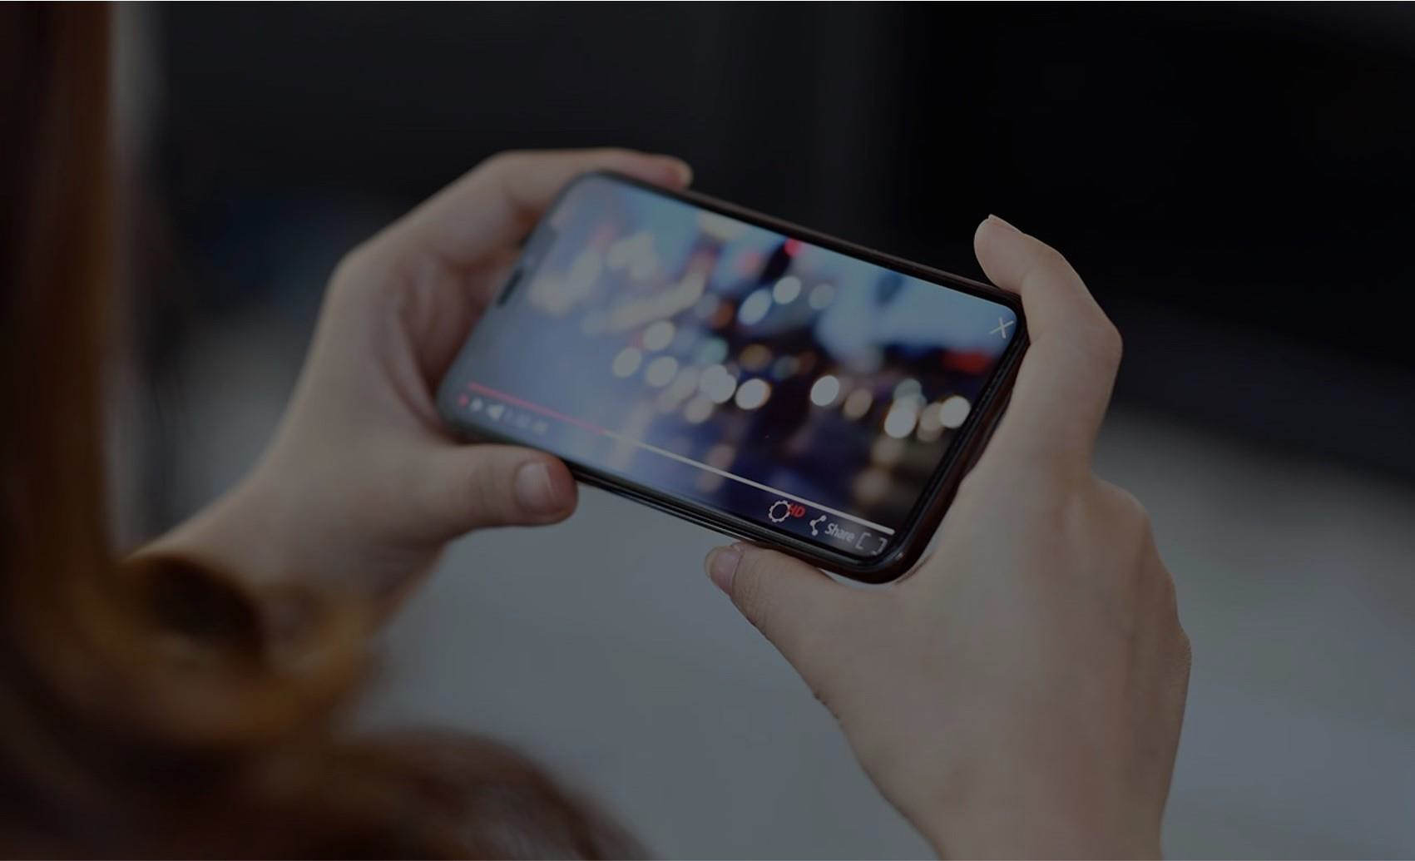
Ads before or after videos on YouTube. You don’t pay unless the ad is viewed in entirety
engage
Targeting Blend: Optimizing For Results
Based on your goals and the campaign data, our team will employ 2-5 tactics to continuously optimize your YouTube strategy.
objectives
THE SOLUTIONS
Video Advertising
customer
Geography:
Market, Cities, Zip Codes, or Radius of an address
Tap into YouTube’s 2
billion monthly users.
Custom Audiences:
Affinity – by interest
Intent – by intending to purchase
research
Data-driven targeting tactics allow your video ads to be shown, in full, to maximize your impact.
Topical
Remarketing Contextual Keyword
idea
plan
Video

Slide 20
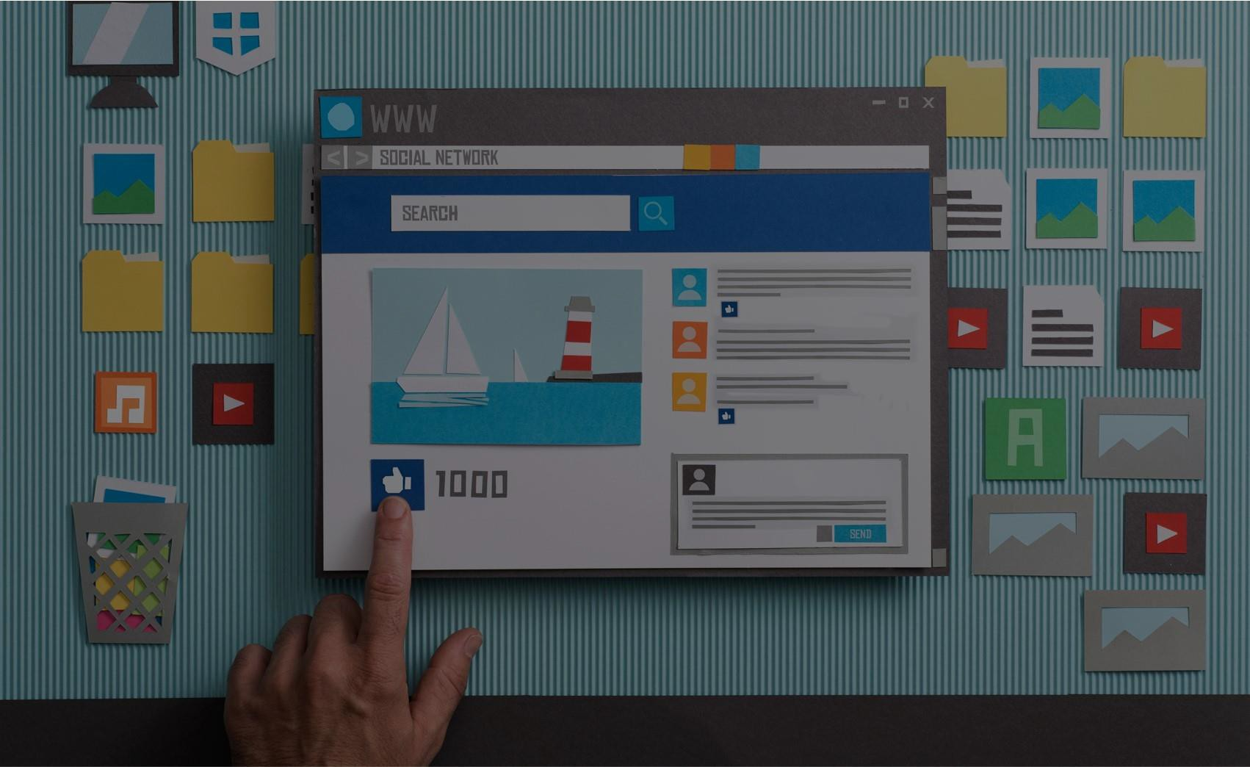
SOCIAL M E D I A
We will primarily use our Facebook page for videos and ads. This will also be our landing page on the videos that are produced for TV and YouTube, at least initially
engage
objectives
Targeting Your Goals: Optimizing For Results
From increasing awareness, expanding reach, driving traffic, to creating engagement, generating leads
THE SOLUTIONS
T A R G E T I N G
customer
Facebook and Instagram
Display, Carousels, Videos
Or Lead Generation
Targeting Tactics:
Demographics, Affinity Groups
Drive engagement by precisely targeting your audience on Facebook and Instagram.
research
From targeted reach to driving leads, the world’s top social media platforms deliver results.
idea
plan
Display
Video

Slide 21
VIDEO
This is a combination of the BV Watersmart and BV Runs on Water Campaigns. It will be heavy on BVROW. KBTX will develop everything, with our approval before airing. These are minimum numbers, we can expect more reach. WE will have a dashboard we can analyze data at any point during the campaign and see what is working and what isn’t.
C U S T O M R E C O M M E N D A T I O N B A S E D
O N Y O U R T A R G E T M A R K E T A N D G O A L S
objectives
INTERACTIVE
THE SOLUTIONS
Broadcast TV
Reach % | Reach # | Frequency
56% | 149,288 HH | 3.0
4
Digital Video
S t r a t e g i c
1
customer
attract
demo-optimized
attract demo-optimized | :30 Spot | 1 min. Segment
BV Early Morning (5a-6a) | 8 | -
DAYTIME ROS (6a-6p) | 16 | -
BV This Morning (6a-7a) | 16 | 2
CBS This Morning (7a-9a) | - | 2
News at Noon (12p-12:30p) | - | 2
EVENING NEWS ORBITS | 12
 | 52 | 6
 | $4,640 | 440,000 imps.
:30 Spot
Audience Targeted Video Ads | 25,000 | $625
KBTX.com
attract demo-optimized
5
research
Local Audience – Display Ads
50,000
$500 Value
P l a n
2
Connected TV
idea
attract
demo-optimized
675,000
Minimum Imp. Monthly
Streaming TV | 25,000 | $1,000
Digital Video
$8,965
Per
Month
3
attract
targeted
demo-optimized
YouTube | 15,000 | $1,500
Social Media Targeted Ads | 120,000 | $1,200
21

Slide 22
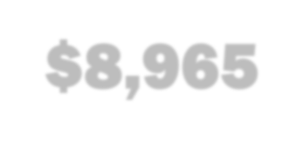
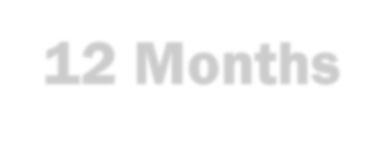
2023 - 2 0 2 4 T E X A S R U N S O N W A T E R P A R T N E R S H I P A G R E E M E N T
objectives
THE SOLUTIONS
8,100,000
Minimum Impressions Annually
Broadcast TV 440k Impressions
Streaming 25k Impressions
YouTube 15k Completed Views
Social Media 120k Impressions
Targeted Video 25k Impressions
KBTX.com 50k Impressions
S t r a t e g i c
customer
675,000 Minimum Impressions Monthly
*Includes Flow Code & 24/7 Access to Analytics Dashboard plus continuation of the BVGWCD page featured on KBTX.com*
$8,965
research
Per Month
Alan Day
P l a n
Campaign Length:
12 Months
Date
idea
All advertising, production services, consulting services, and digital management services sold or offered by Gray Television Group, Inc. or Gray Media
Group, Inc. (collectively “Gray”) are subject to Gray’s Standard Terms and Conditions available at www.gray.tv/advertising.
22

Slide 23
THANK
YOU!
objectives
customer
Ashley Seelig
9 7 9 . 2 2 0 . 5 2 1 5
a s h l e y . s e e l i g @ k b t x . c o m
research
idea
plan

