Slide 1
Assessing Surface and Groundwater Interactions Between the Middle Brazos River Alluvium Aquifer and the Brazos River
February 13th 2025 Board Presentation
Mark G.F. Nickels
Advisor Dr. Joe Yelderman

Slide 2
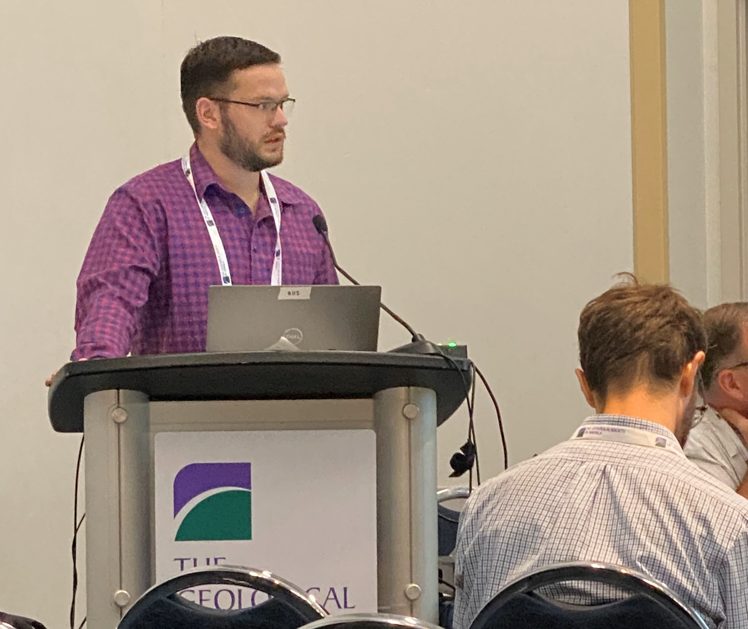
GSA Connects National Meeting
Notes:
- Good reception and input
-

Slide 3
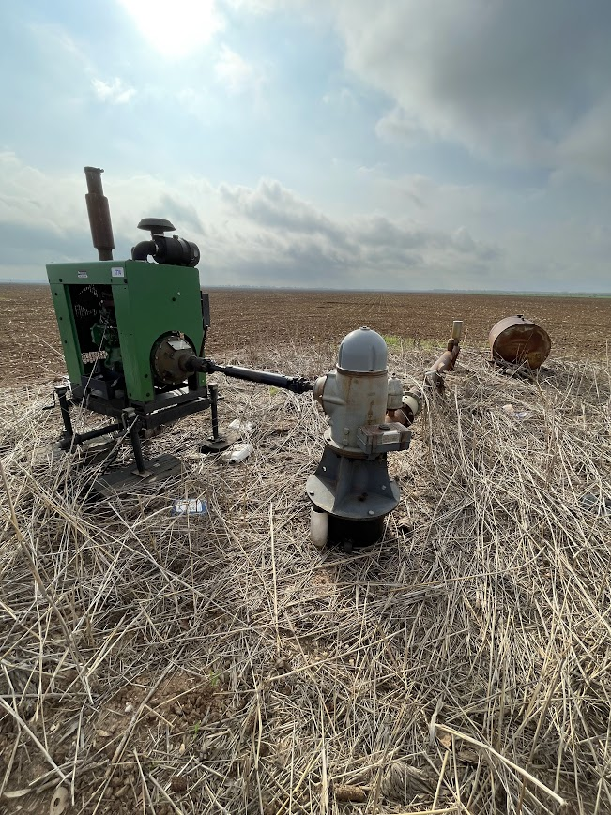
Purpose and Motivation: Follow up from Public Meeting Dec. 9th
The Brazos River, Brazos River Alluvium Aquifer (BRAA), and bedrock aquifers are a vital resource in central Texas.
Current state of groundwater modeling of the BRAA has been based on limited data for understanding the heterogeneity of a compartmentalized aquifer with complex interactions.

Slide 4
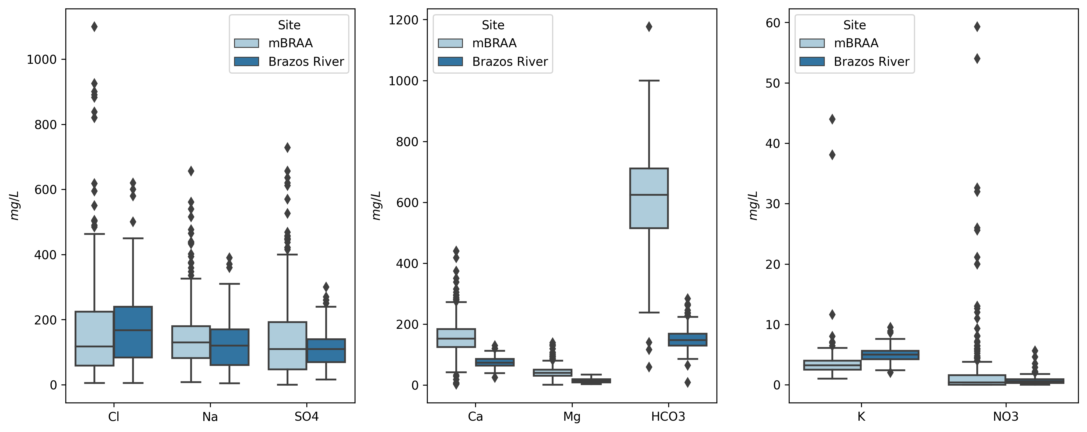
Chem Data: Ionic
Data variability
Sampling bias
Suggesting chemical sampling
Notes:
Bicarbonate is most distinctive
Sample bias in wells: wells are drilled in good water generally
Variability is higher in the aquifer
Suggest chem sampling: helps to

Slide 5
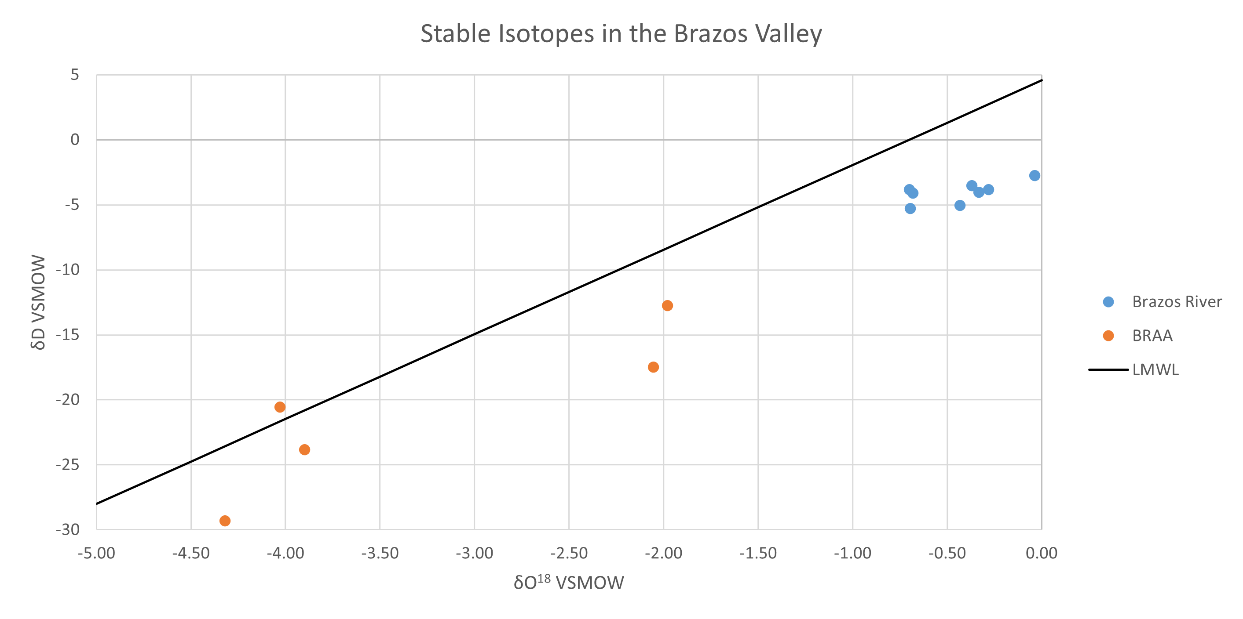
Chem Data: Isotopic
Notes:
Limited wells, but the ones that we do have are distinct

Slide 6
Chem Data: Isotopic
Notes:
Two other wells plot in the middle, however it is from an unused casing, and could have evaporation that is related to it.

Slide 7
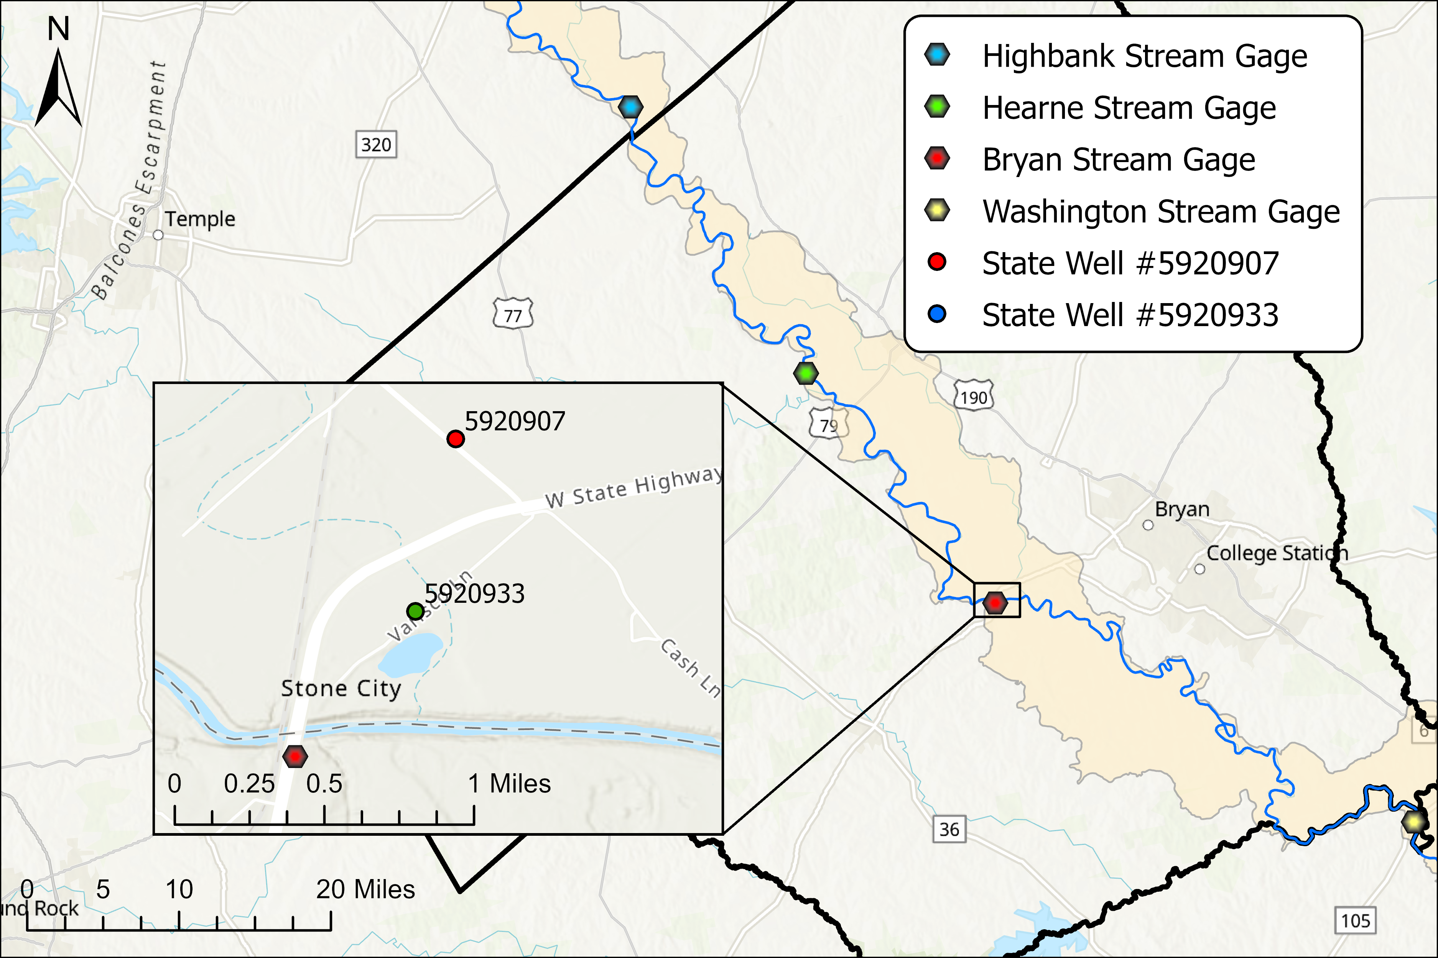
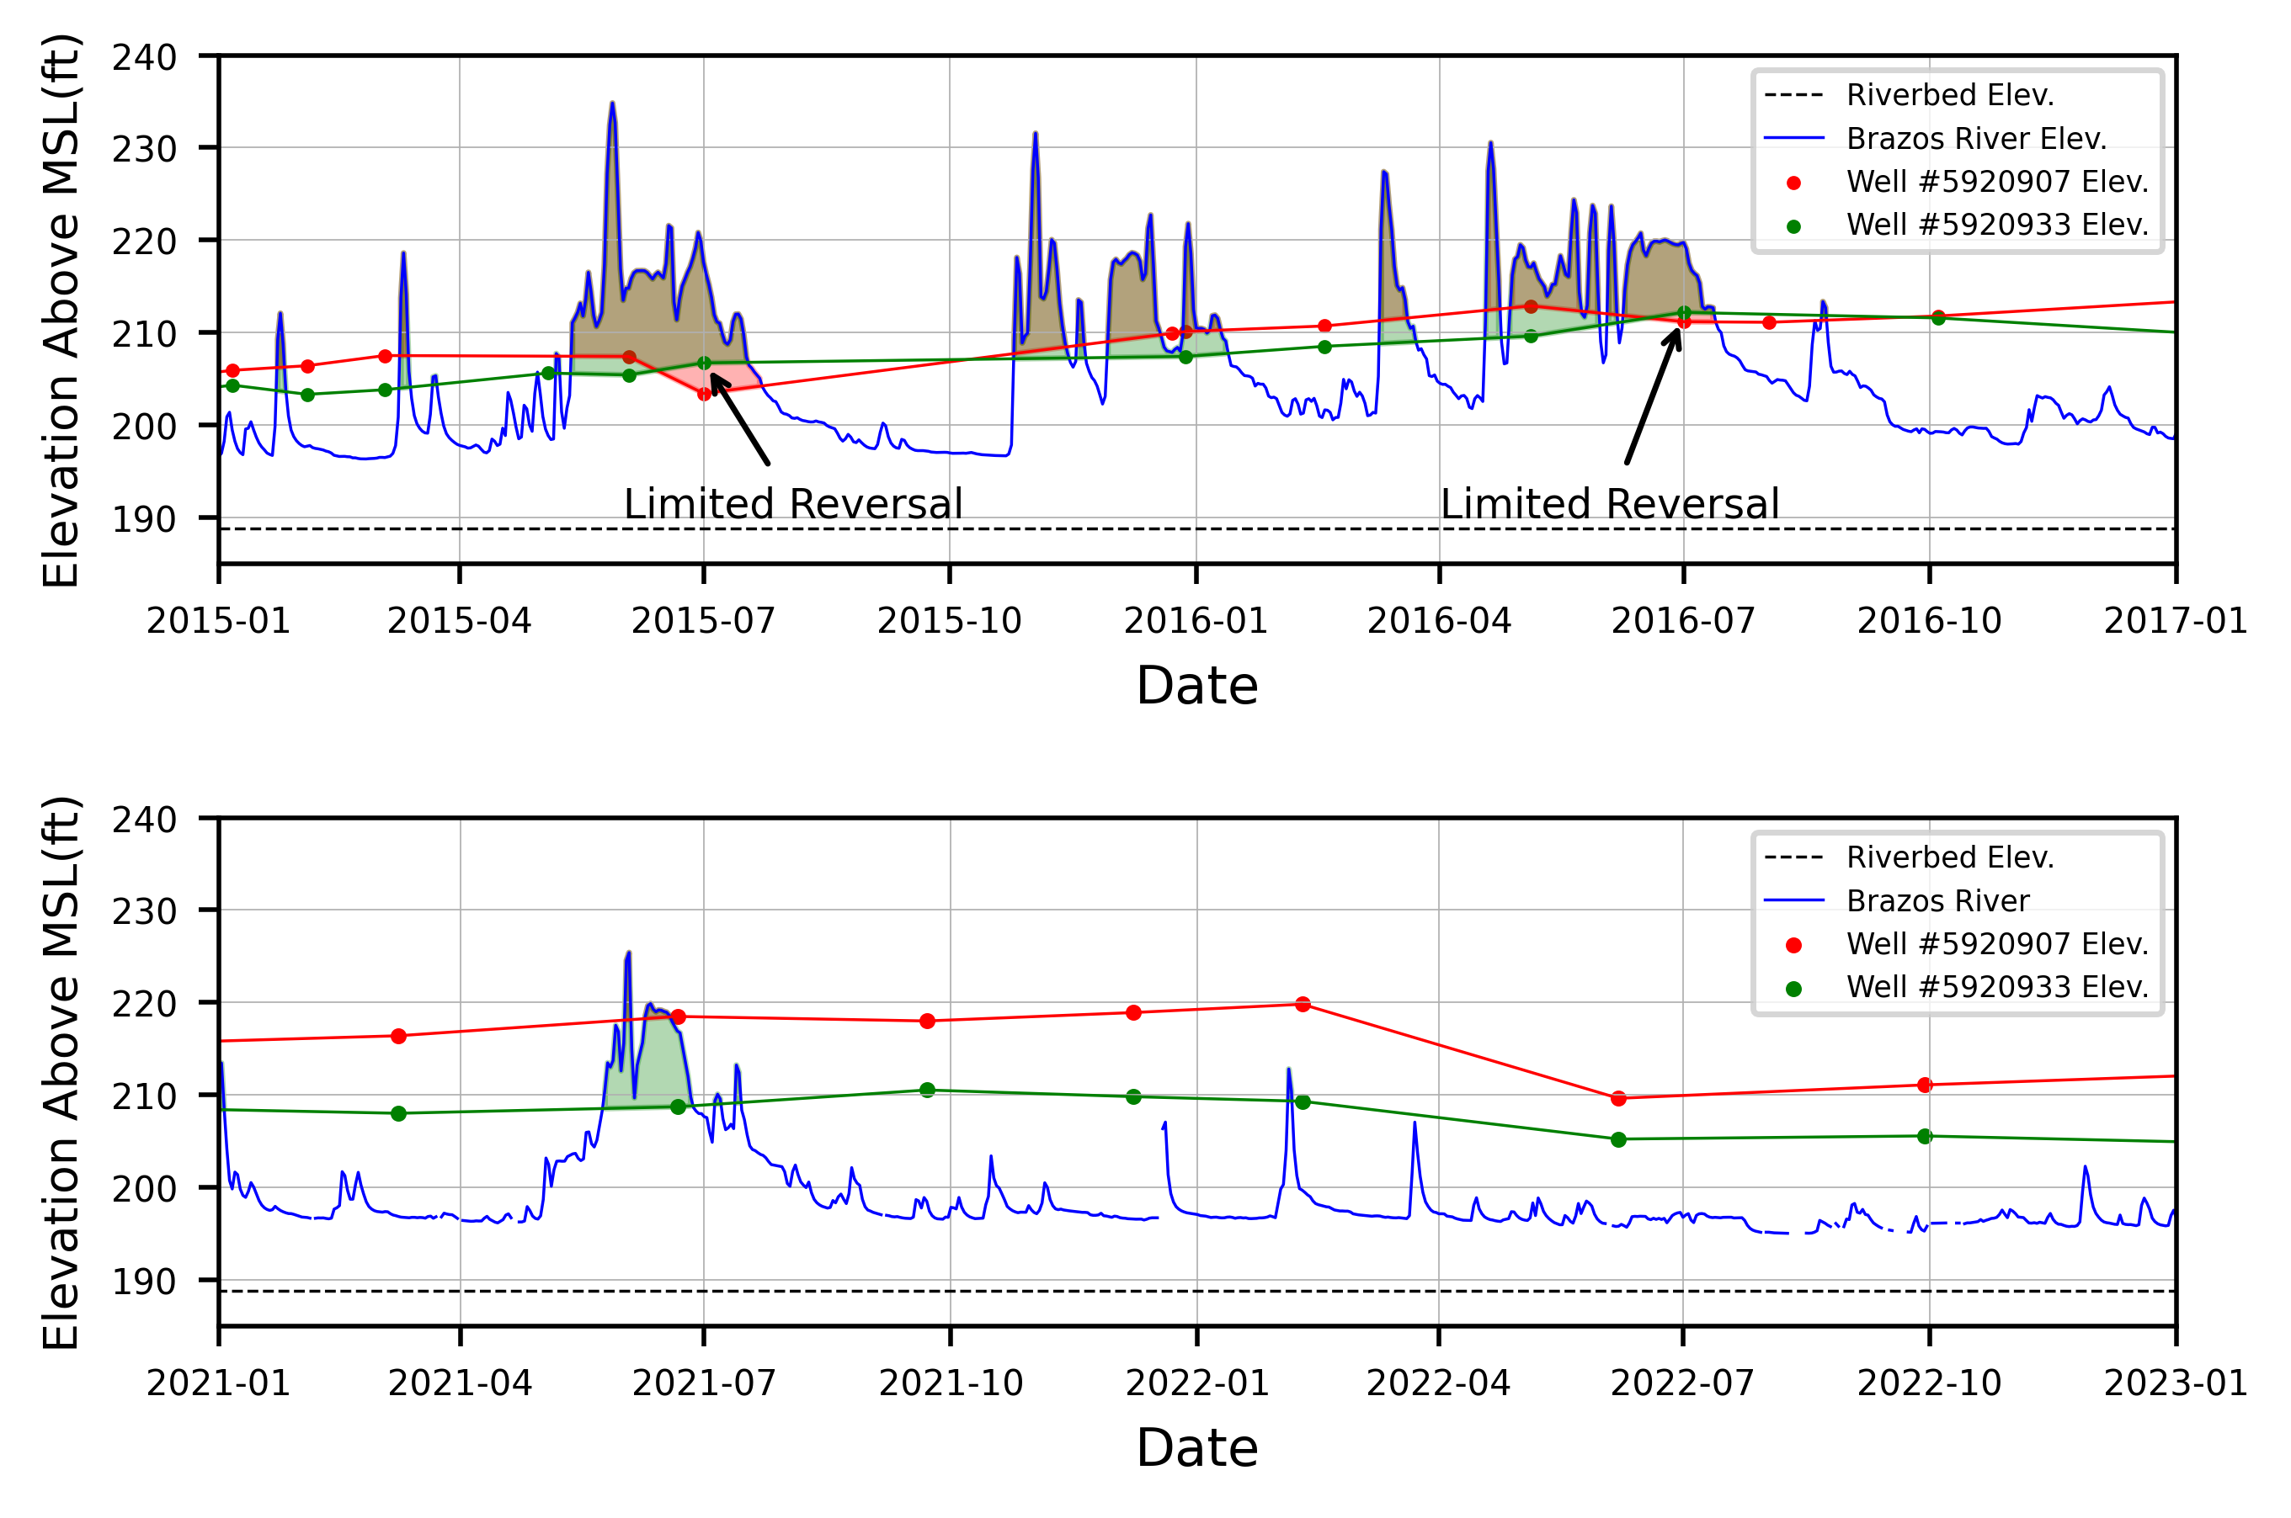
Historic Water Level
Dry
Wet
Notes:
Map
Axises

Slide 8
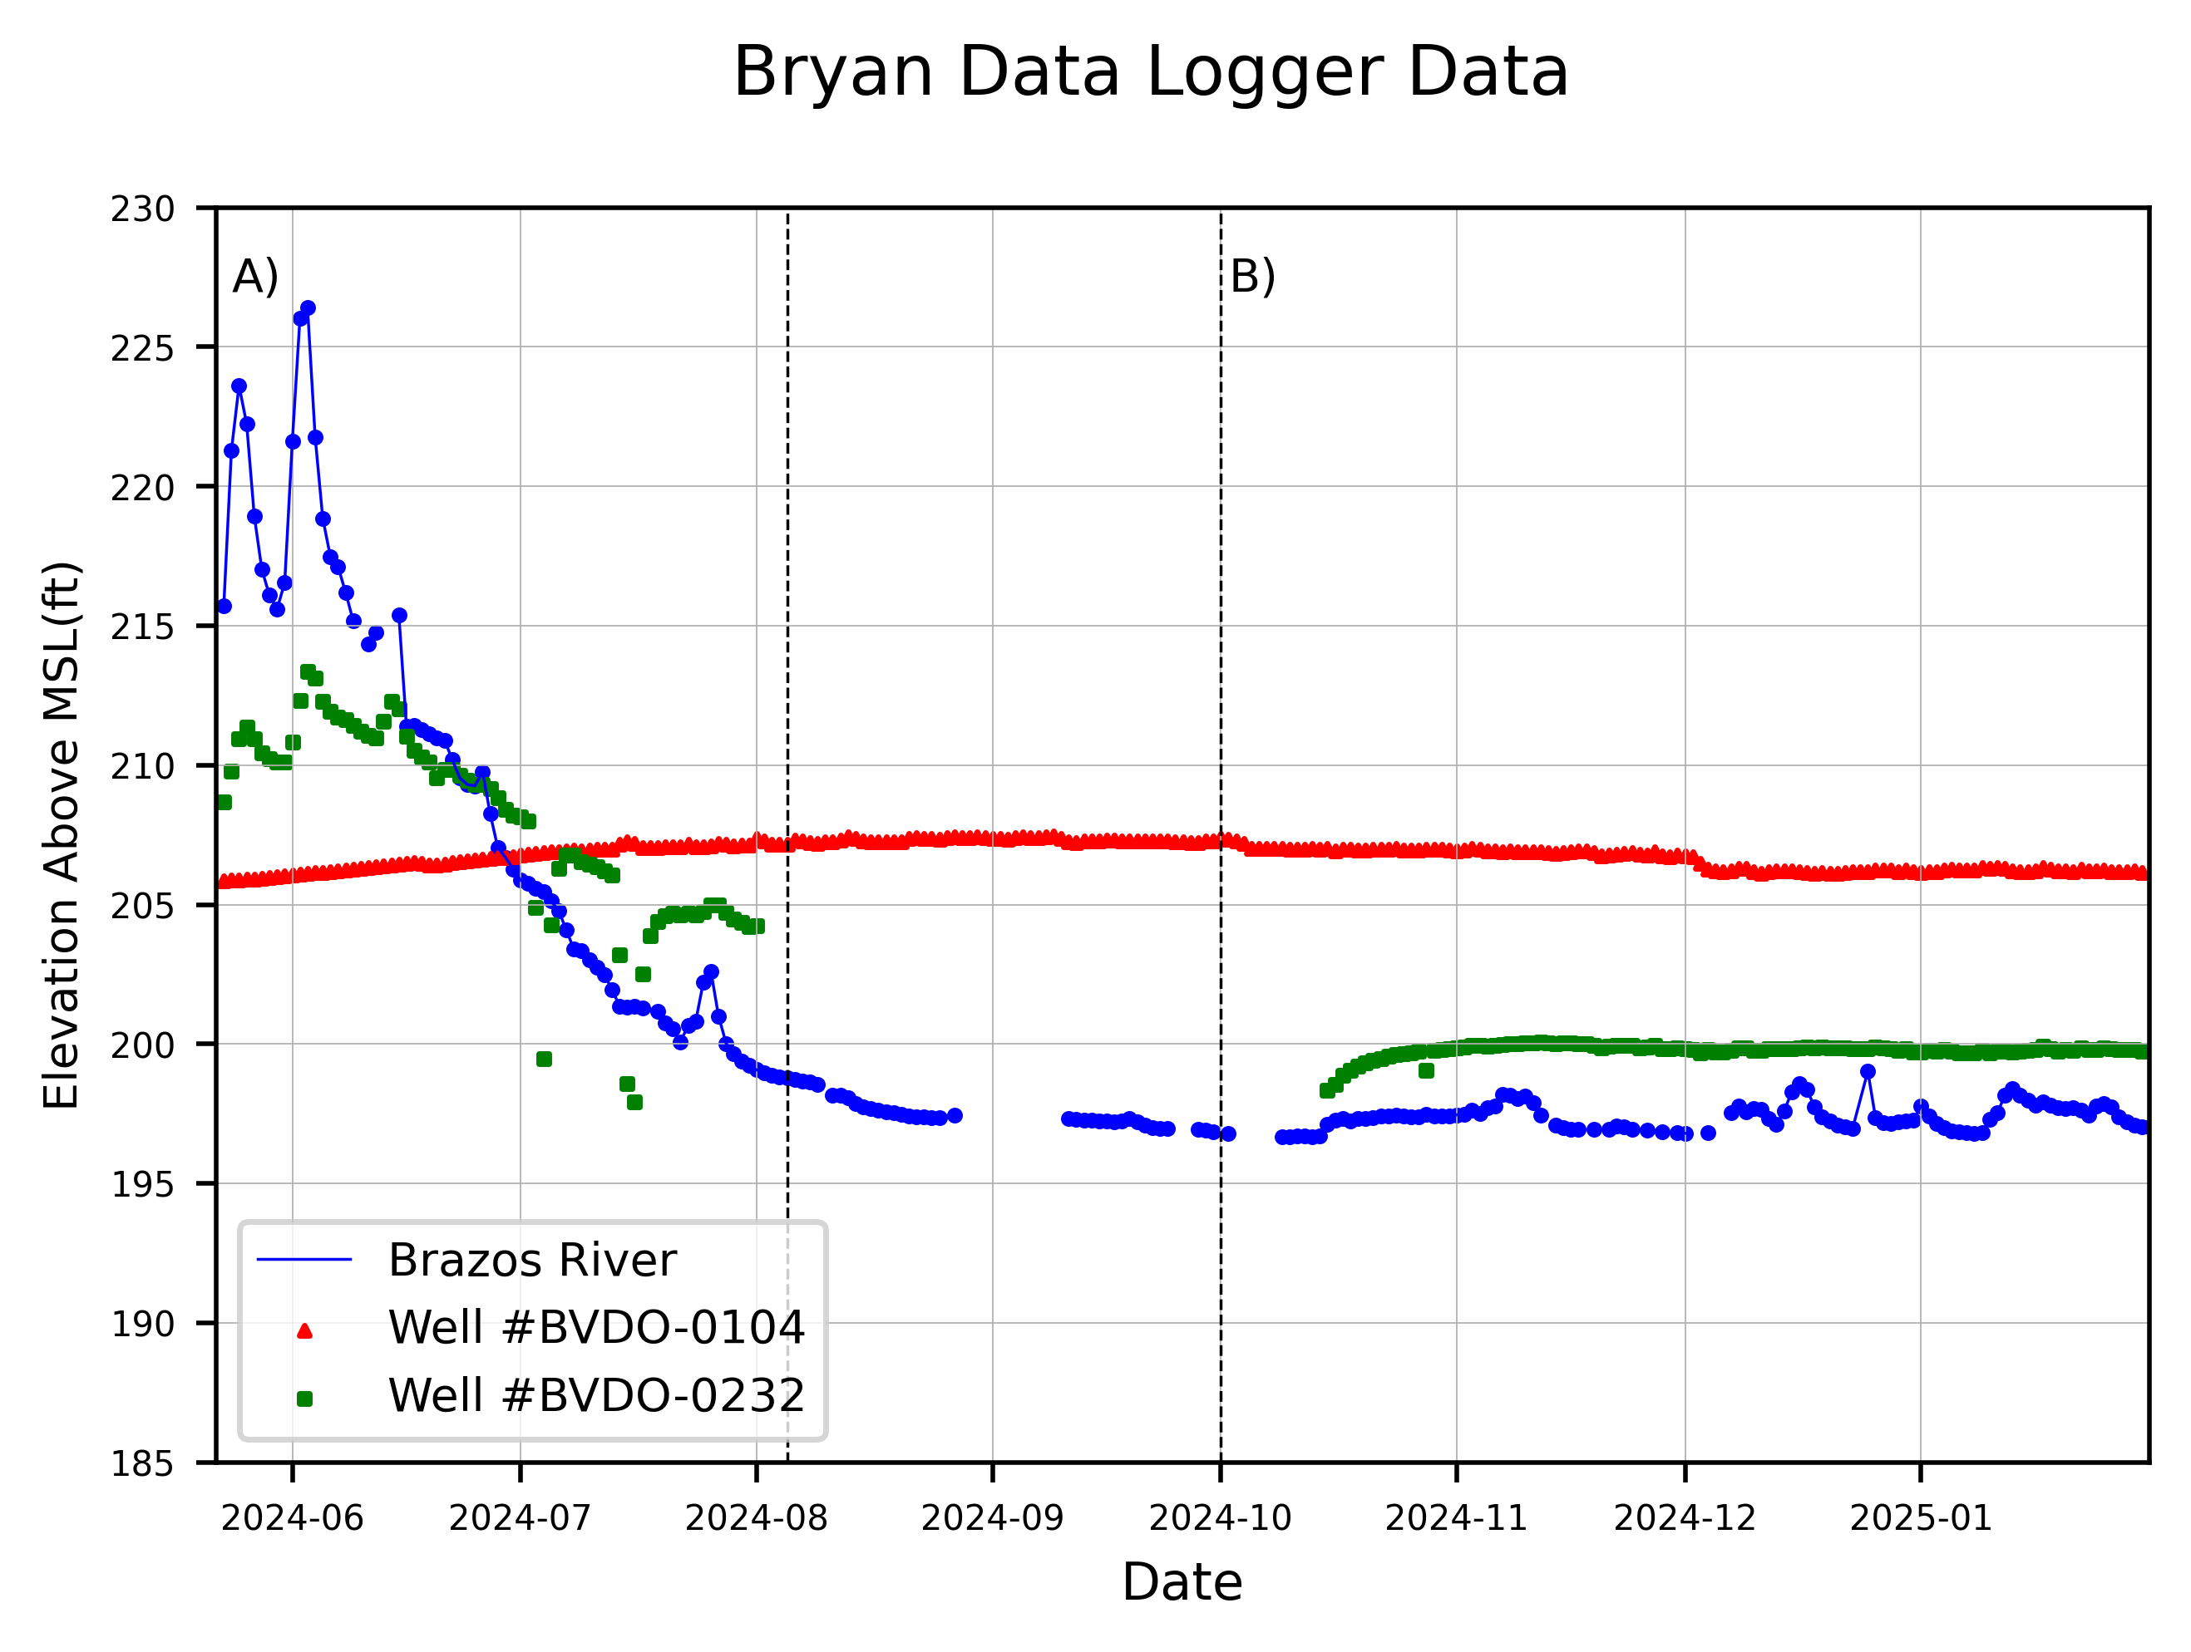
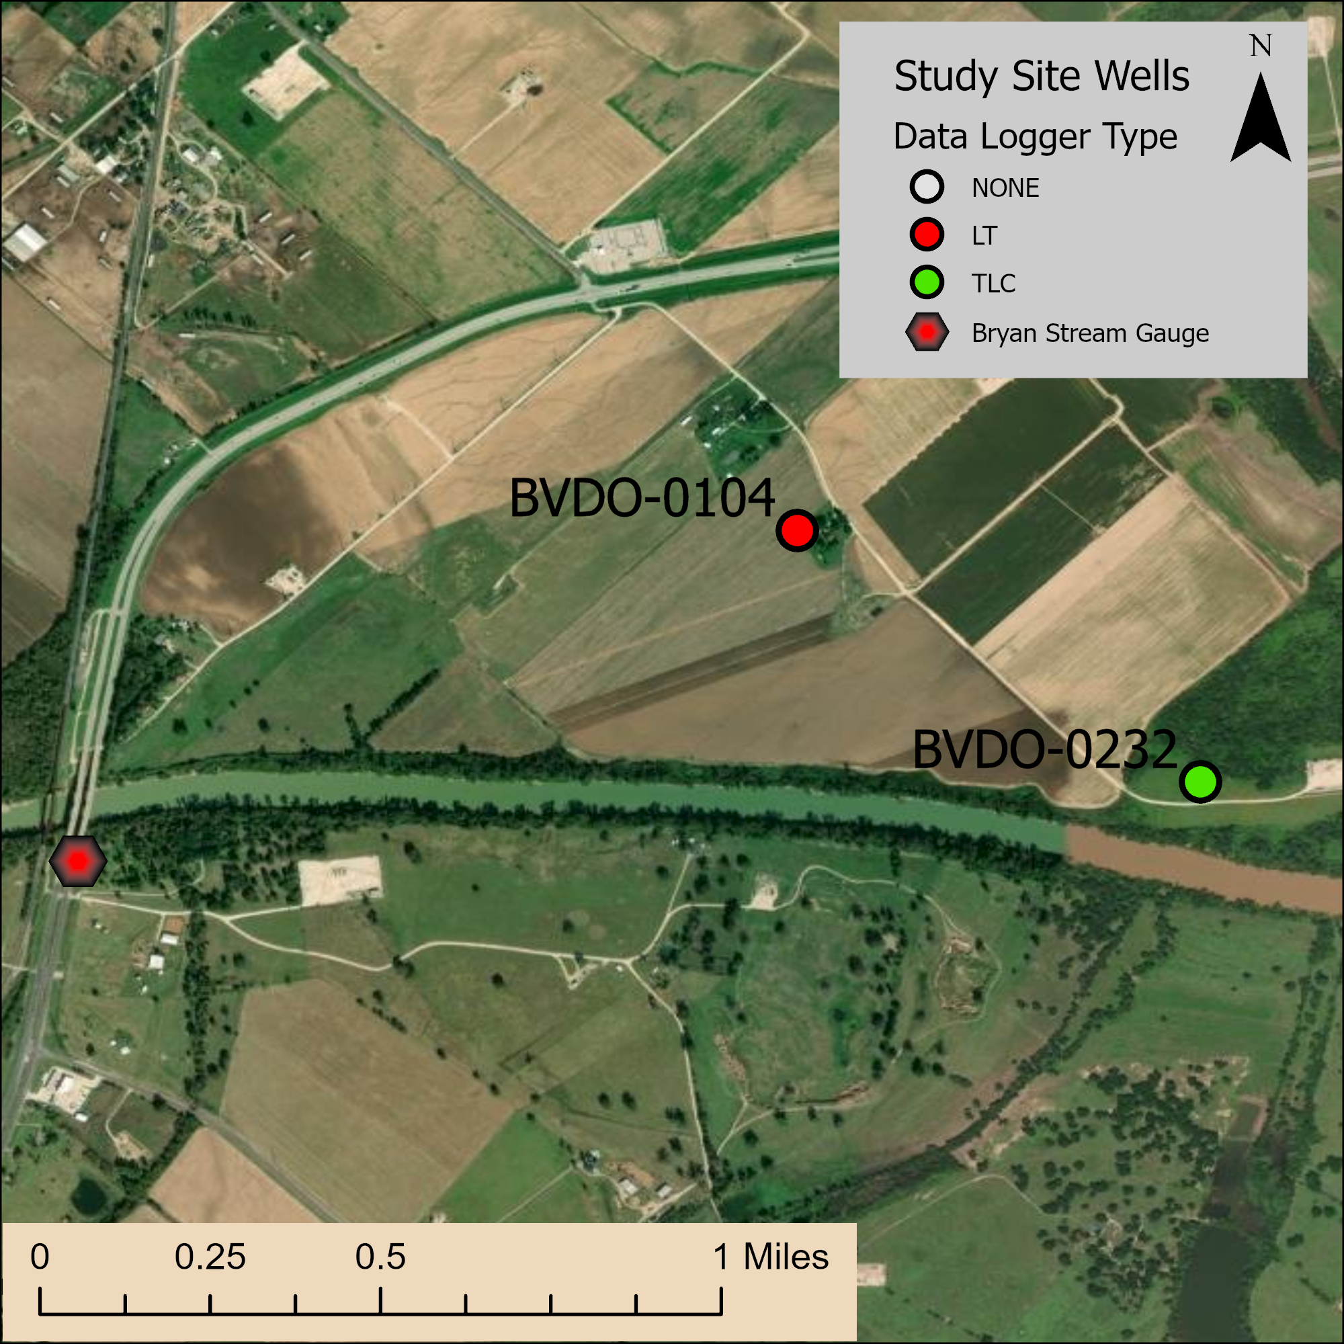
Local Study Site: Bryan Field Data

Slide 9
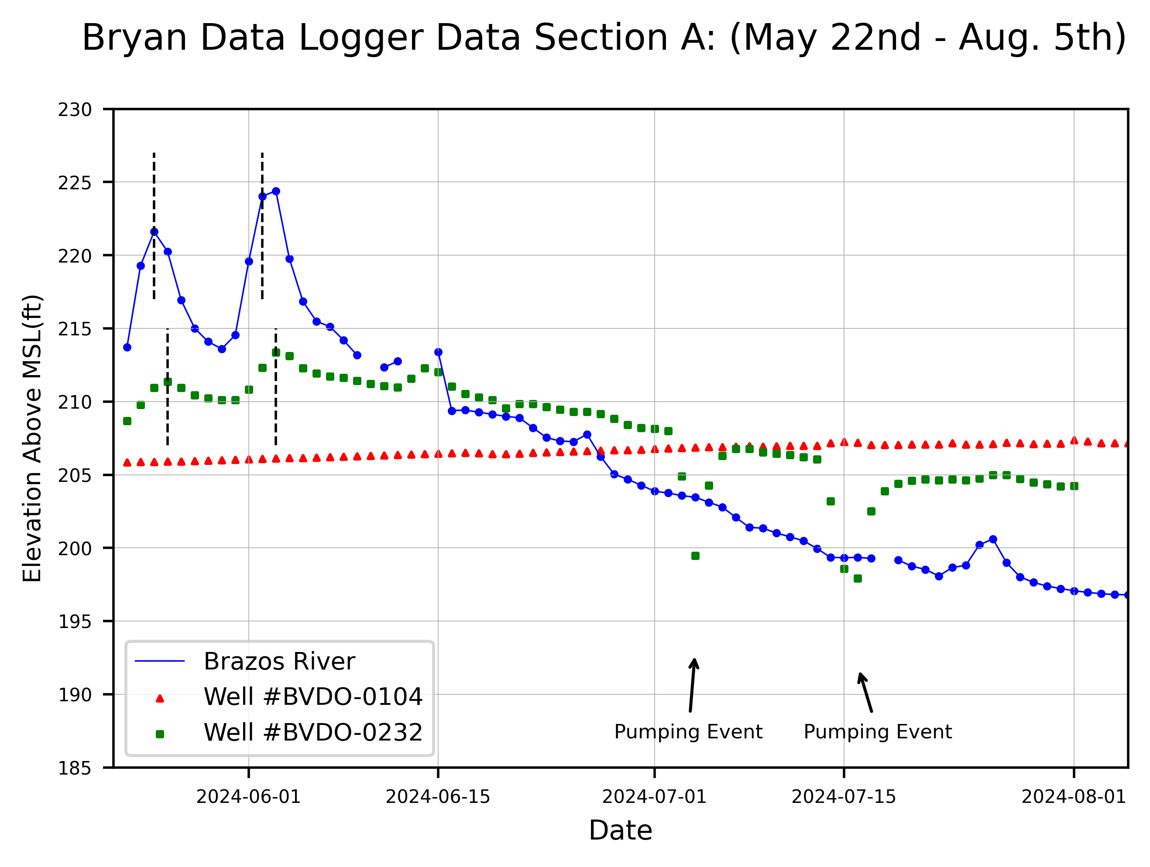
Local Study Site: Bryan Field Data

Slide 10
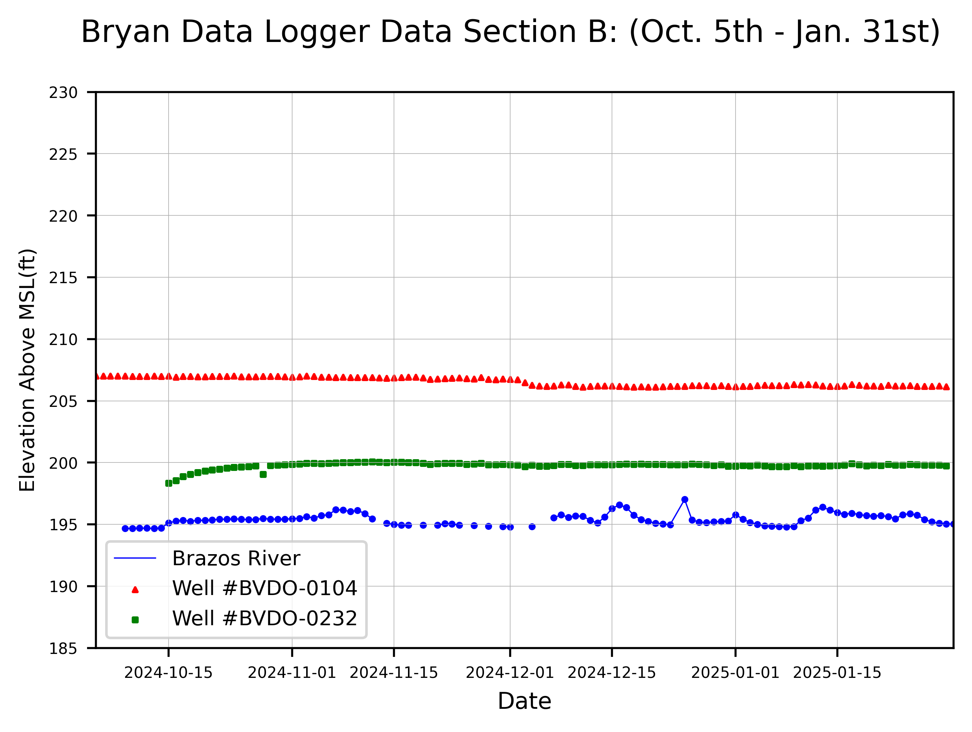
Local Study Site: Bryan Field Data

Slide 11
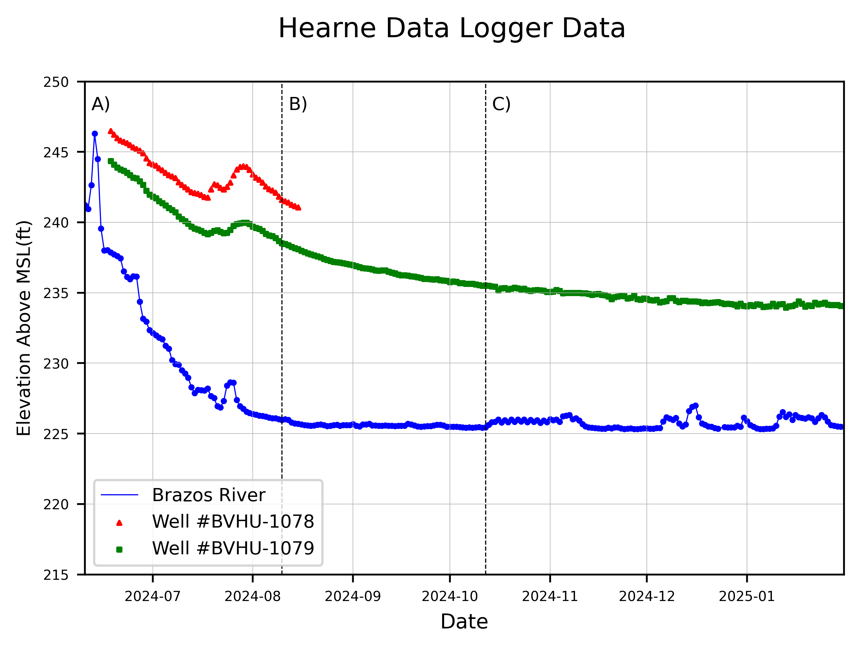
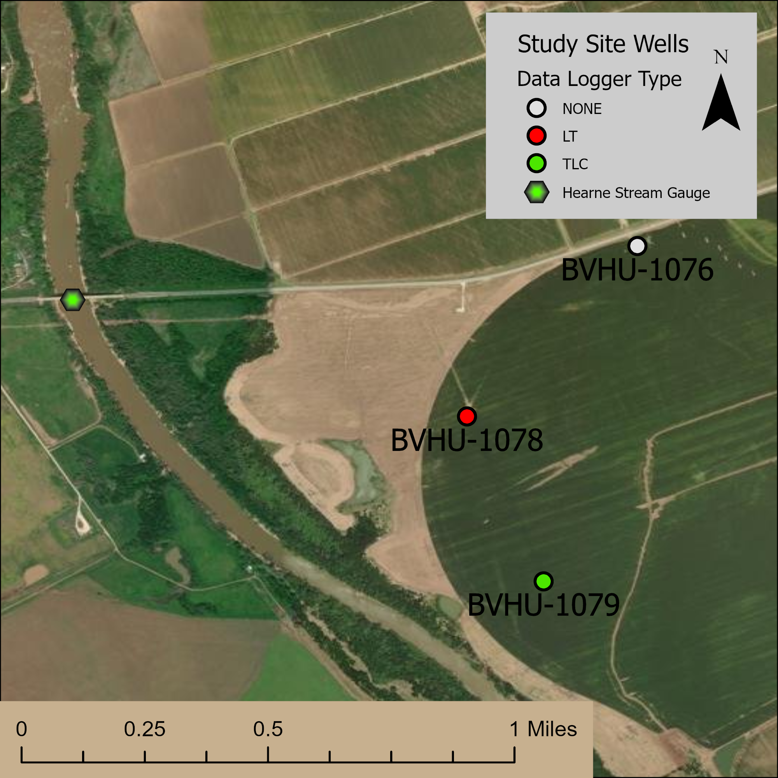
Local Study Site: Hearne Field Data

Slide 12
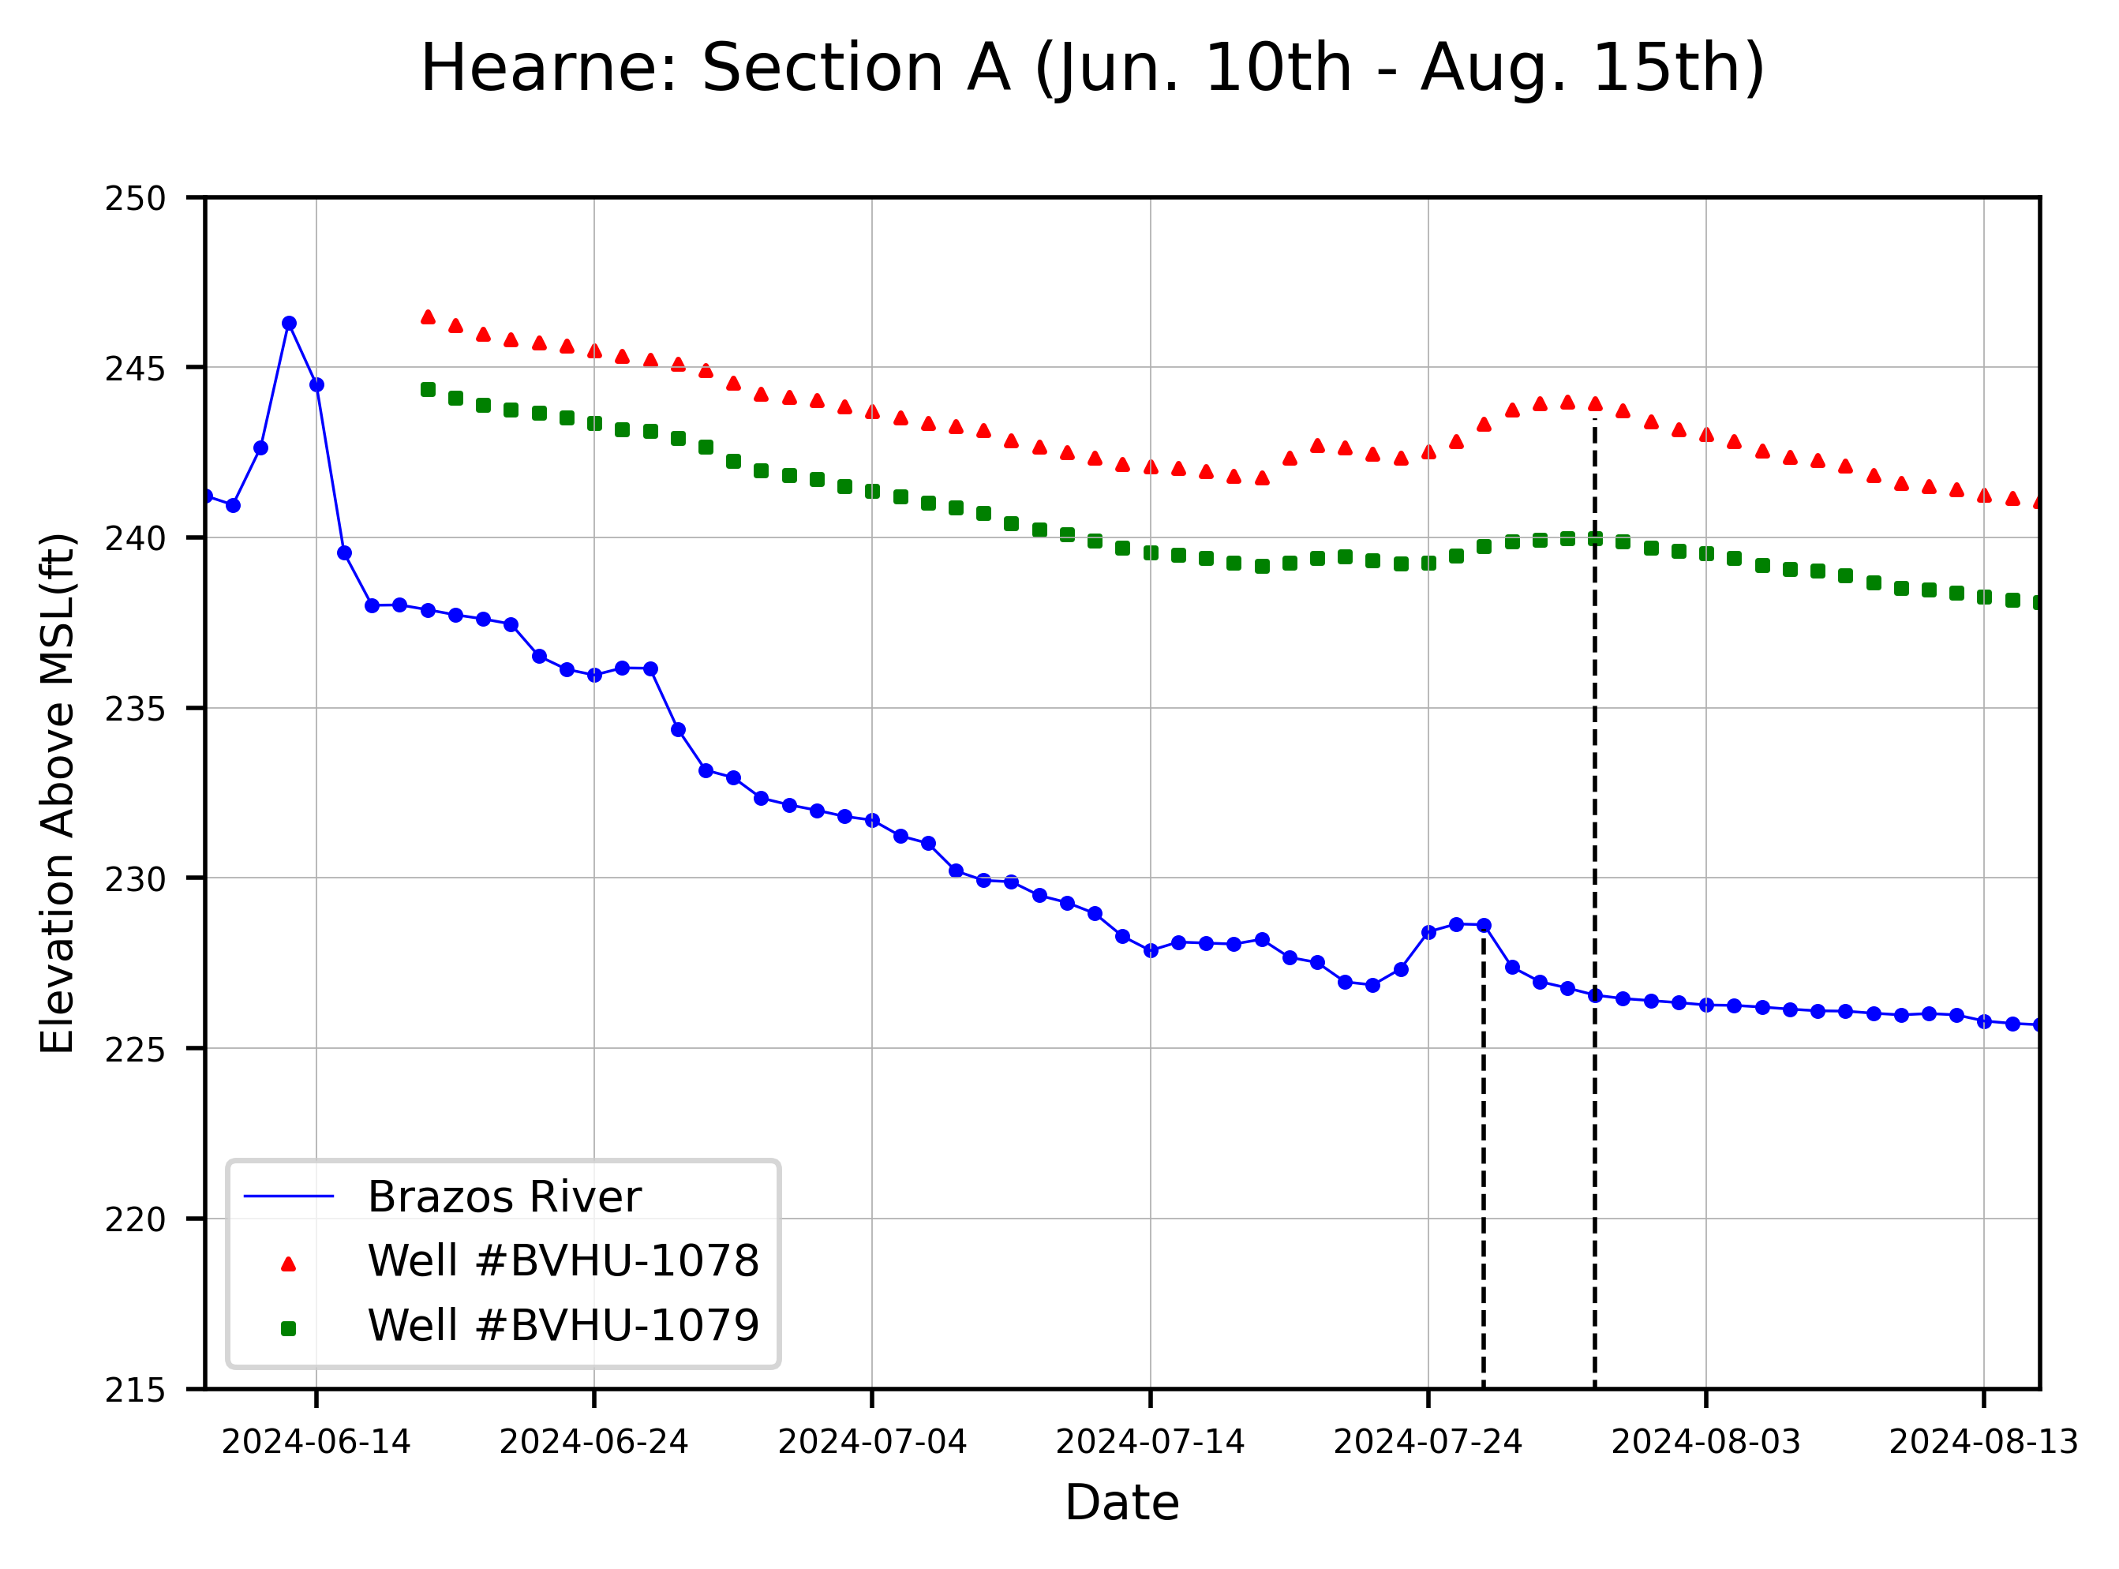
Local Study Site: Hearne Field Data

Slide 13
Further Plans:
Bank Flow Measurements (Feb 17th)
Work with data from AquaStratiges to see if the trends are true at each location
Finish drafting and editing report/thesis (March)

Slide 14
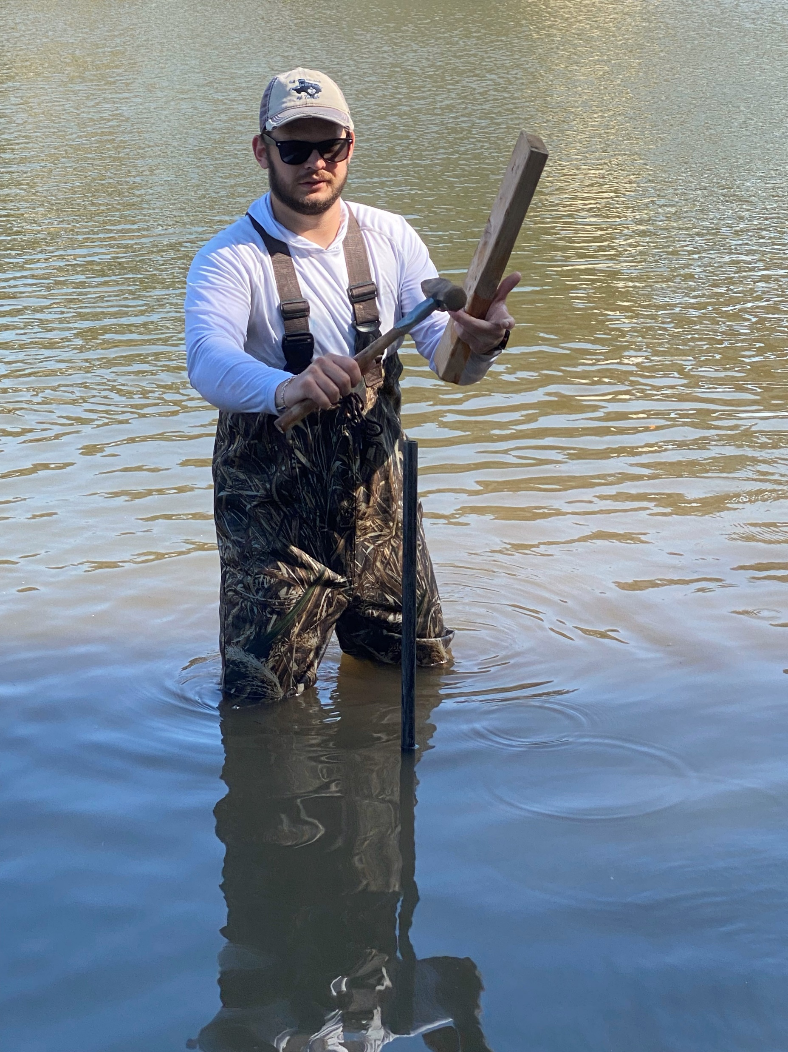
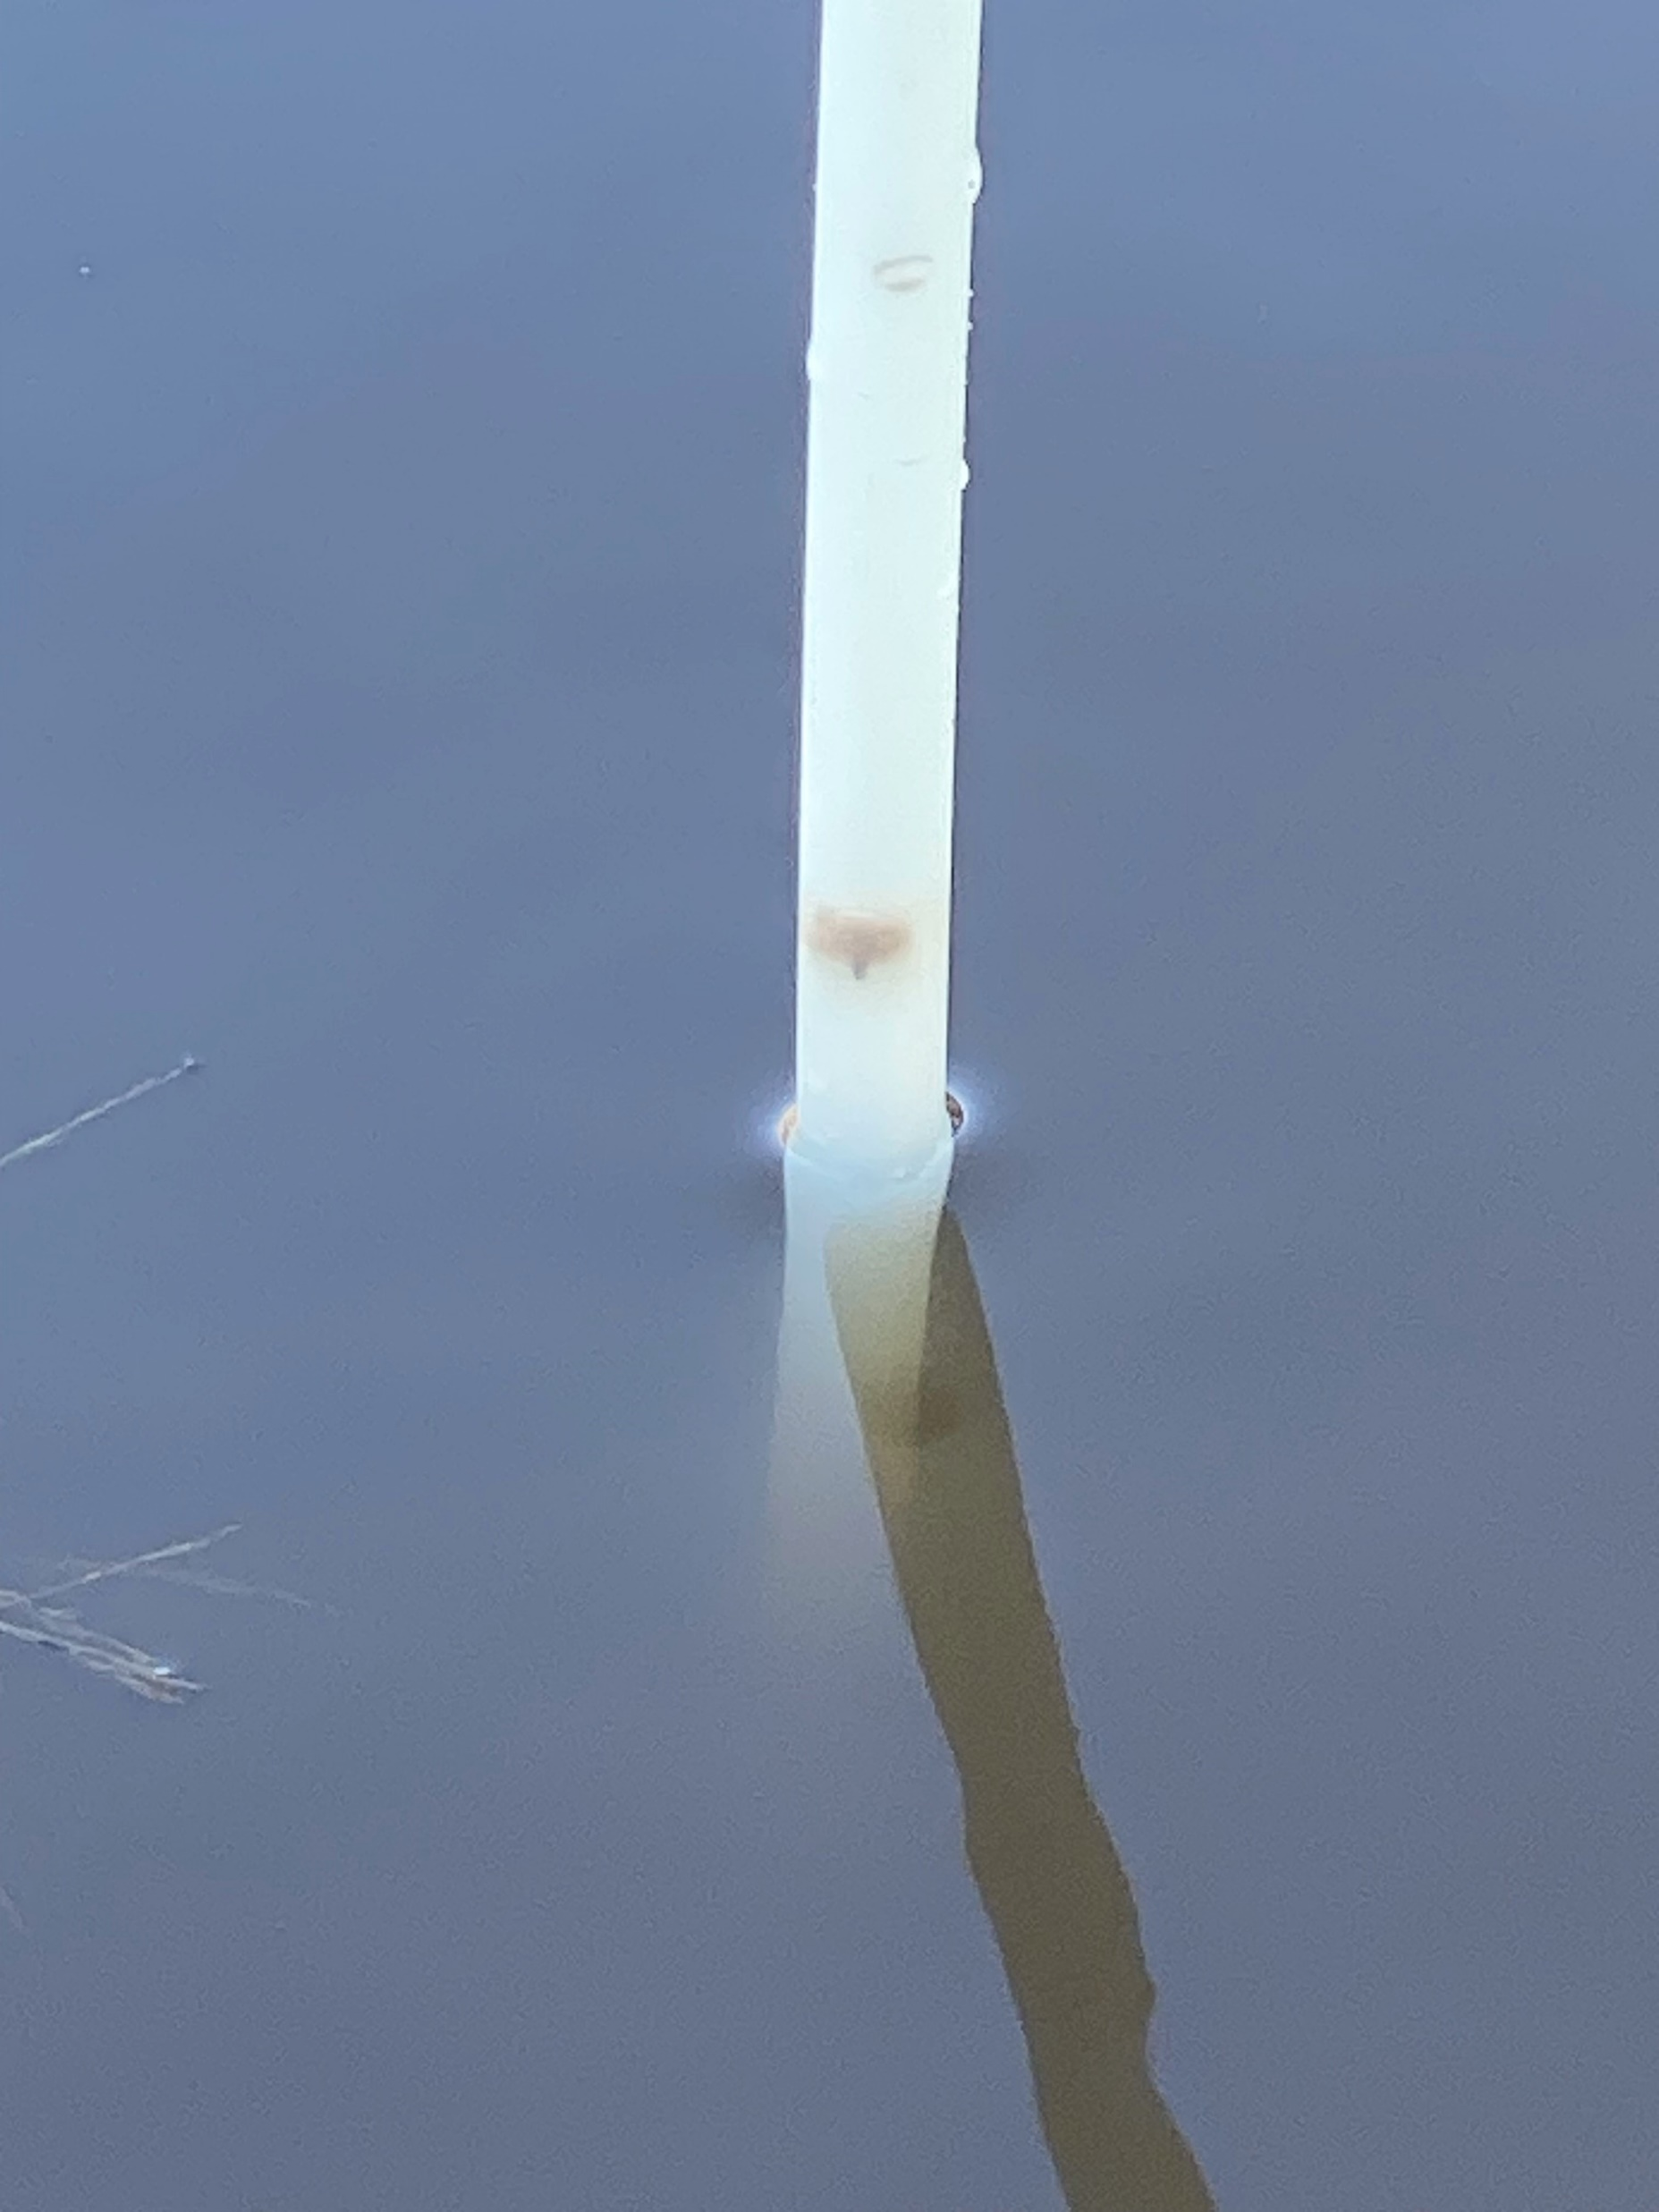
Further Plans: Bank Flow

Slide 15
Further Plans:
Bank Flow Measurements (Feb 17th)
Work with data from AquaStratiges to see if the trends are true at each location
Finish drafting and editing report/thesis (March)

Slide 16
Acknowledgements
Alan Day, Brazos Valley GCD
Wayne Hamilton, Baylor University
Dr. Joe Yelderman, Baylor University
AquaStrategies
Landowners: Will Vaughn, Mark Hoelscher, and Laura de Asarta

Slide 17
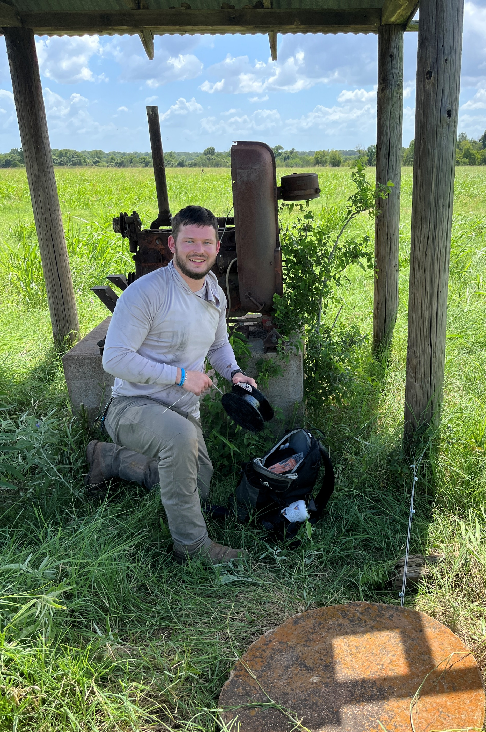
Questions
mark_nickels1@baylor.edu

