Slide 1
Model Simulation Results For BVGCD Permits Issued in the Simsboro Aquifer since last DFC Update
DRAFT
Brazos Valley
Groundwater Conservation District
July 13, 2023

Slide 2
Purpose of Run
DRAFT
GMA 12 Joint Planning - Preparation for DFC discussions
How to proceed in the next planning cycle

Slide 3
Assumption for Simulation (V2)
DRAFT
“S-19” well file used as base pumping with GAM V3.02
No other changes to pumping in GMA 12
For BVGCD permits approved since S-19, the full permit volume was produced starting in 2025
Permits included:
Updated Upwell
Trey Skiles
James Brien
Robertson County WSC
Wickson Creek SUD – Well 9
City of Calvert
Corpora Farms
Badgerjack Resource Holdings, L.P.
High Timber Resources, L.P.

Slide 4
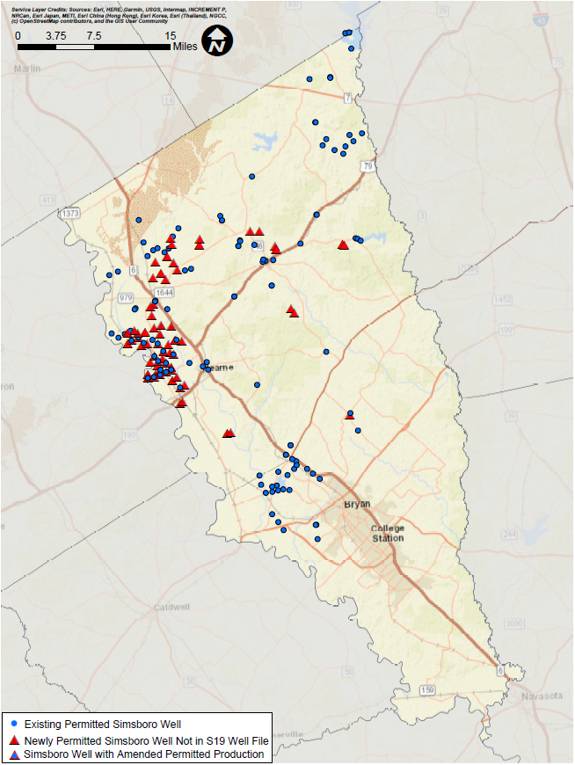
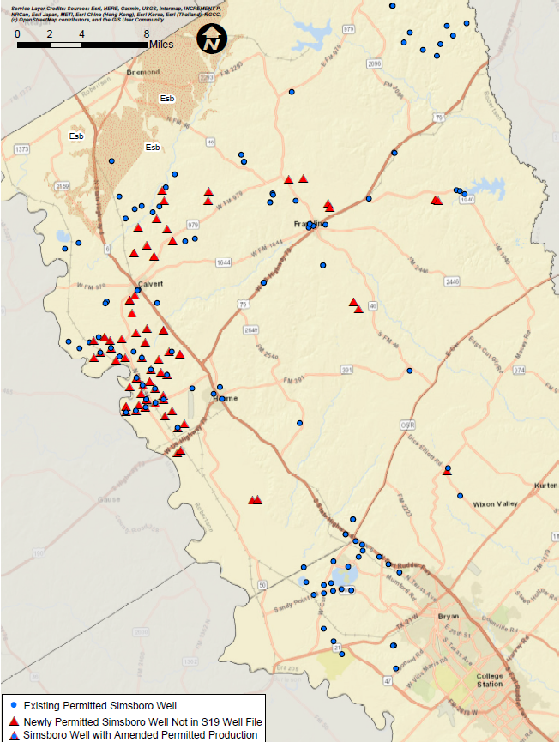
Simulated
BVGCD
Simsboro
Aquifer
Permitted
Well
Locations
DRAFT

Slide 5
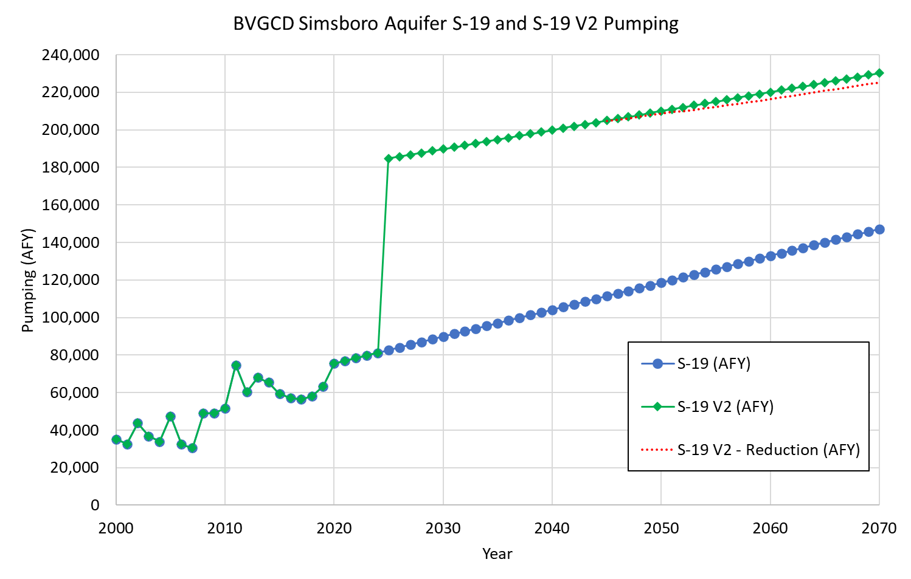
DRAFT

Slide 6
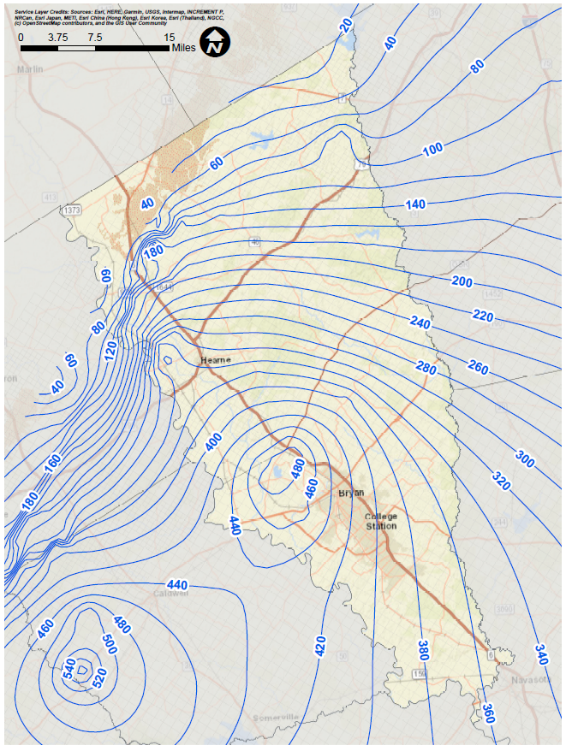
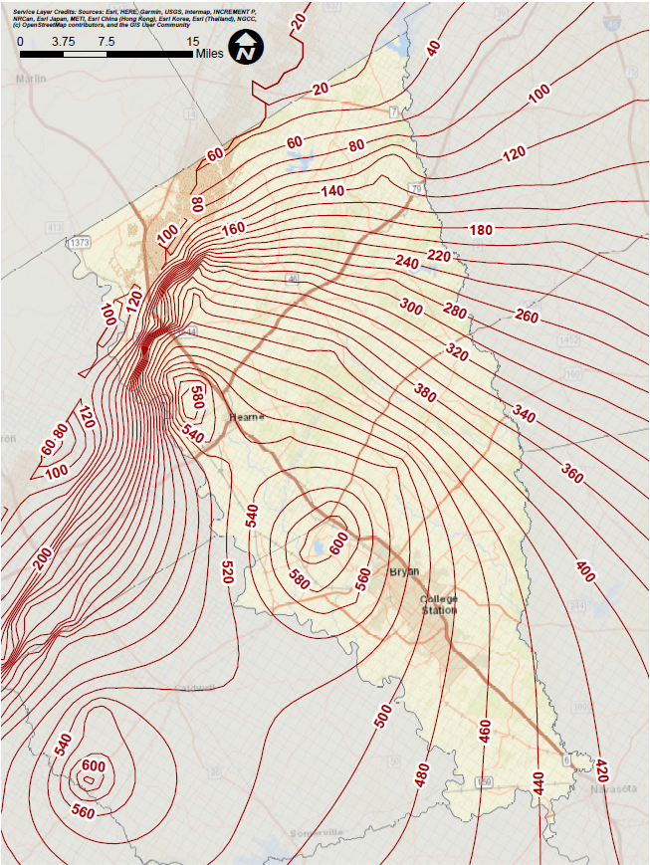
Simulated
Simsboro
Aquifer
Drawdown
2000-2070
(BVGCD Overview)
S19
S19 Plus
(Version 2)
Drawdown Contour (ft)
Contour Interval = 20 feet
DRAFT

Slide 7
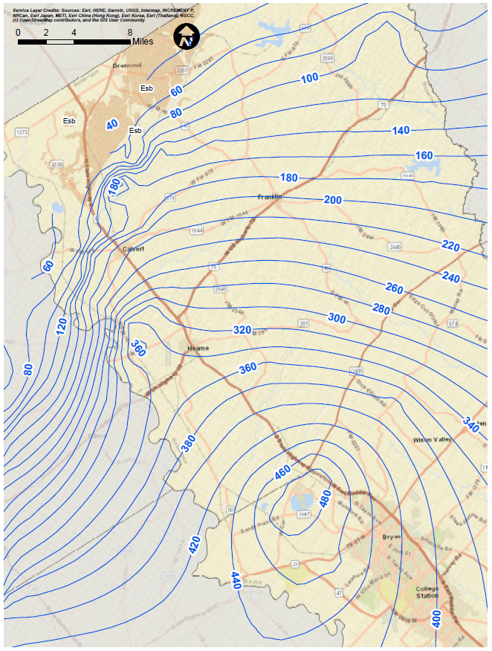
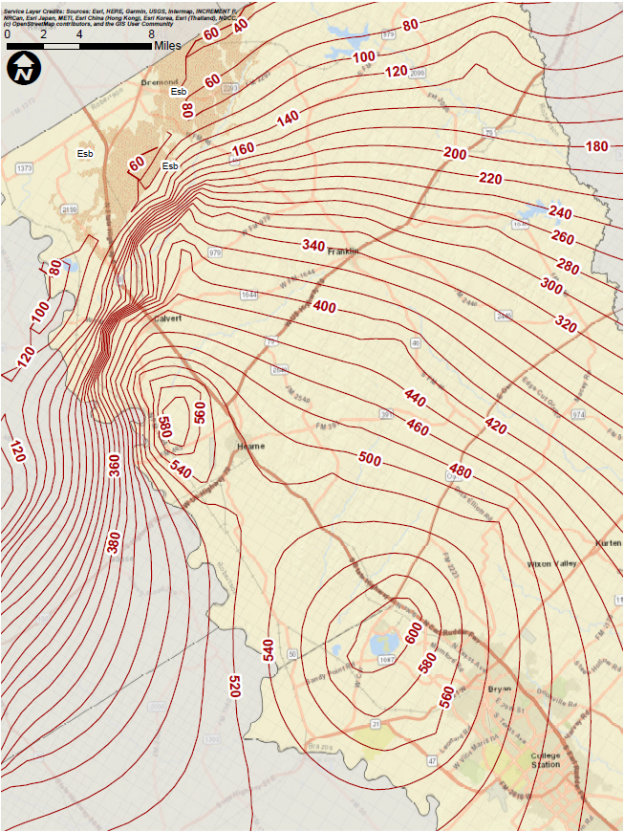
Simulated
Simsboro
Aquifer
Drawdown
2000-2070
S19
S19 Plus
(Version 2)
Drawdown Contour (ft)
Contour Interval = 20 feet
DRAFT

Slide 8
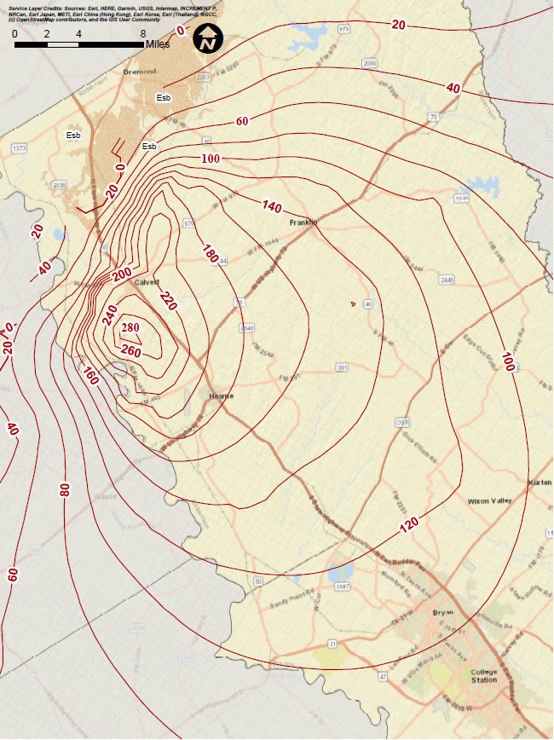
Additional
Drawdown
In the Simsboro Aquifer
Due to Permitted Pumping Issued Following the Development of the S19 Well File
DRAFT
Additional Drawdown = S19 Plus (Version 2) – S19
Drawdown Difference Contour (ft)
Contour Interval = 20 feet

Slide 9
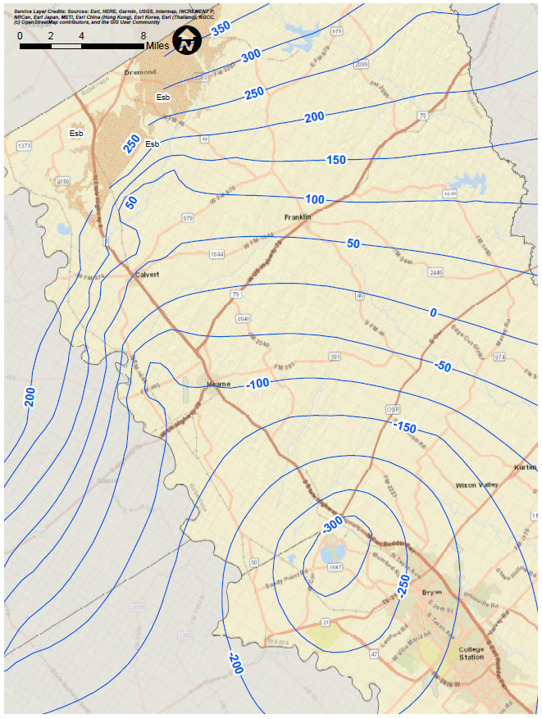
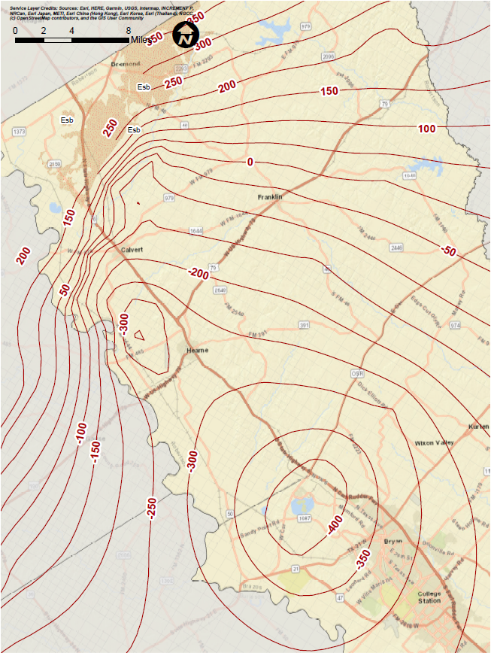
Simulated
Simsboro
Aquifer
Water Level
/Head
Elevations
at 2070
S19
S19 Plus
(Version 2)
Head Contour (ft, rsl)
Contour Interval = 50 feet
DRAFT

Slide 10
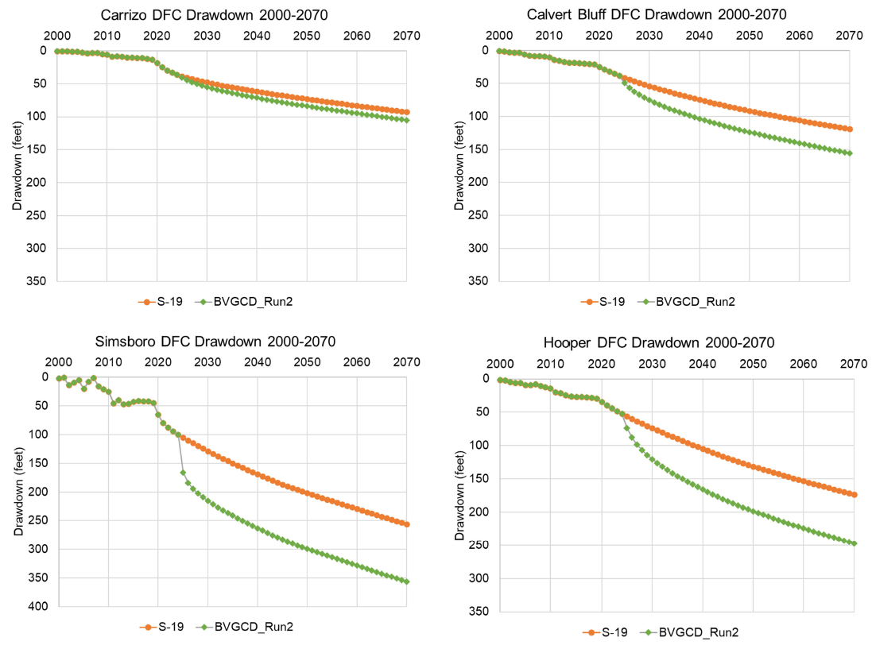
Average Simulated BVGCD Drawdown Through Time
93
105
119
156
DFC: 84
DFC: 111
DFC: 262
DFC: 167
174
247
256
356
DRAFT

