Slide 1
Assessing Surface and Groundwater Interactions Between the Middle Brazos River Alluvium Aquifer and the Brazos River
September 12th 2024 Board Presentation
Mark G.F. Nickels
Advisor Dr. Joe Yelderman
Notes:
Thank both Dr. Joe, Alan and BVGWCD

Slide 2
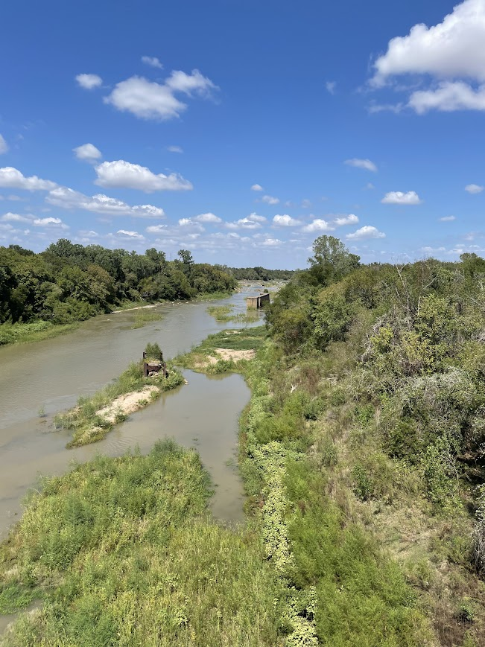
Overview
Review
Study Site Updates
Data Collected
Review of Project Timeline
Further Plans

Slide 3
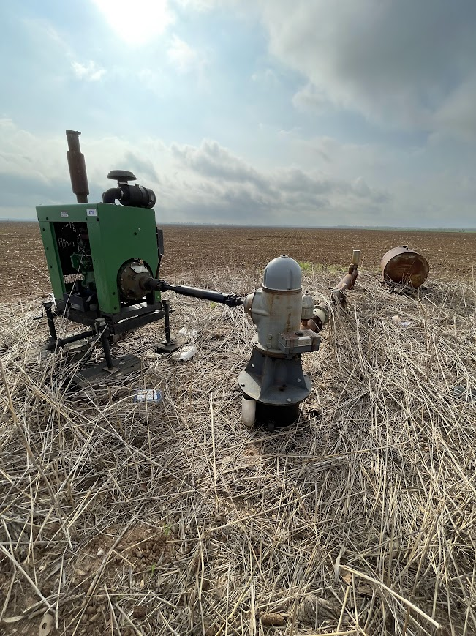
Purpose and Motivation
The Brazos River, Brazos River Alluvium Aquifer (BRAA), and bedrock aquifers are a vital resource in central Texas.
Current modeling of the BRAA has been based on limited data for understanding the heterogeneity of a compartmentalized aquifer with complex interactions.

Slide 4
Better define the interactions between Brazos River and the BRAA
What are the impacts of high or low water in the Brazos River?
What is the difference in water chemistry between the river and alluvium?
What is the influence of seasonality?
What is the influence of pumping (irrigation)?

Slide 5
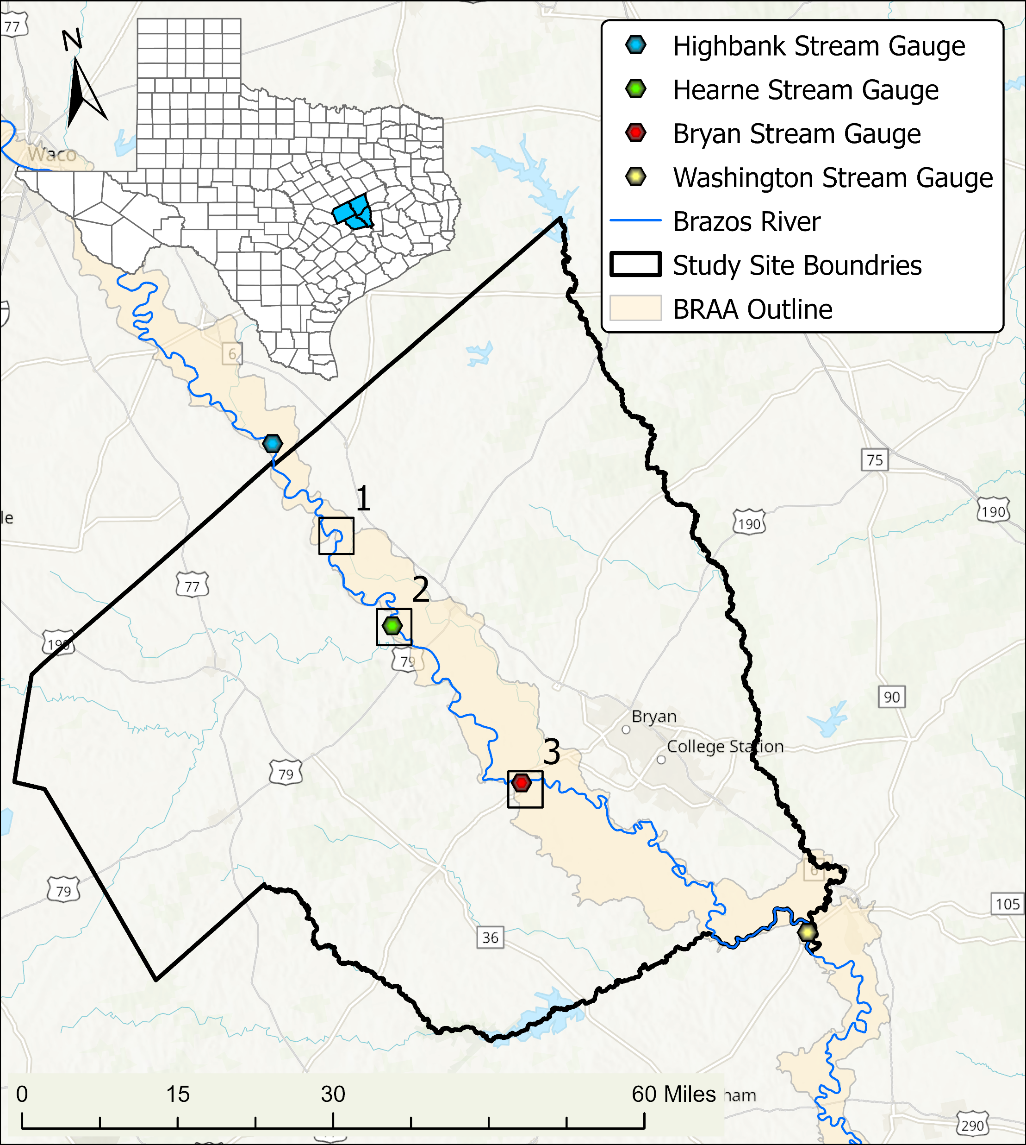
Local Study Sites
Calvert
Coordinate river level with AquaStrategies stream measurements
Hearne
USGS stream gauge
Bryan
USGS stream gauge

Slide 6
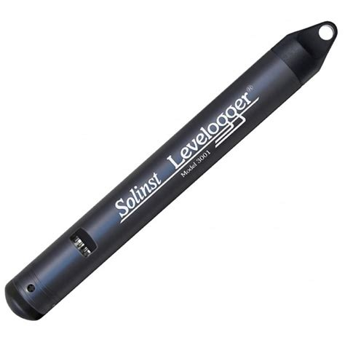
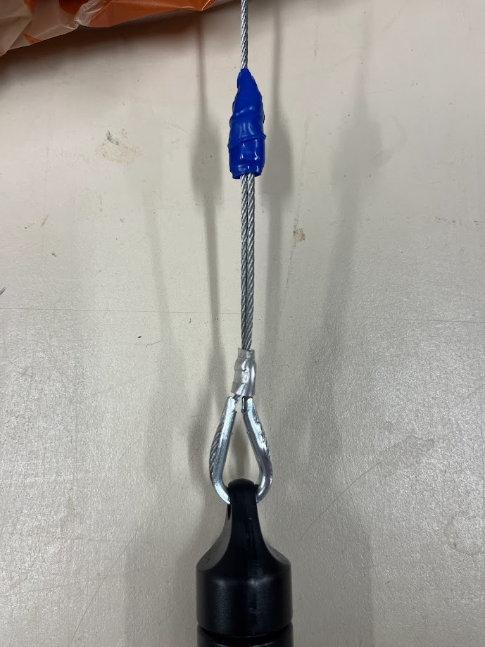
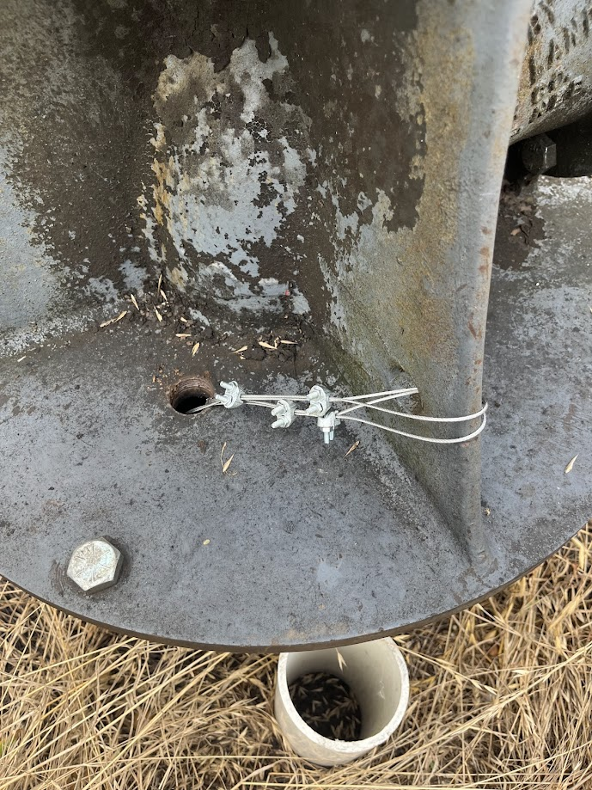
Data Loggers

Slide 7
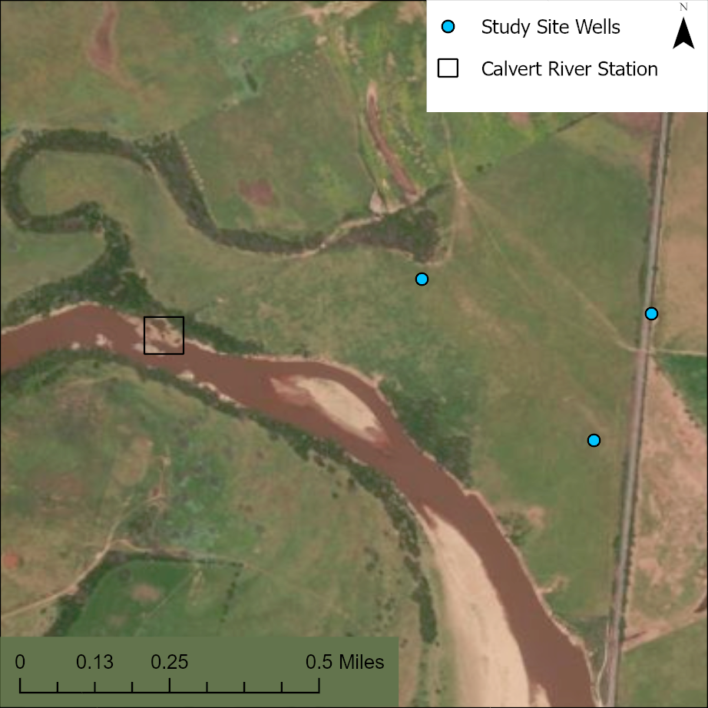
Local Study Site: Calvert
LT Datalogger
TLC Datalogger

Slide 8
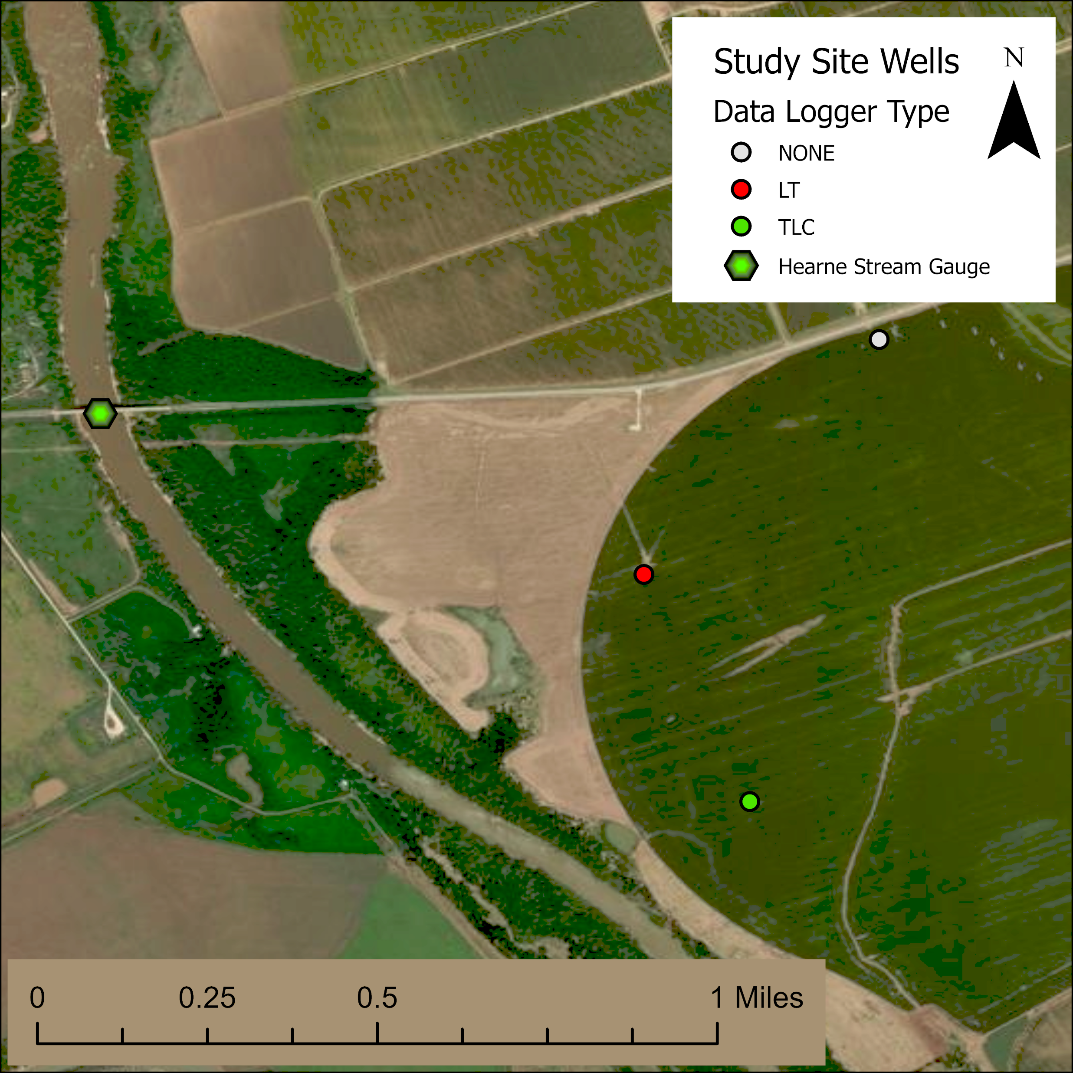
Local Study Site: Hearne
LT Datalogger
TLC Datalogger
Notes:
Quantify the river elevation change

Slide 9
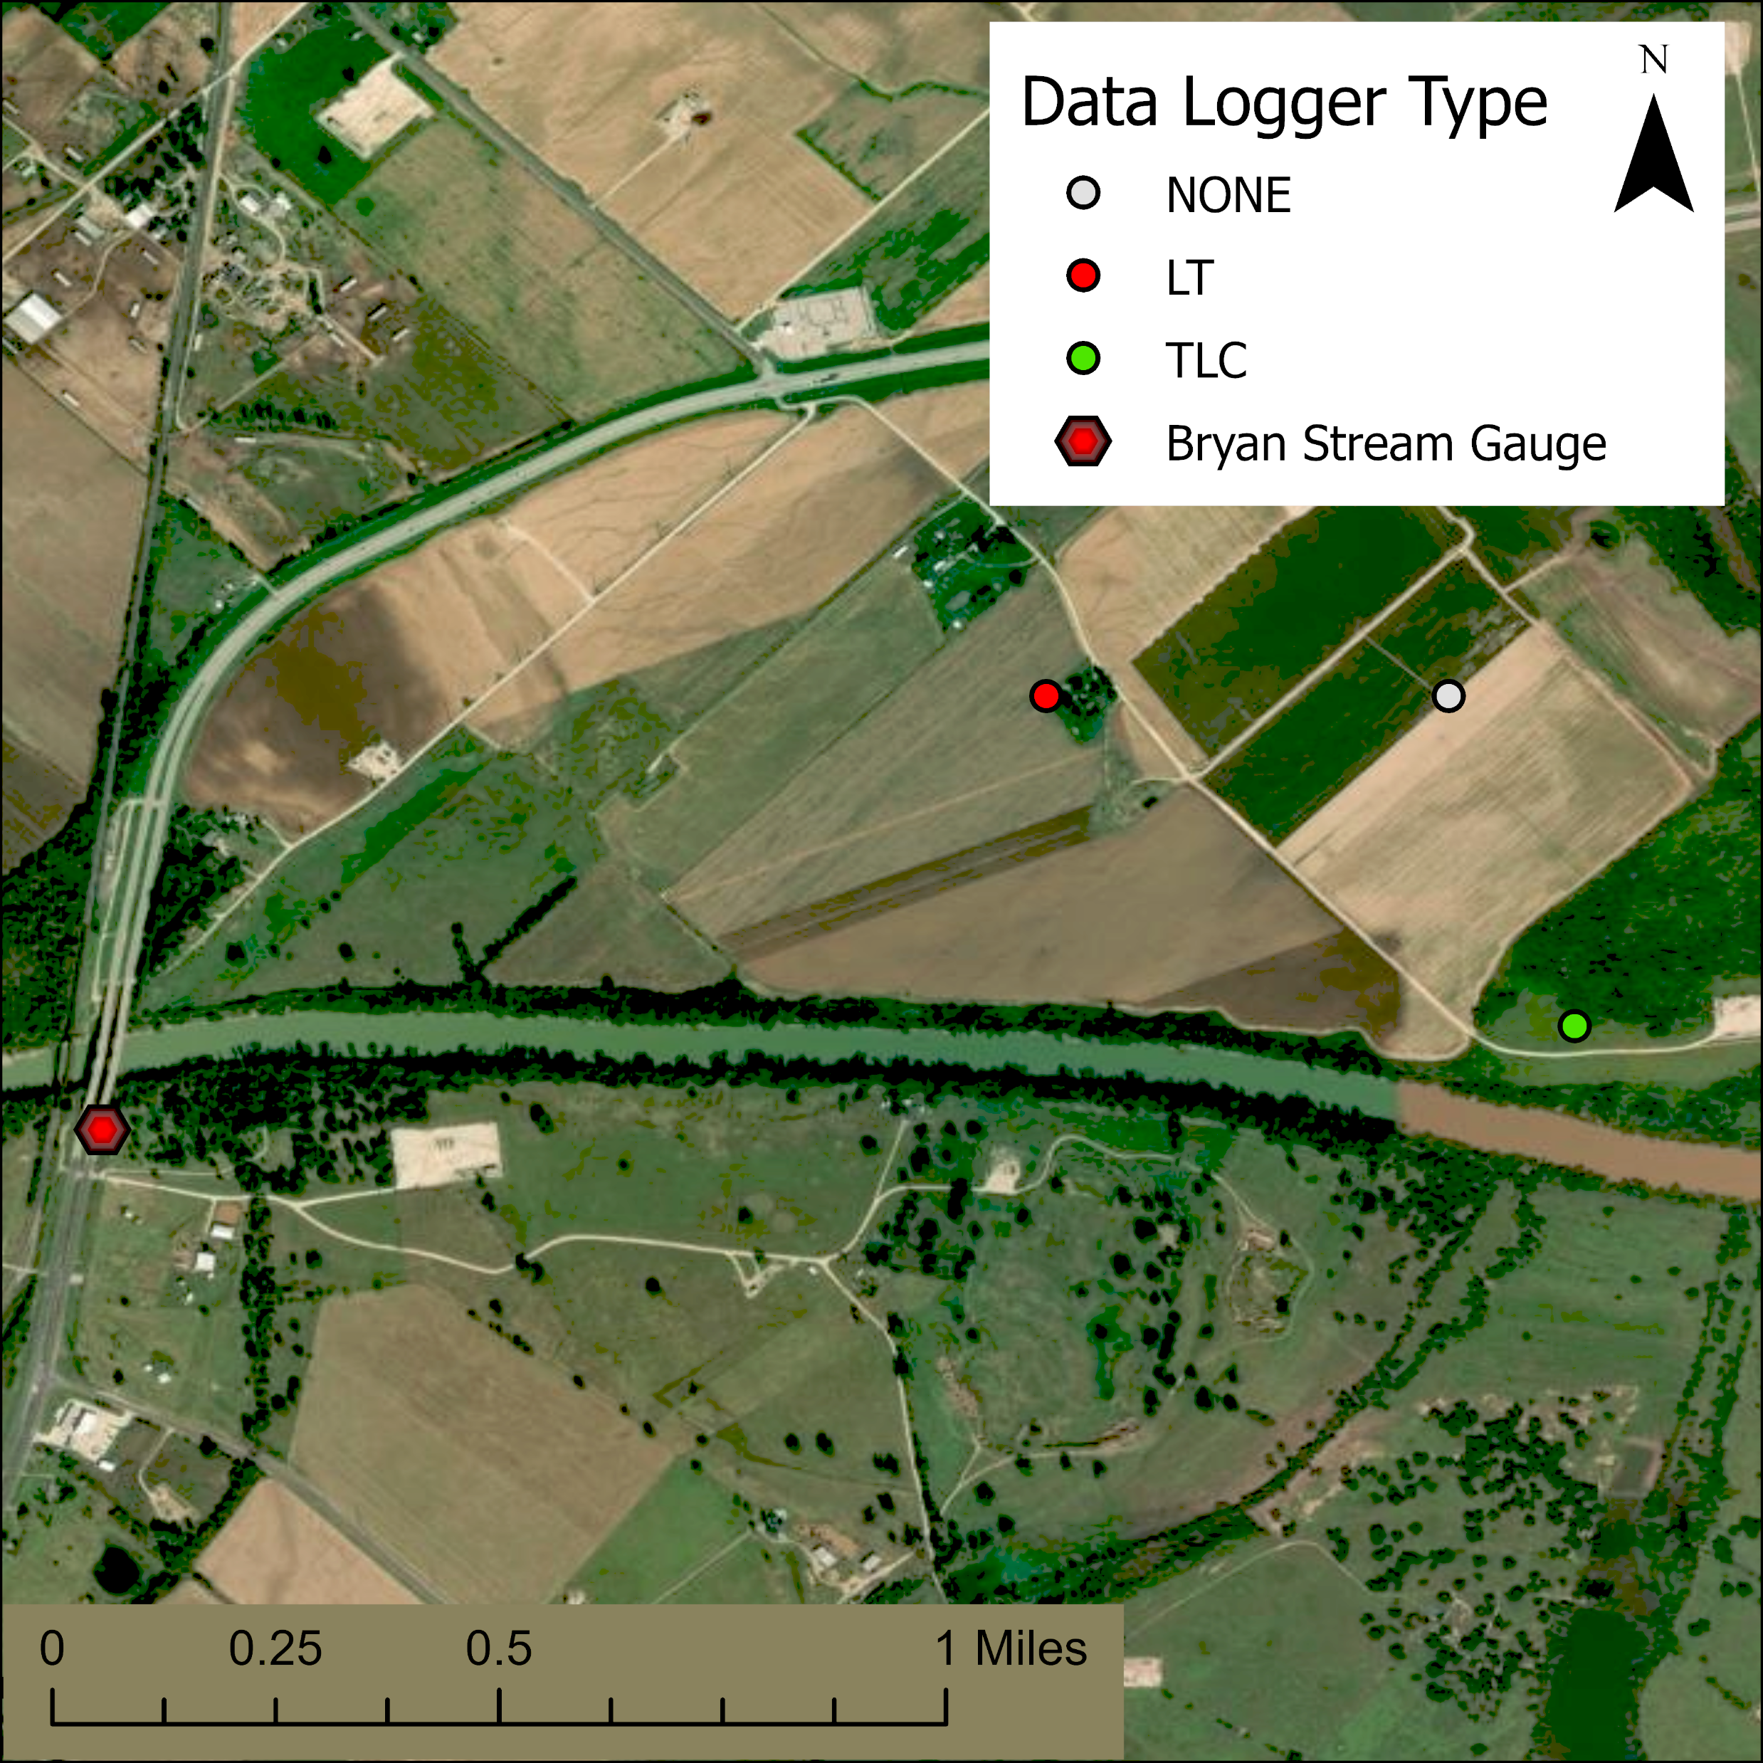
Local Study Site: Bryan
LT Datalogger
TLC Datalogger
Notes:
USGS Hearne (FM 485) on April 17th at 12am - 209.49 + 18.3 ft = 227.79
USGS Bryan (Hwy 210) on April 17th at 12 am – 188.78 + 10.89 ft =199.67
Distance = ~30mi with ~ 30ft change, ~ 1ft per mile

Slide 10
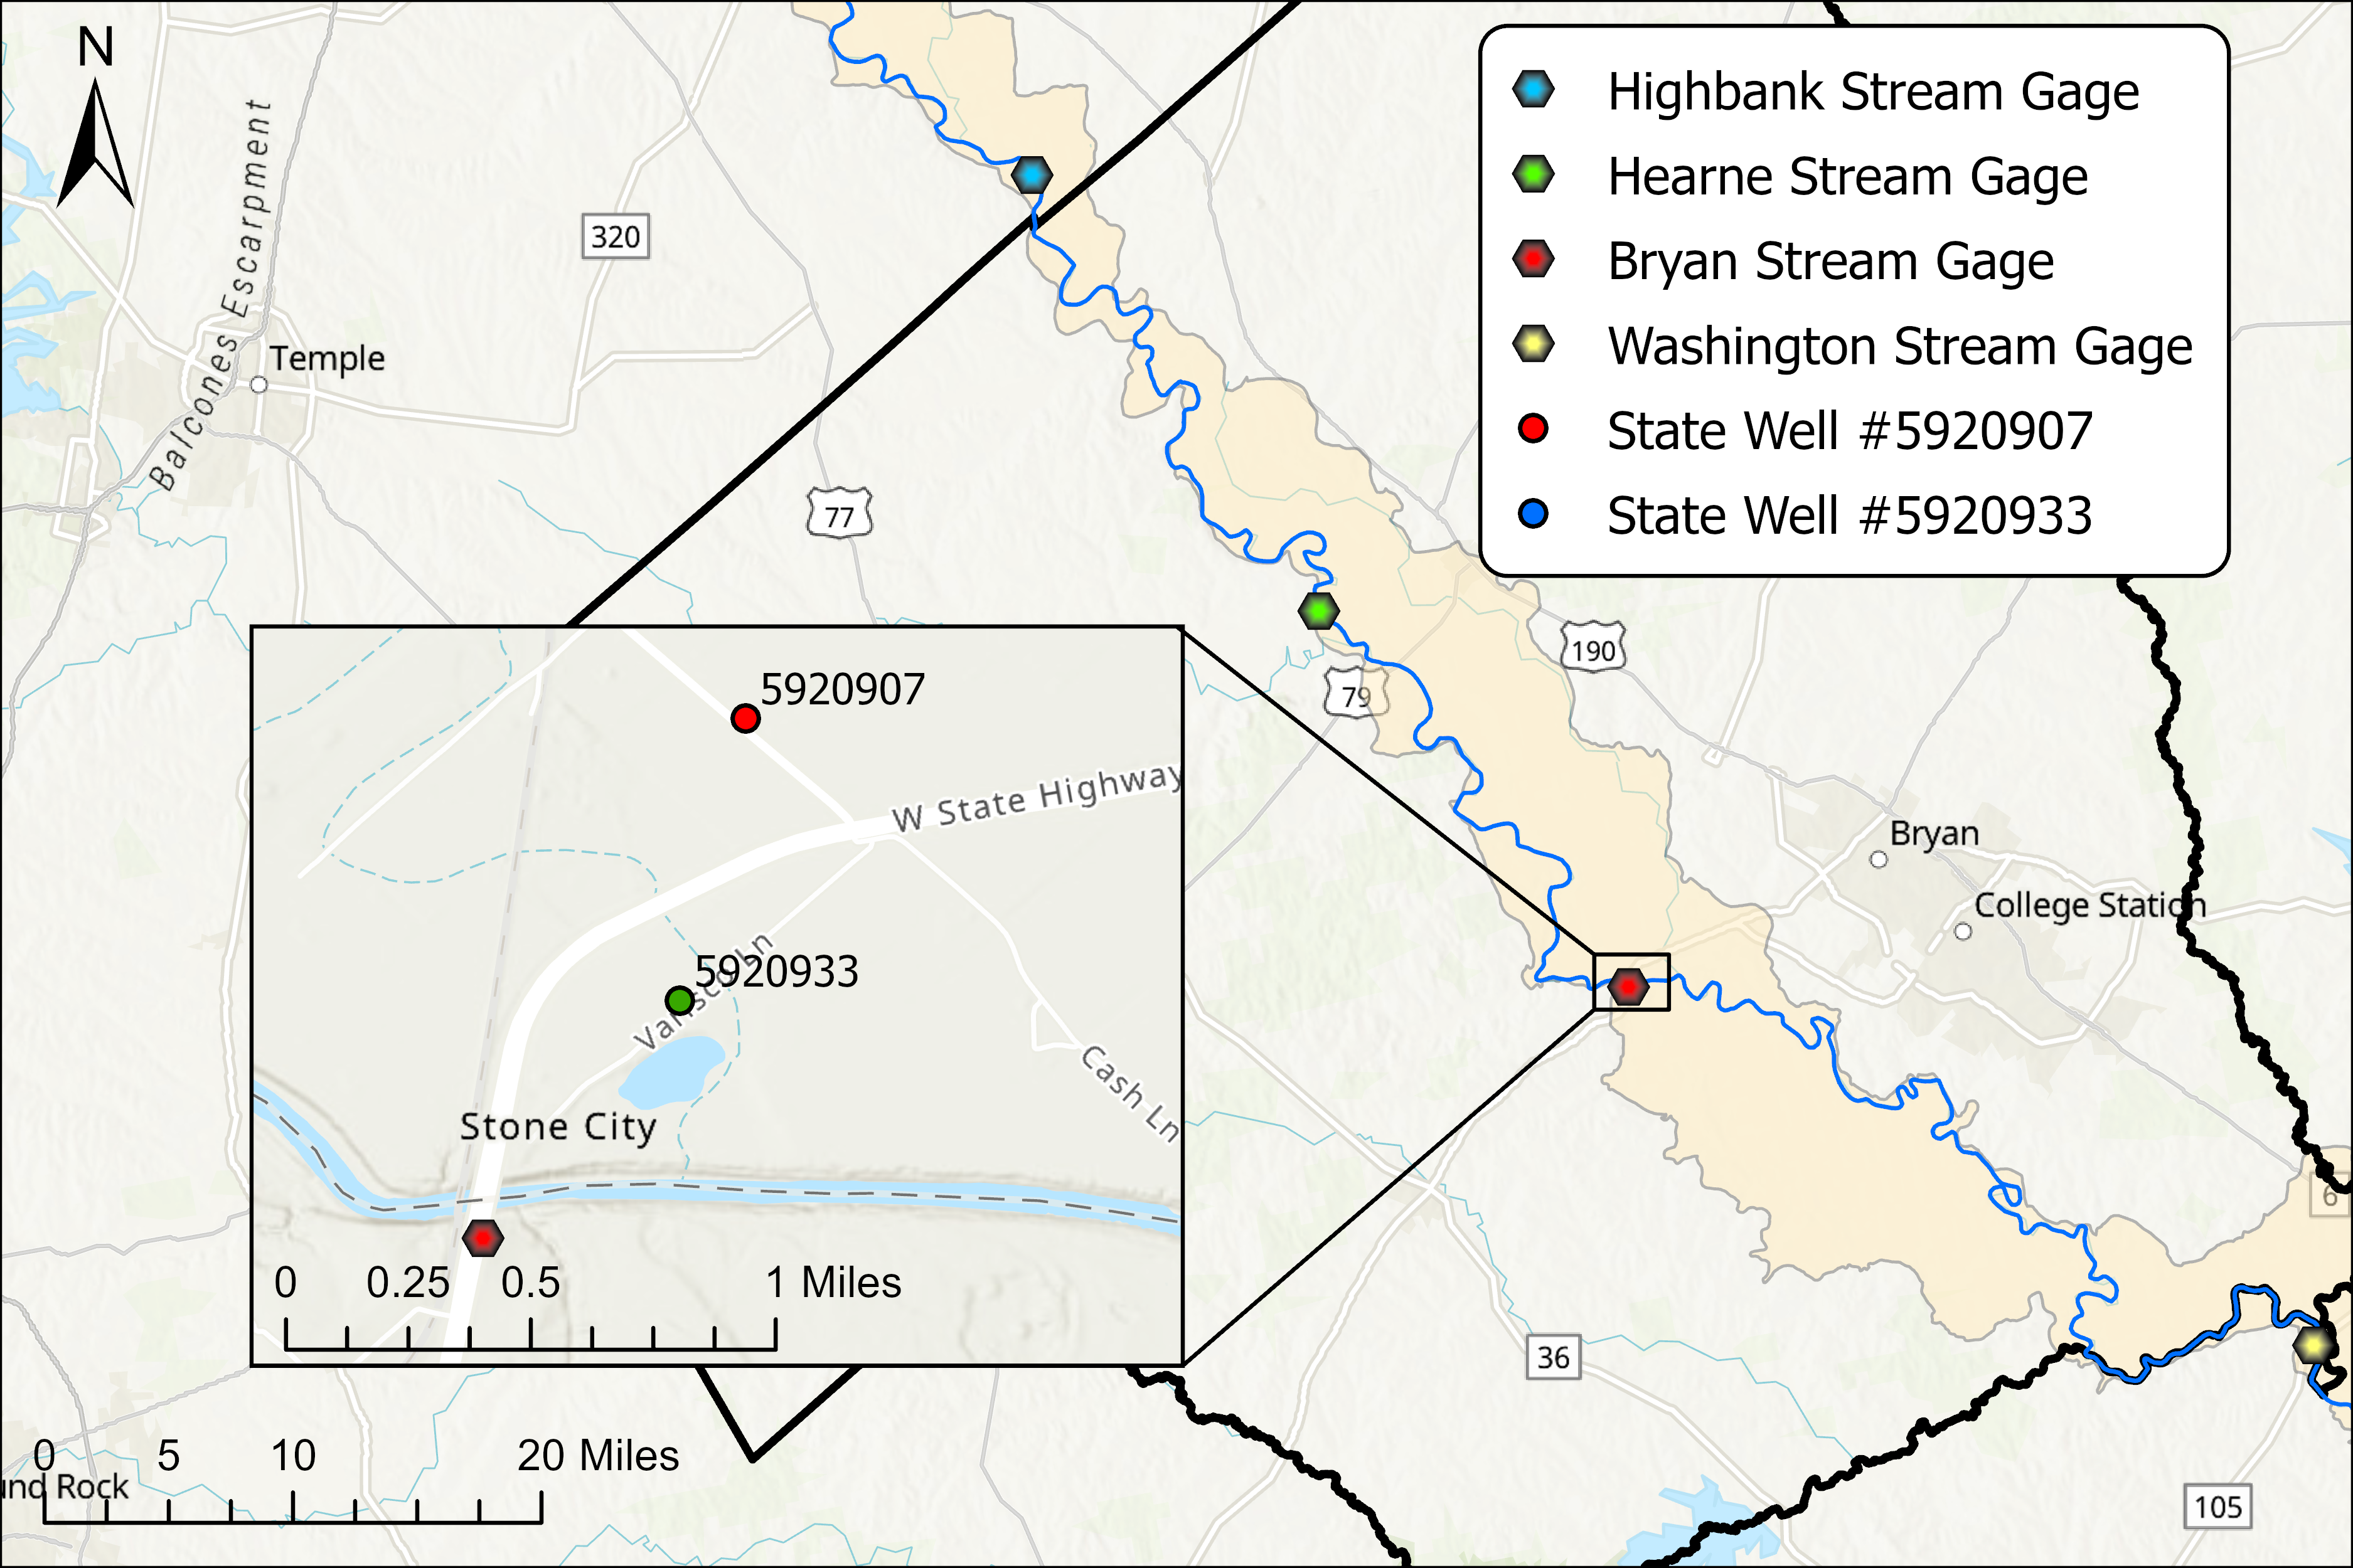
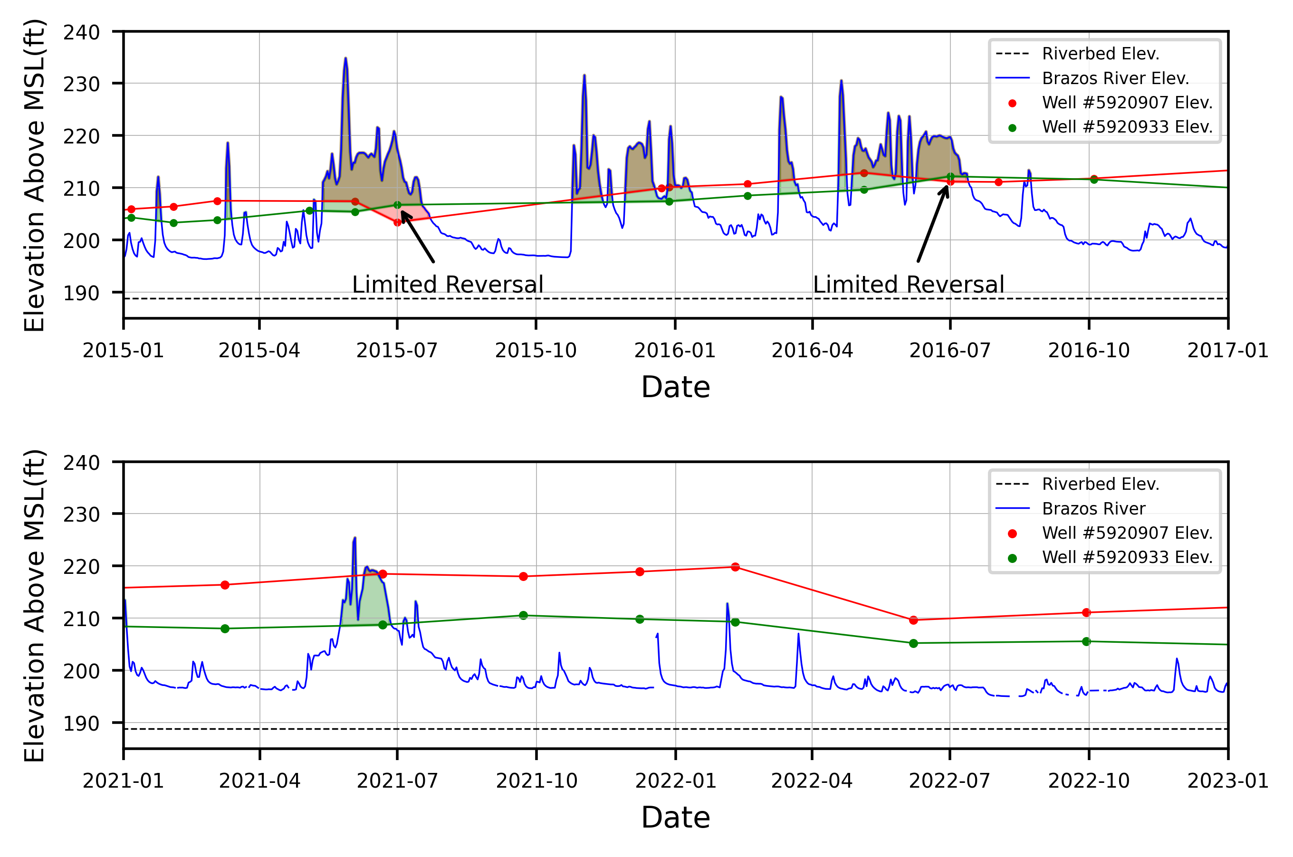
Local Study Site: Bryan
Notes:
Flip the hydrographs for presentation flow

Slide 11
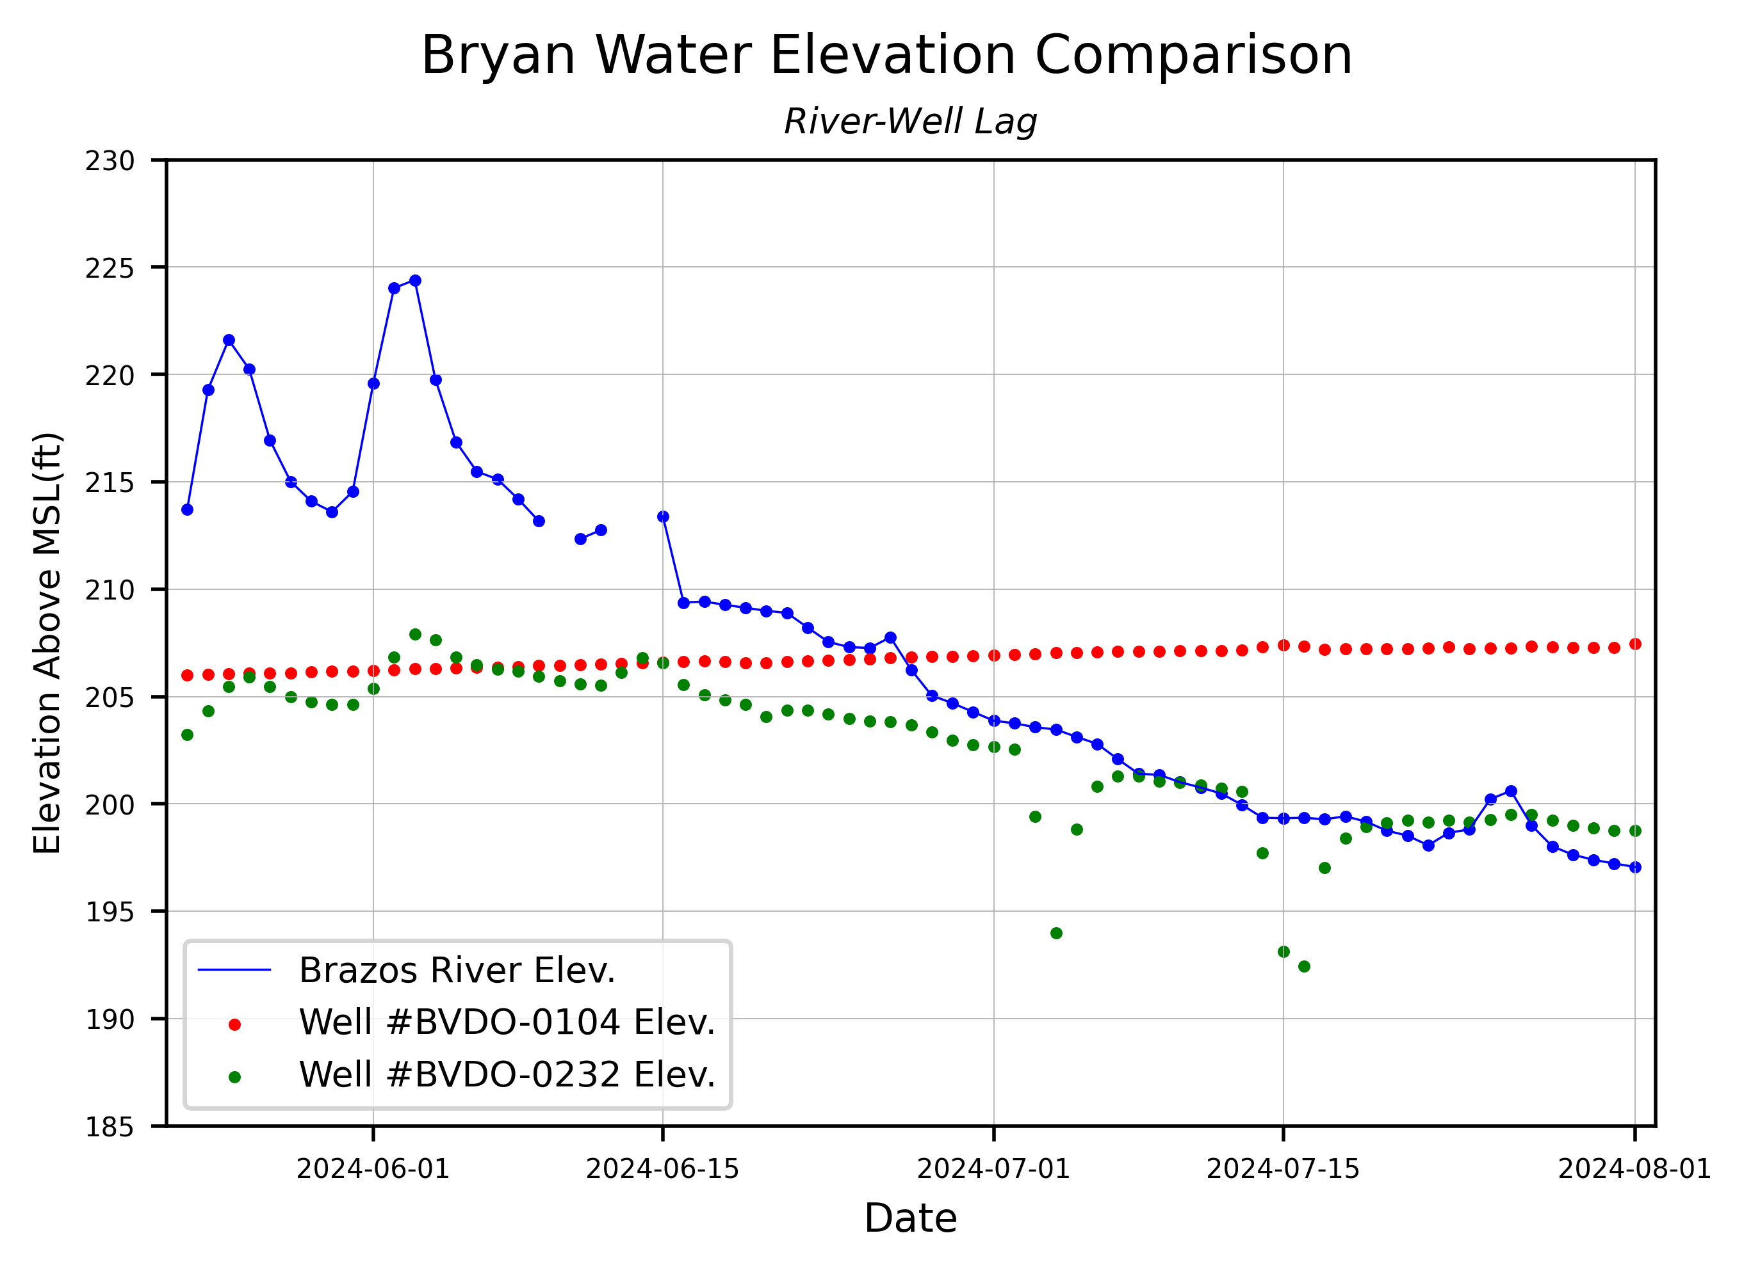
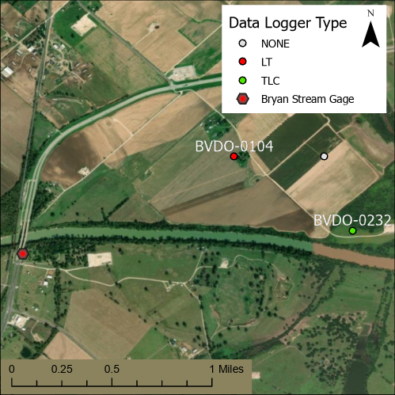
Local Study Site: Bryan Field Data
May - June
High river level
Gradient appears reversed
Need higher accuracy elevation for wells
Need to confirm river drop over the site

Slide 12
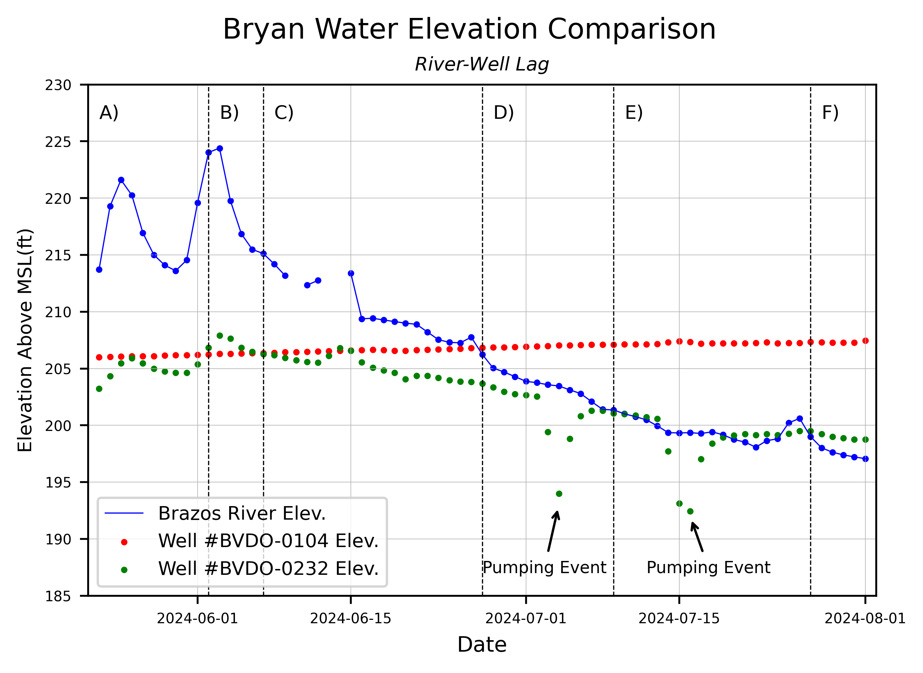
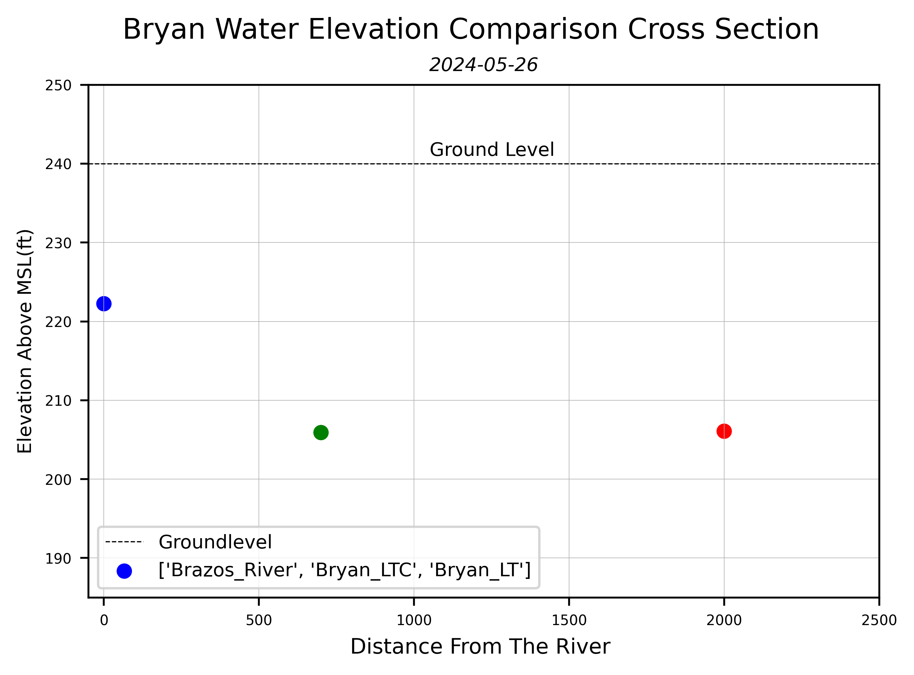
Local Study Site: Bryan Field Data (Stage A)
High river level
Gradient is partially reversed

Slide 13
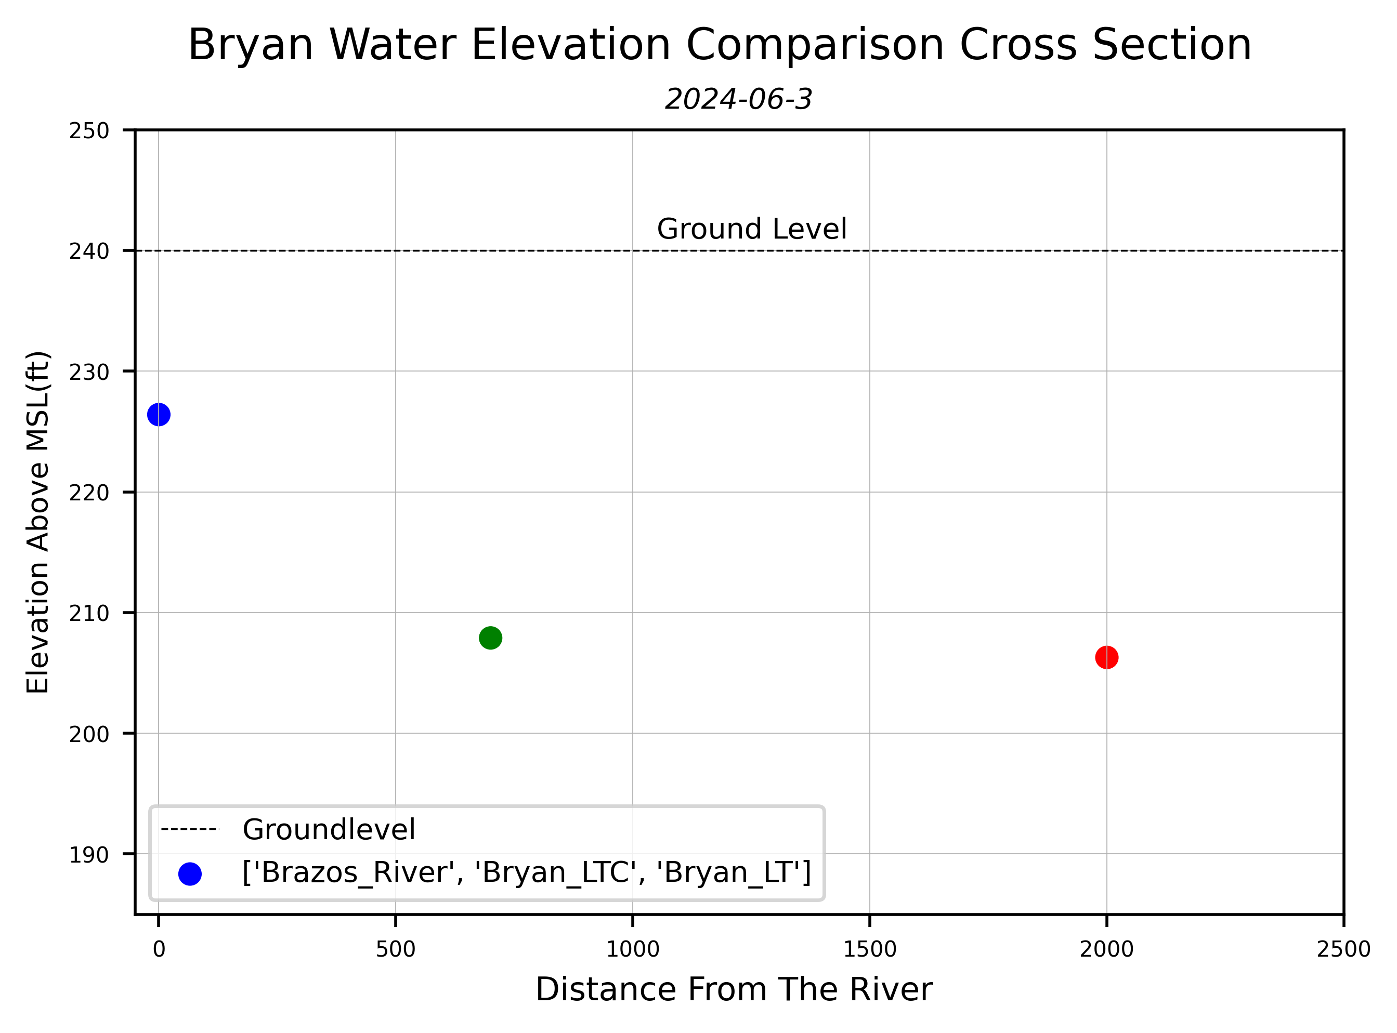
Local Study Site: Bryan Field Data (Stage B)
High river level
Gradient is fully reversed

Slide 14
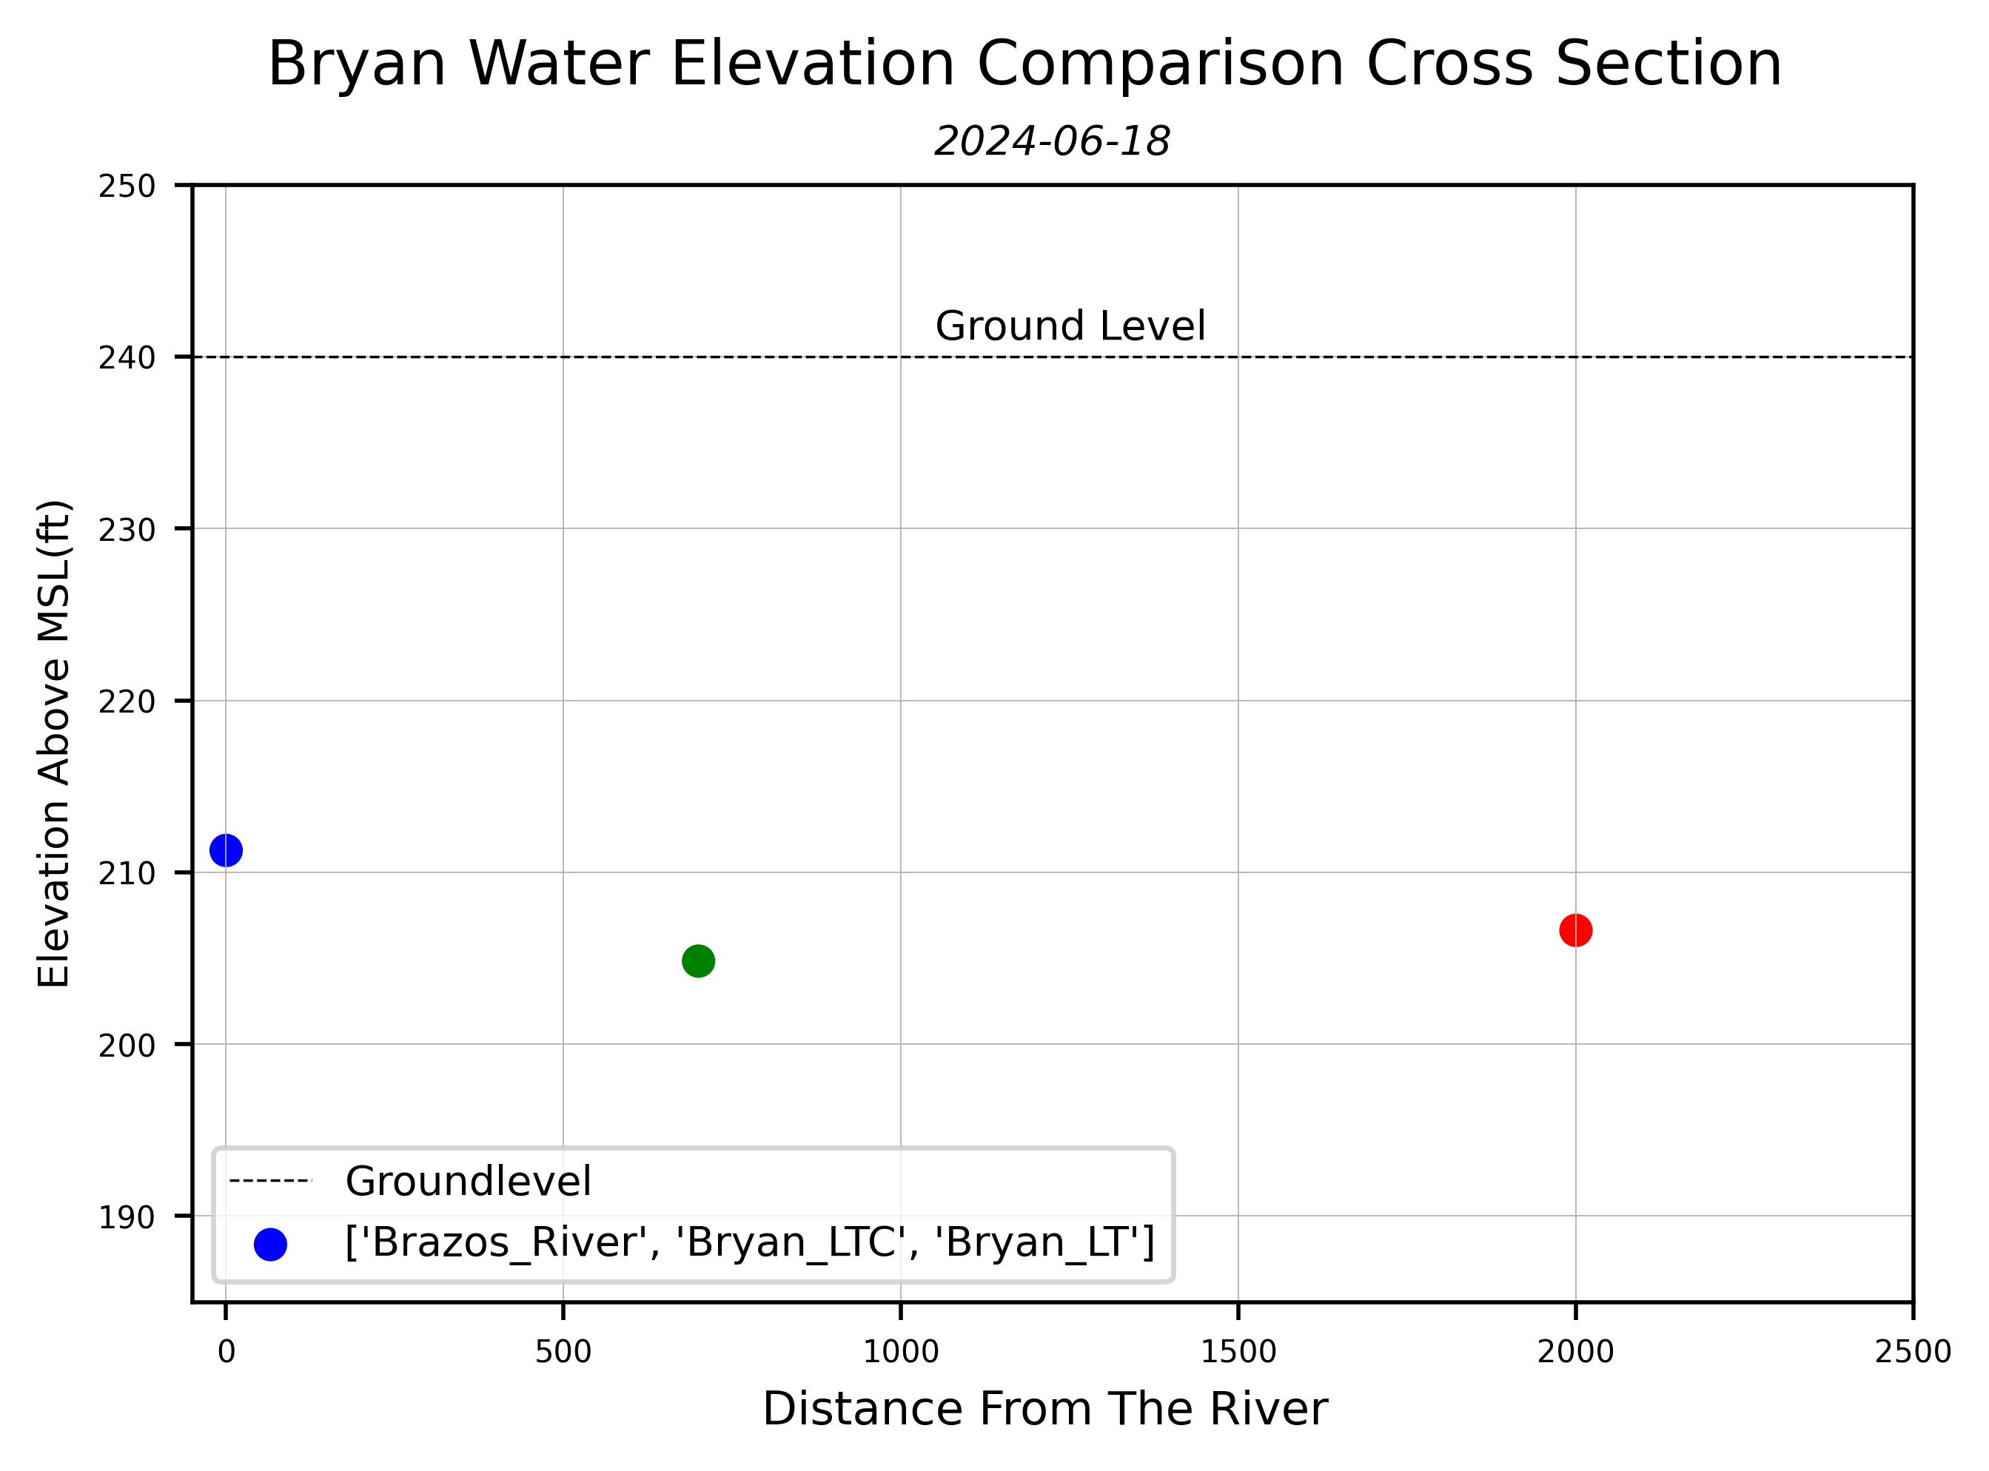
Local Study Site: Bryan Field Data (Stage C)
Medium river level (falling)
Gradient returns to partially reversed

Slide 15
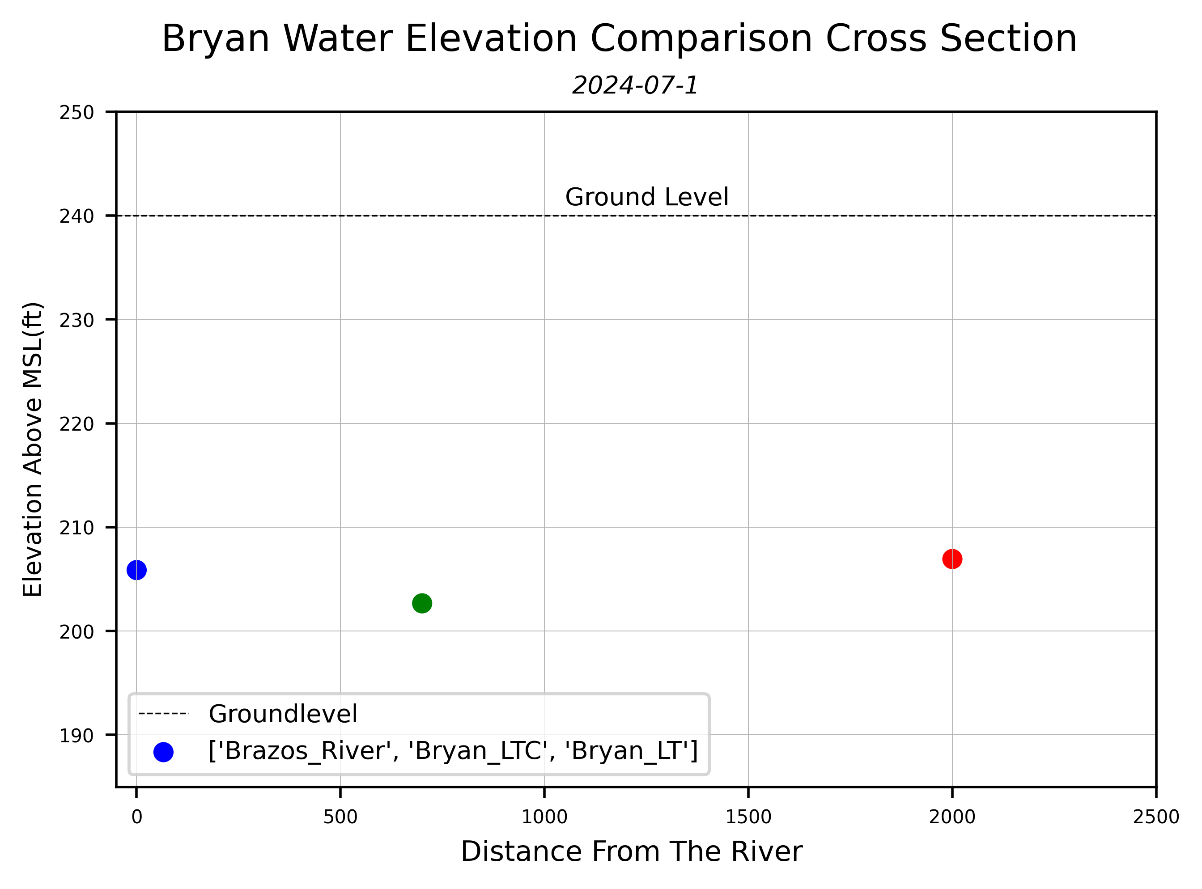
Local Study Site: Bryan Field Data (Stage D)
River level continues to fall
Gradient suggests flow to the middle well
Represents a change between river to aquifer and aquifer to river

Slide 16
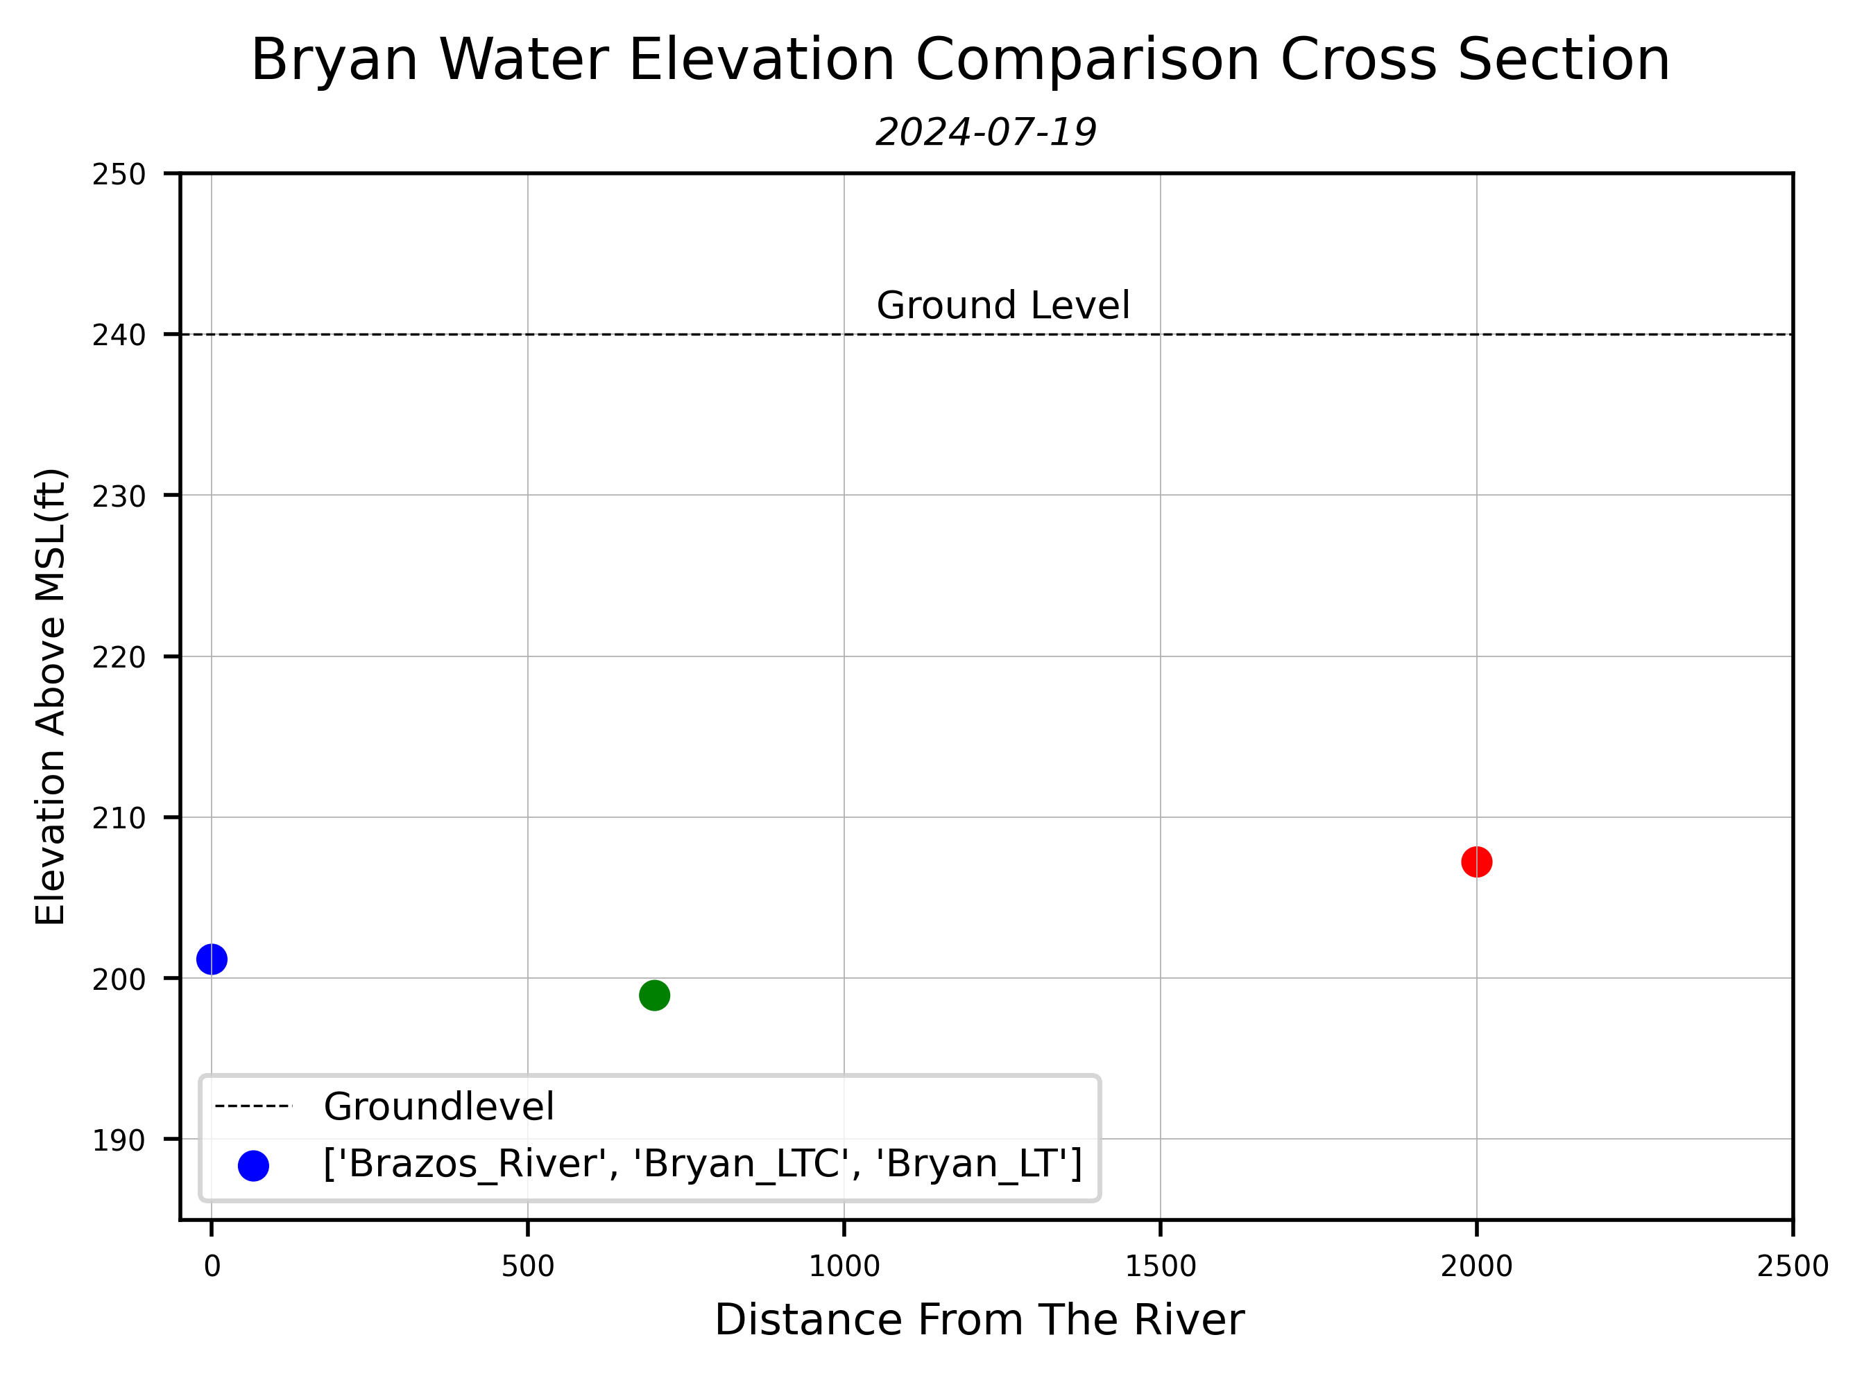
Local Study Site: Bryan Field Data (Stage E)
River and middle well intertwined
Gradient from the aquifer to the river

Slide 17
Local Study Site: Bryan Field Data (Stage F)
High river level
Gradient is partially reversed

Slide 18
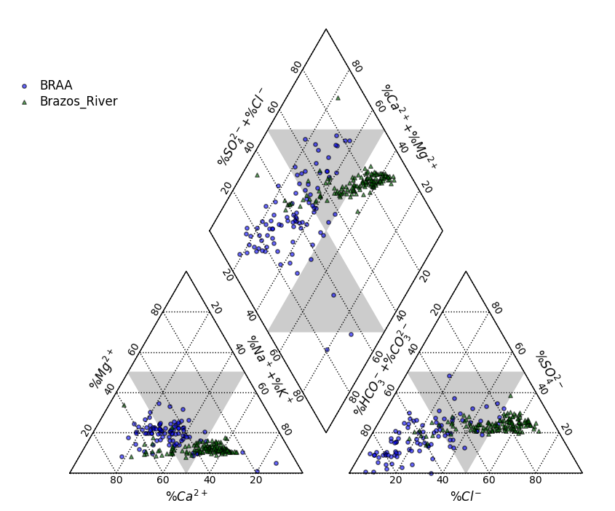
Data Collected: Historical

Slide 19
Timeline
Task | Fall ‘23 | Spring ‘24 | Summer ‘24 |  | Fall ’24 | Sprin’24
Literature Review
River Sampling
Aquifer Sampling
Data Analysis
Report and Thesis Composition

Slide 20
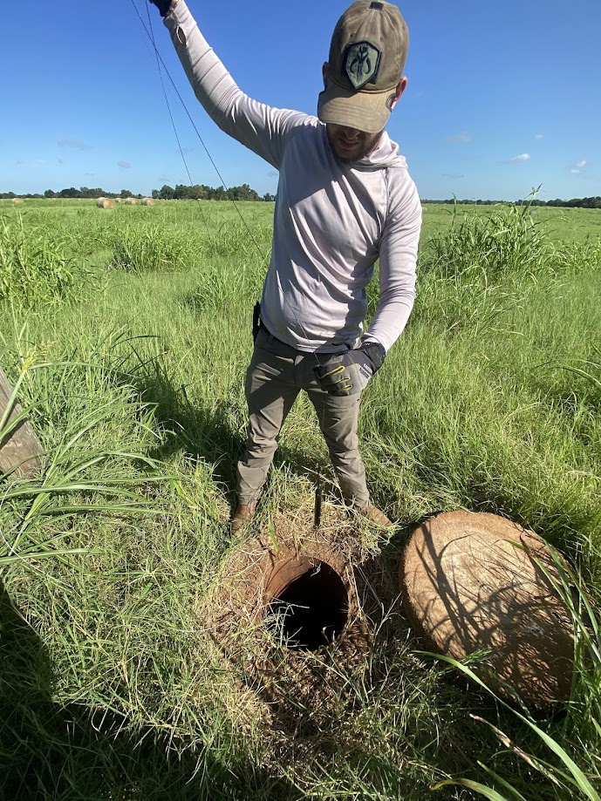
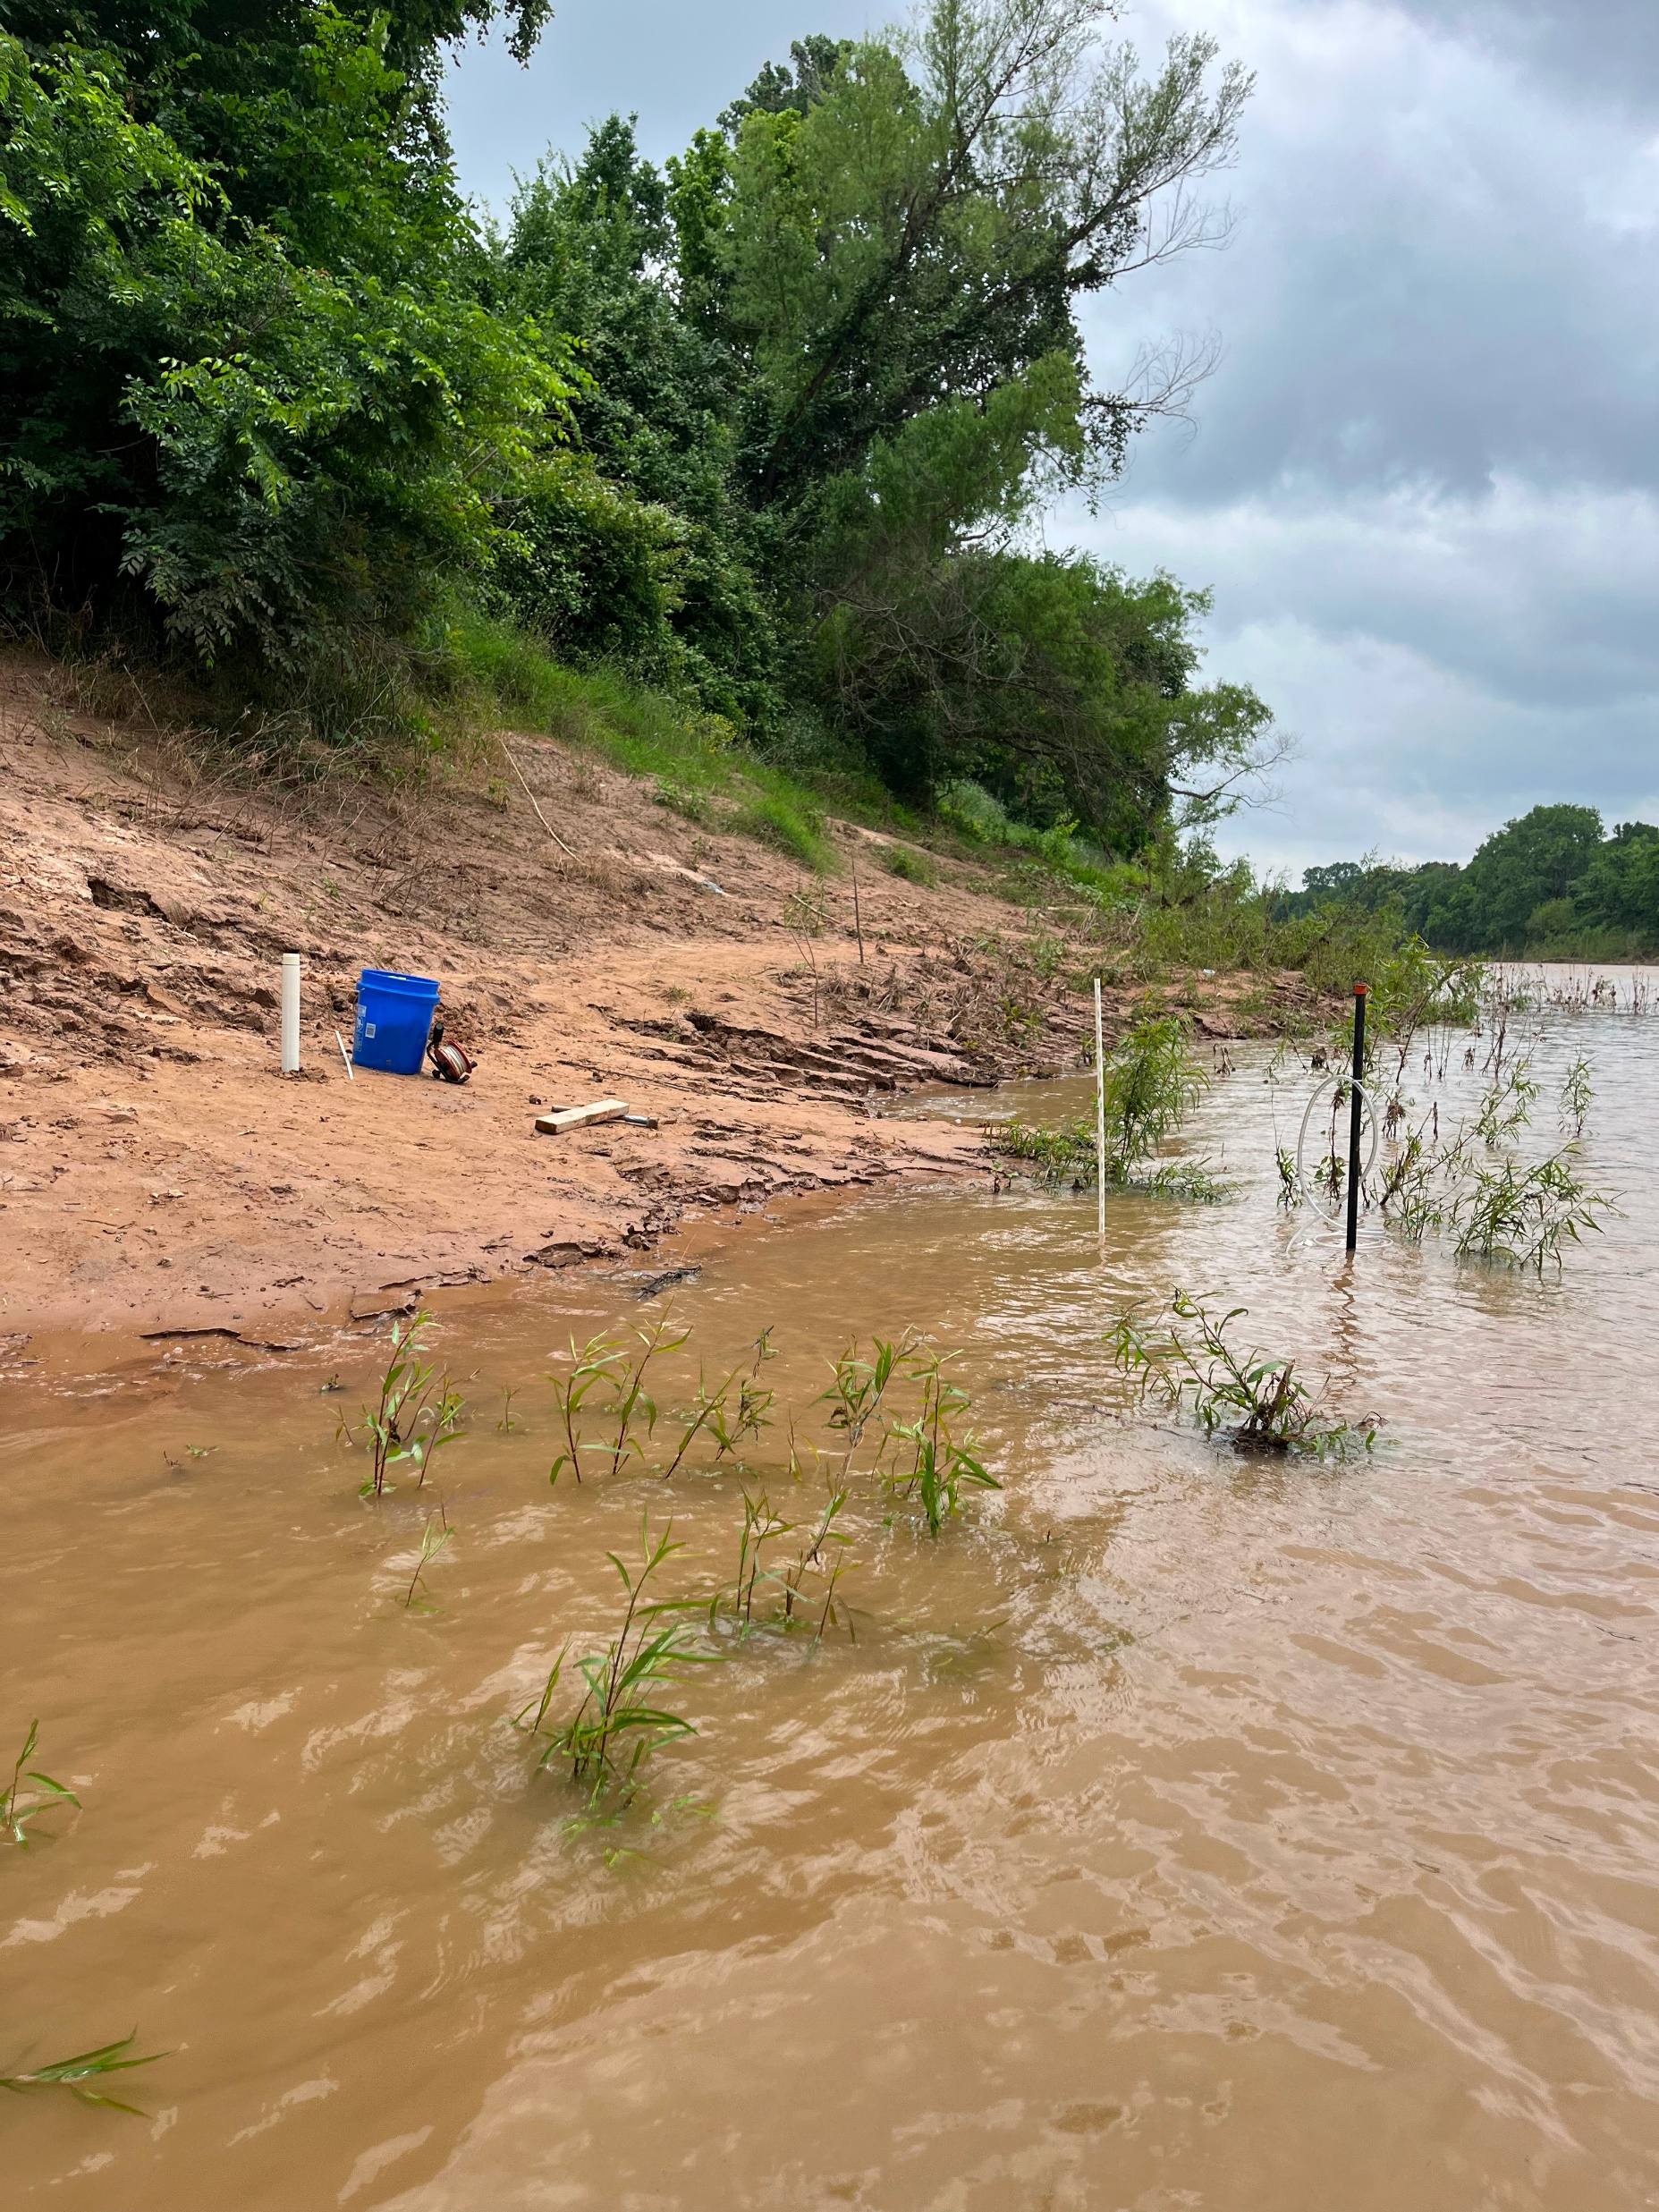
Further Plans:
At each location:
River Sampling
Aquifer Chemistry Sampling
Bank Flow Measurements
Present at the National GSA conference

Slide 21
Further Plans: River Sampling
At each location:
Water chemistry samples
Ionic chemistry
Isotope
Field measurements
Temperature
Dissolved Oxygen (DO)
Specific Conductance (SpC)
pH
Field alkalinity titrations

Slide 22
Methods: Bank flow Data
Mini-Piezometers
Hydraulic gradient between the riverbed sediment and the river
Seepage meters
Flow into or out of the riverbed sediments
K values
Multiple repetitions
dh
dl
Plastic Bag
Steel Drum

Slide 23
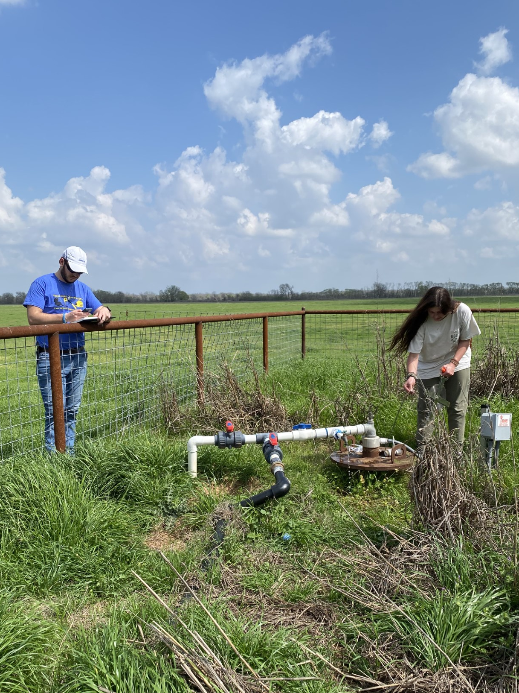
Methods: Groundwater Sampling
At each location:
Water level
Sonic and steel tape/E-Line
Water chemistry samples
Ionic chemistry
Isotope
Field measurements (bucket flow cell)
Temperature
Dissolved Oxygen (DO)
Specific Conductance (SpC)
pH
Field alkalinity titrations
Notes:
So far we have sampled 52 wells, mostly in pairs of bedrock wells and BRAA.
Highlight key findings

Slide 24
Acknowledgements
Alan Day, Brazos Valley GCD
Vivian Yale, Baylor University
Wayne Hamilton, Baylor University
Dr. Joe Yelderman, Baylor University
AquaStrategies
Landowners: Will Vaughn, Mark Hoelscher, and Laura de Asarta

Slide 25
References
Scholarly Work
Cronin, J. G., & Wilson, C. A. (1976). Groundwater in the Flood-Plain Alluvium of the Brazos River, Whitney Dam to Vicinity of Richmond, Texas. Texas Water Development Board, Report 41(March 1967), 12–16.
Ewing, J. E., Jevon, P. E., Harding, J., Jones, T. L., Griffith, C., Freese, J. S. A., et al. (2016a). Final Conceptual Model Report for the Brazos River Alluvium Aquifer Groundwater Availability Model Texas Water Development Board.
Databases
Texas Water Development Board Groundwater Database, 1999, available at (http://www.twdb.state.tx.us/GwRD/waterwell/well_info.asp)
U.S. Department of the Interior and U.S. Geological Survey, USGS Surface-Water Daily Data for the Nation, 2023, available at (https://waterdata.usgs.gov/nwis/dv?)

Slide 26
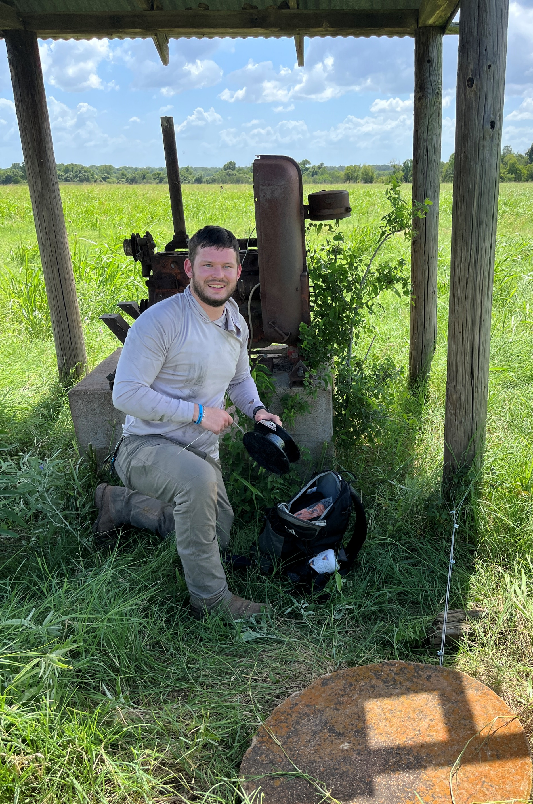
Questions
mark_nickels1@baylor.edu

Slide 27
Data Collected: River Isotopes

Slide 28
Data Collected: River vs Aquifer Chem.

