Slide 1
Preliminary QC/Sparta/C-W Modeling Results and Modeling Results for the Yegua-Jackson and Brazos River Alluvium Aquifers
Presented to
Board of Directors
Brazos Valley Groundwater Conservation District
by
Ground Water Consultants, LLC
December 5, 2019

Slide 2
Model Layers- Aquifer
Layer 1- Colorado and Brazos River Alluvium
Layer 2- Shallow flow systems
Layer 3- Sparta Aquifer
Layer 4- Weches Formation
Layer 5- Queen City Aquifer
Layer 6- Reklaw Formation
Layer 7- Carrizo Aquifer
Layer 8- Calvert Bluff Aquifer
Layer 9- Simsboro Aquifer
Layer 10- Hooper Aquifer

Slide 3
Model Run S-7
Includes results for Sparta, Queen City, and Carrizo-Wilcox Aquifers
All runs include estimated historic pumping for 2011 to 2018
S-7- Some additional pumping added compared to Run S-2. S-7 represents a reasonable starting point for reaching final DFCs for GMA 12
Use Updated Model for all Runs to determine DFCs

Slide 4
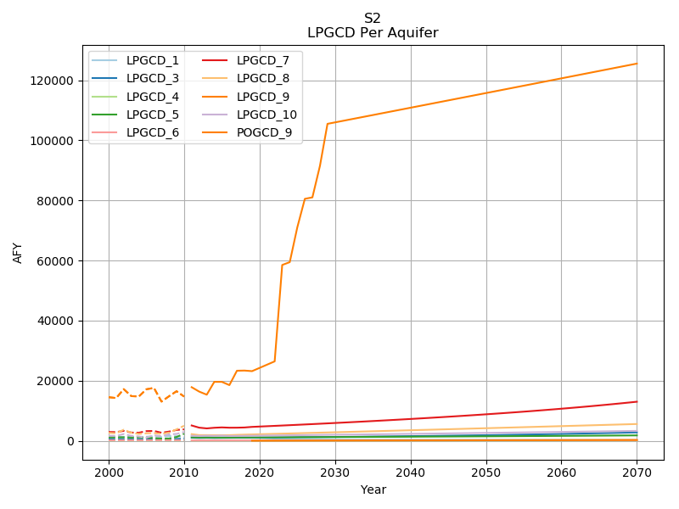
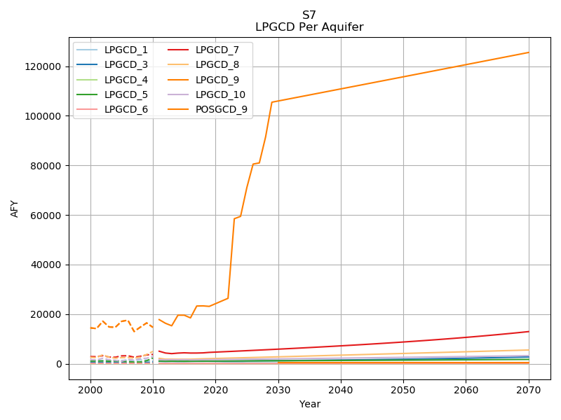
Notes:
Simsboro step ups still present in full because these are export projects, assume full production.

Slide 5
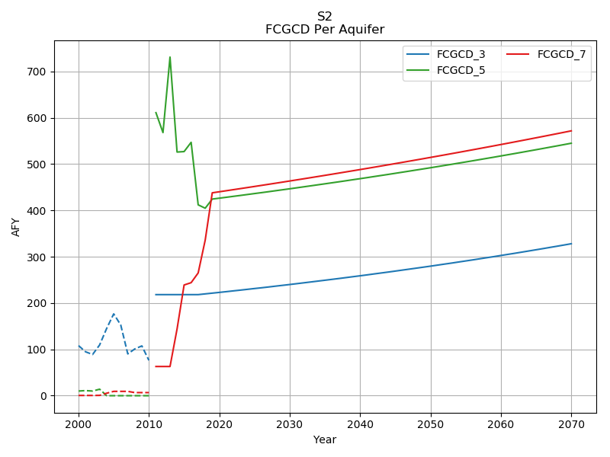
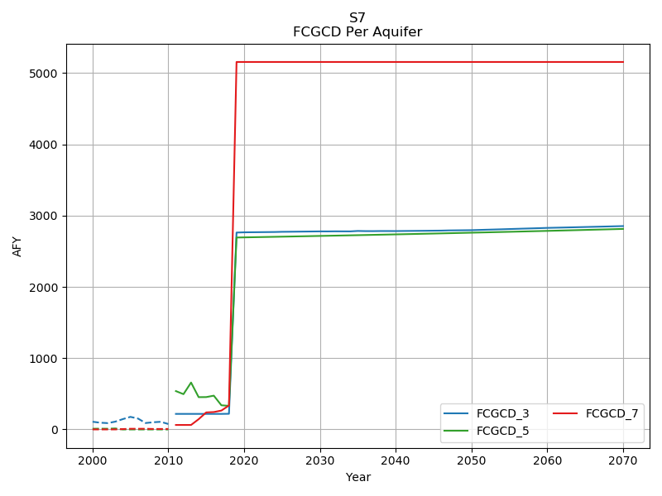

Slide 6
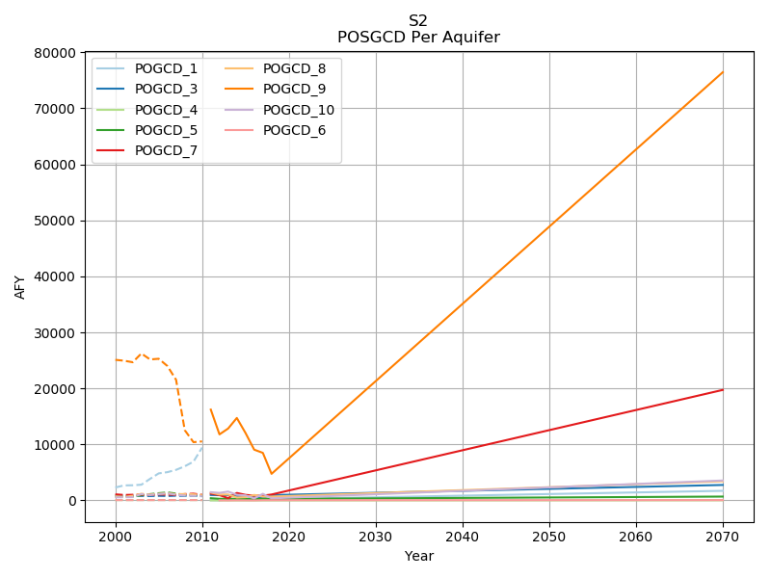
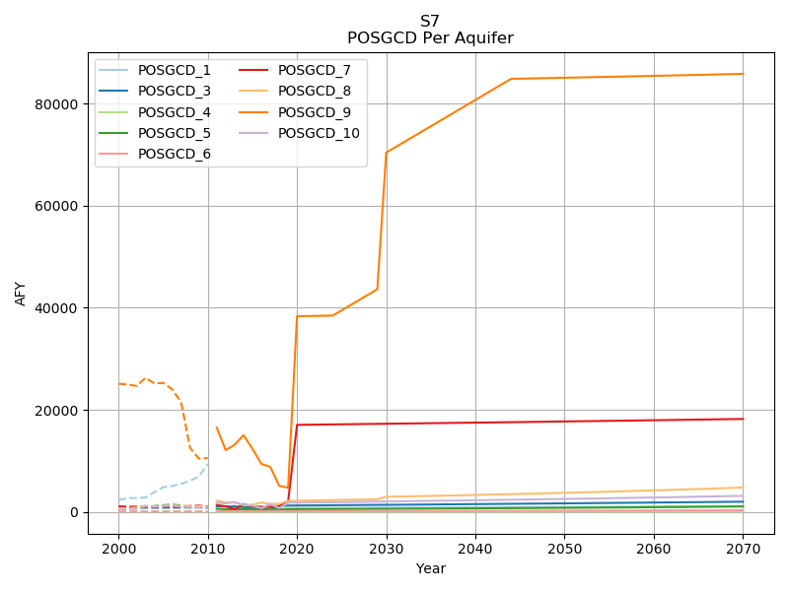

Slide 7
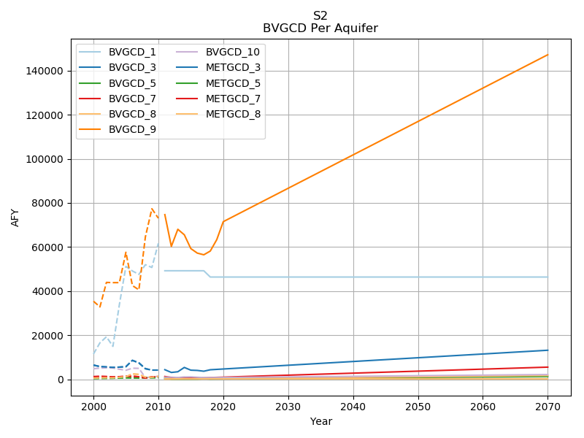
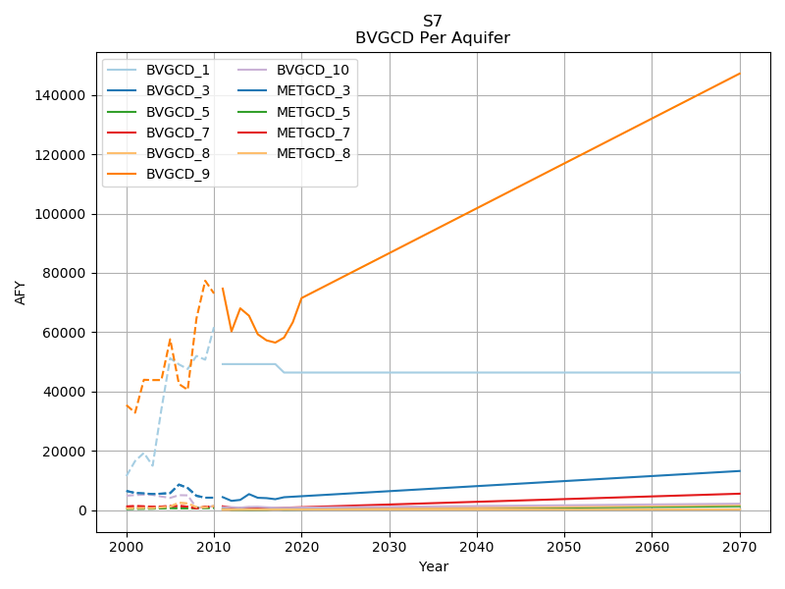

Slide 8
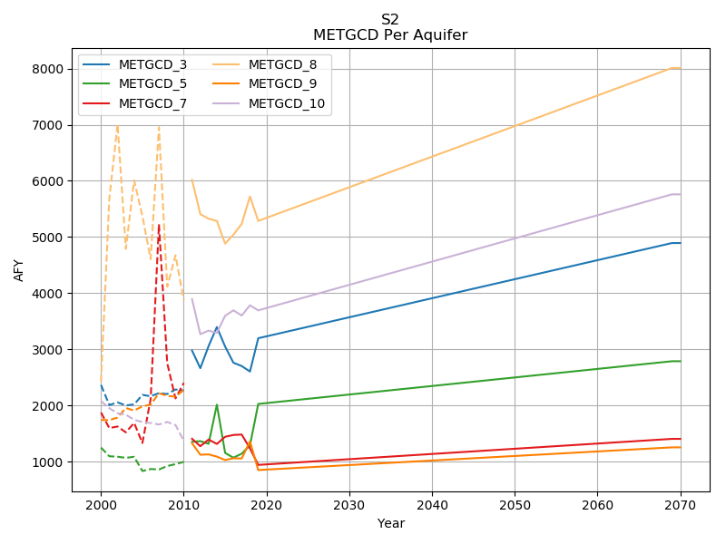
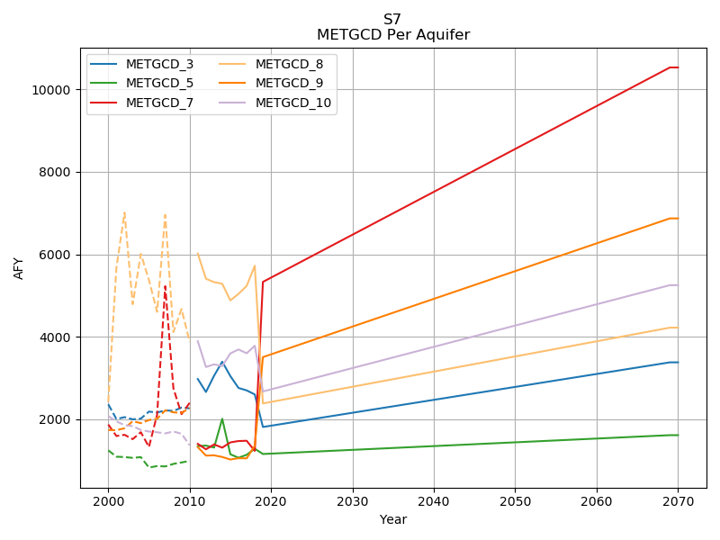

Slide 9
Current GMA 12 DFCs
Aquifer | Current DFCs (1999-2069) Using Previous Model, ft
 | GMA 12 | LPGCD | BVGCD | POGCD | METGCD | FCGCD
Sparta | 16 | 5 | 12 | 28 | 5 | 47
Queen City | 16 | 15 | 12 | 30 | 2 | 64
Carrizo | 75 | 62 | 61 | 67 | 80 | 110
Calvert Bluff | 114 | 100 | 125 | 149 | 90
Simsboro | 228 | 240 | 295 | 318 | 138
Hooper | 168 | 165 | 207 | 205 | 125

Slide 10
Current DFCs and Average Drawdown From Run S-7
Aquifer | Ave. Dd for 1999-2069 for S-7 Using Updated Model
 | GMA 12 | LPGCD | BVGCD | POGCD | METGCD | FCGCD
Sparta | 30 | 25 | 50 | 21 | 31 | 52
Queen City | 29 | 30 | 43 | 21 | 25 | 75
Carrizo | 99 | 147 | 84 | 184 | 53 | 136
Calvert Bluff | 111 | 170 | 112 | 196 | 64
Simsboro | 207 | 346 | 257 | 384 | 89
Hooper | 131 | 193 | 176 | 239 | 79
Aquifer | Current DFCs (1999-2069) Using Previous Model
 | GMA 12 | LPGCD | BVGCD | POGCD | METGCD | FCGCD
Sparta | 16 | 5 | 12 | 28 | 5 | 47
Queen City | 16 | 15 | 12 | 30 | 2 | 64
Carrizo | 75 | 62 | 61 | 67 | 80 | 110
Calvert Bluff | 114 | 100 | 125 | 149 | 90
Simsboro | 228 | 240 | 295 | 318 | 138
Hooper | 168 | 165 | 207 | 205 | 125
Note: DFC and Drawdown values in feet

Slide 11
Model Run S-9
Started with Pumping from Run S-7
Adjust S-7 pumping by aquifers to achieve the DFCs set for the entire GMA-12 region
Constraints were placed on adjustments to pumping
Do not increase pumping in an aquifer above S-7
Do not decrease pumping in an aquifer by more than 50%

Slide 12
Results from Run S-9
Aquifer | Fraction of S-7 Pumping | Current GMA Wide DFCs(1999-2069) Previous Model |  |  | S-9 (2009-2069) GMA Wide DFCs, Updated Model
 |  | DFC, ft Dd | MAG, ac-ft | MAG/ft Dd | Average Dd, ft | MAG, ac-ft | MAG/ft Dd
Sparta | 0.50 | 16 | 24,292 | 1,518 | 15 | 11,950 | 817
Queen City | 0.50 | 16 | 6,700 | 419 | 17 | 4,231 | 255
Carrizo | 0.62 | 75 | 41,167 | 549 | 74 | 32,237 | 436
Calvert Bluff | 1.00 | 114 | 10,927 | 96 | 100 | 16,341 | 164
Simsboro | 1.00 | 228 | 192,565 | 845 | 201 | 364,861 | 1,811
Hooper | 1.00 | 168 | 15,357 | 91 | 127 | 14,289 | 113
Total |  |  | 291,008 |  |  | 443,909
Updated GAM generally has less groundwater production per foot of drawdown for Sparta, Queen City, and Carrizo than does previous GAM
Updated GAM generally has more groundwater production per foot of drawdown for Calvert Bluff, Simsboro, and Hooper than does previous GAM

Slide 13
Results from PS-9: LPGCD & BVGCD
Aquifer | LPGCD |  |  |  |  |  | BVGCD
 | Ave Drawdown, ft |  | MAG, ac-ft/yr |  |  |  | Ave. Drawdown, ft |  | MAG, ac-ft/yr
 | Current | PS-9 | Current | PS-9 |  |  | Current | PS-9 | Current | PS-9
Sparta | 5 | 12 | 2,393 | 1,332 |  |  | 12 | 21 | 9,019 | 6,280
Queen City | 15 | 17 | 1,315 | 857 |  |  | 12 | 21 | 1,200 | 633
Carrizo | 62 | 106 | 12,052 | 9,064 |  |  | 61 | 57 | 5,494 | 3,354
Calvert Bluff | 100 | 146 | 3,984 | 5,529 |  |  | 125 | 88 | 1,757 | 1,742
Simsboro | 240 | 326 | 30,303 | 131,085 |  |  | 282 | 207 | 96,198 | 144,240
Hooper | 165 | 178 | 1,255 | 3,253 |  |  | 207 | 147 | 2,000 | 2,119
Total |  |  | 51,302 | 151,120 |  |  |  |  | 115,668 | 158,369
LPGCD
PS-9 has notable increase in total “MAG”
PS-9 has less production in Sparta, Queen City and Carrizo
PS-9 has more production in Calvert Bluff, Simsboro and Hooper
BVGCD
PS-9 has notable increase in total ‘MAG”
PS-9 has less production in Sparta, Queen City and Carrizo
PS-9 has more production in Simsboro and Hooper

Slide 14
Summary
Comparison of Updated to Previous GAM
Sparta and Queen City are generally less productive. Increasing DFCs in these aquifers will occur to accommodate existing MAGs
Simsboro is more productive
Mixed results for other aquifers
Results from S-9 Indicate that Existing DFCs will need to be adjusted to be Compatible and this was anticipated. Additional Runs will be performed to reach GMA accepted DFCs
Modeling results indicate that a 10% Uncertainty in Predicted Drawdowns could be used for all aquifers when providing results to the TWDB

Slide 15
Brazos River Alluvium

Slide 16
Development of DFCs
Use the Brazos River Alluvium Aquifer GAM completed in 2016, the same GAM used to develop MAGS in the GMA 12 2016 planning cycle
Develop distribution of pumping consistent with areas of irrigated agriculture in Milam, Burleson, Robertson and Brazos counties. Moved some pumping away from the river
Consider pumping history in the counties and past effects of pumping when developing future DFCs

Slide 17
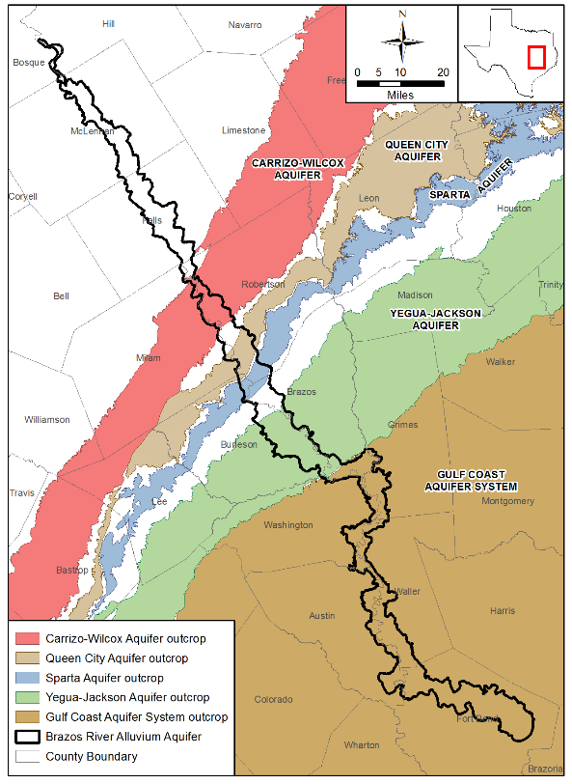
Extent of Brazos River Alluvium Model
From: Final Numerical Model Report for the Brazos River Alluvium Aquifer Groundwater Availability Model, August 2016

Slide 18
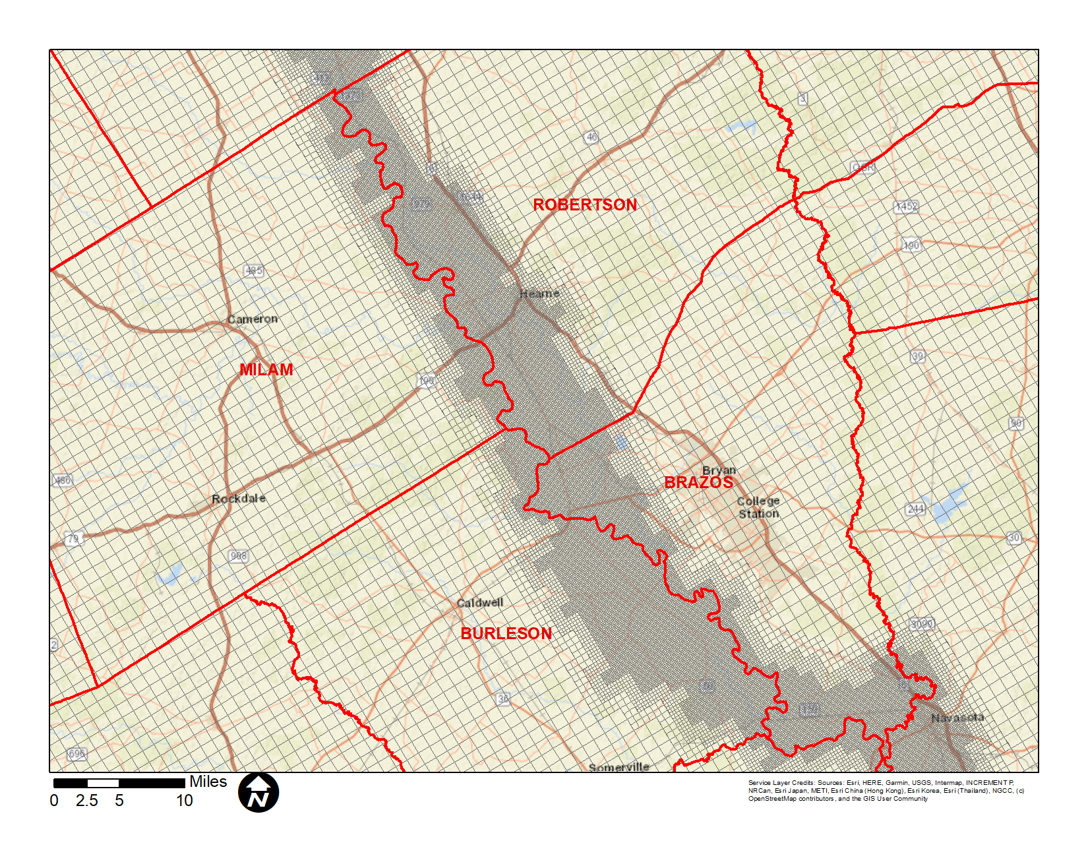
Model Grid for the BRAA GAM

Slide 19
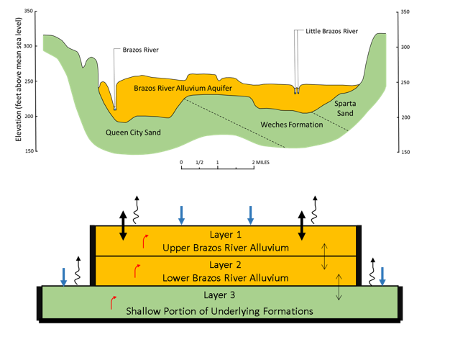
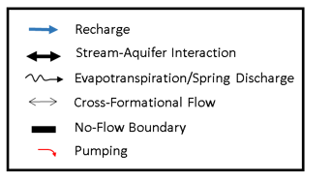
Model Layer in BRAA GAM

Slide 20
Modified TWDB MAG Run
Reduced pumping in wells in Milam County where initial pumping rates could not be sustained
Avoided adding future pumping in same grid cells that include a river node
Keep all the same hydraulic boundaries used by TWDB MAG Run

Slide 21
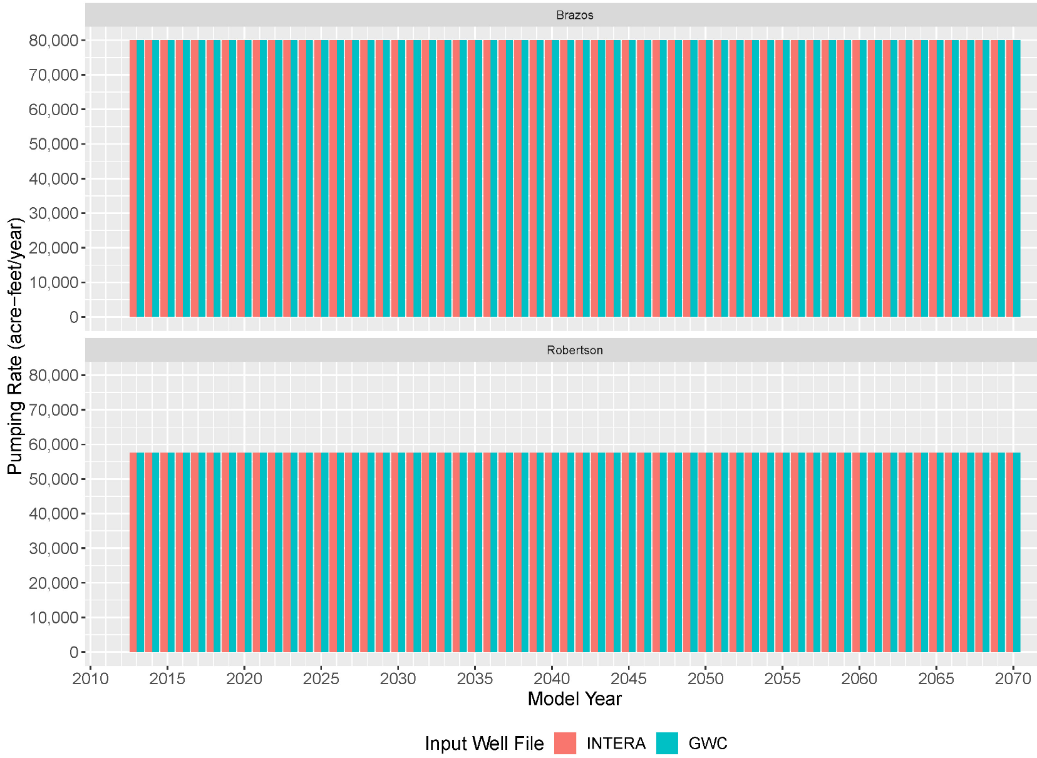
Comparison of Input Well Files For BVGCD
Brazos
Robertson

Slide 22
Comparison of Input and Output Pumping by District: POSGCD

Slide 23
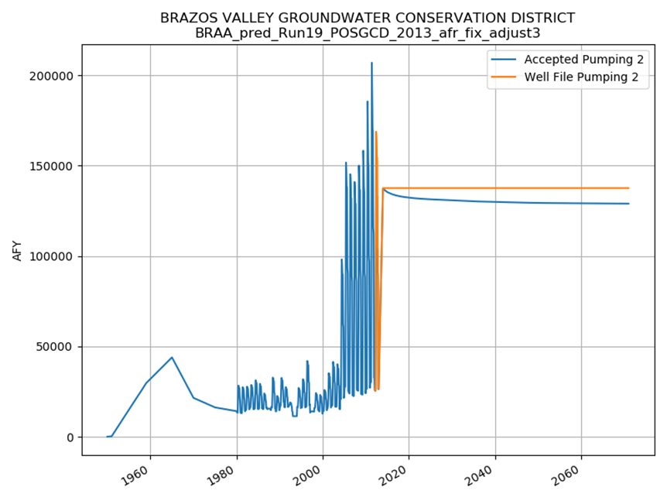
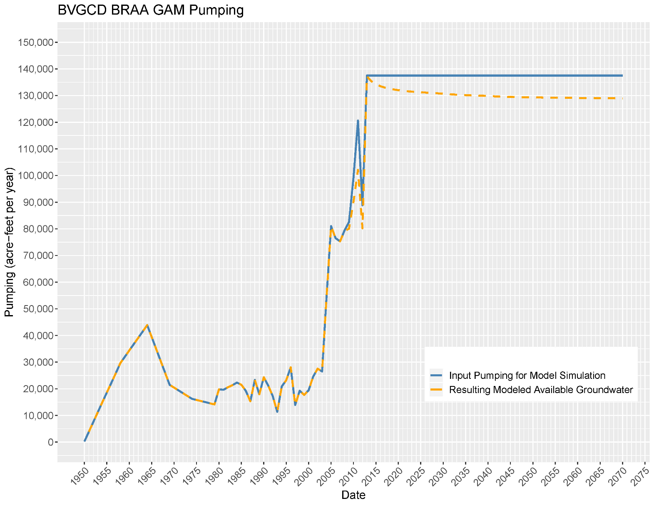
Comparison of Input and Output Pumping by District: BVGCD

Slide 24
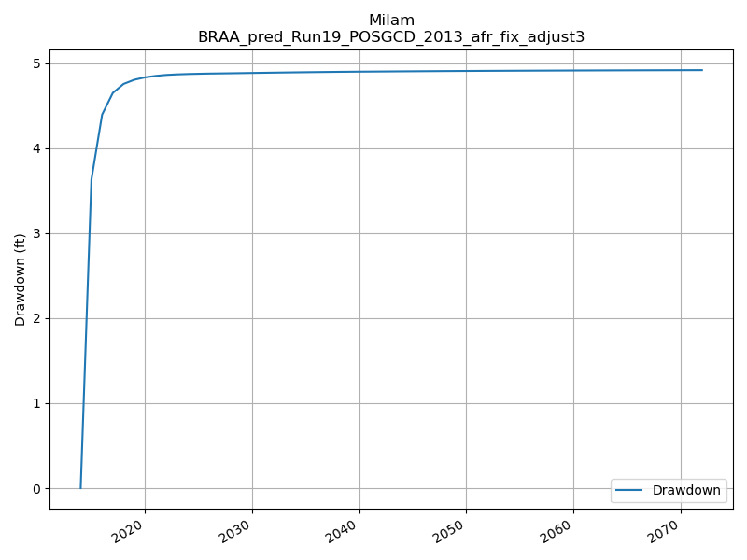
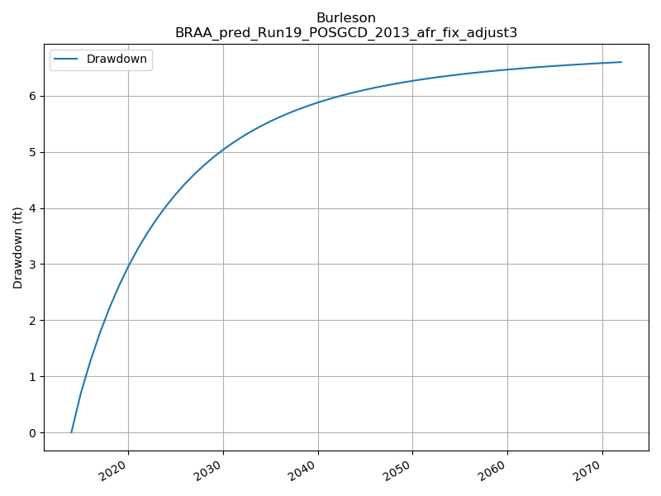
Average Drawdown in Alluvium: POSGCD
Milam
Burleson

Slide 25
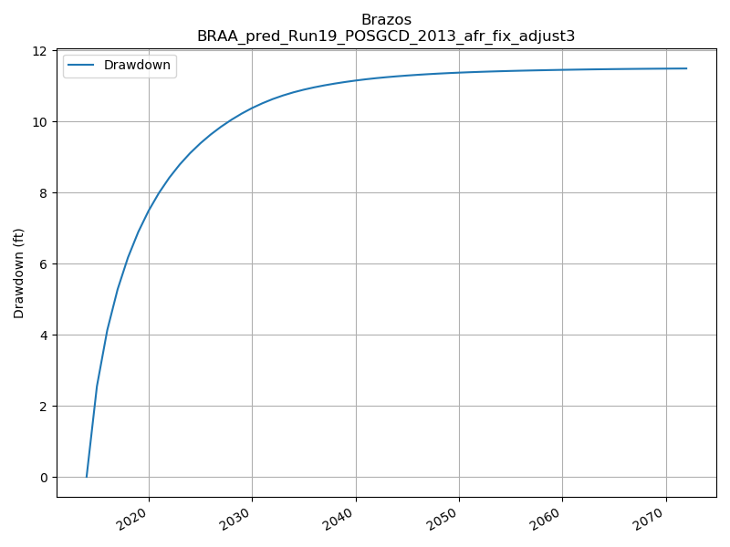
Average Drawdown in Alluvium: BVGCD
Robertson
Brazos
Resulting Saturated Thickness
North Zone: 30%
South Zone: 44%

Slide 26
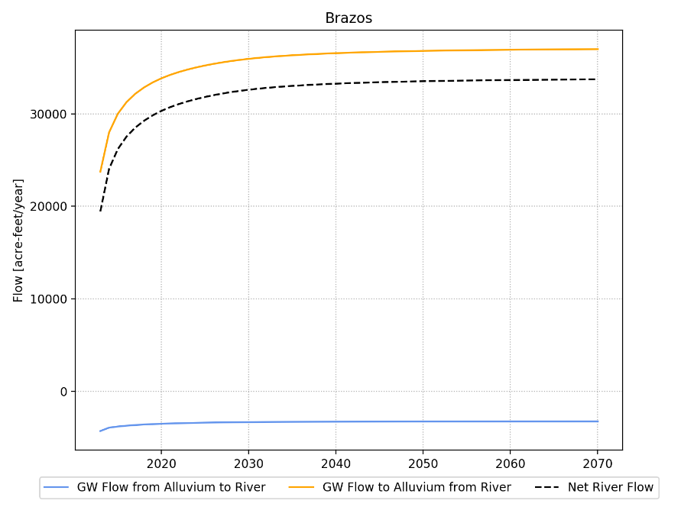
Surface Water-Groundwater Estimated Interaction
County | Flow From Alluvium to River (AFY) |  | Flow From River to Alluvium (AFY) |  | Net Flow (AFY) |  | Increase in Flow from River to Alluvium (AFY) from 2013 to 2070
 | 2013 | 2070 | 2013 | 2070 | 2013 | 2070
Milam | -1,158 | -741 | 28,676 | 33,235 | 27,518 | 32,494 | 4,976
Robertson | -1,049 | -711 | 22,288 | 27,245 | 21,240 | 26,534 | 5,294
Brazos | -4,305 | -3,268 | 23,738 | 36,996 | 19,433 | 33,728 | 14,295
Burleson | -2,804 | -1,851 | 22,194 | 34,206 | 19,391 | 32,355 | 12,964

Slide 27
Summary
Current Simulation Closely Reproduces DFCs from 2016 planning cycle
Resulting MAGs
Milam – 38,626 AFY
Burleson – 32,306 AFY
Robertson – 52,903 AFY
Brazos -76,038 AFY
Based on model results approximately 37,500 AFY of the 200,000 AFY pumped in 2070 is from increased flow from river to alluvium compared to 2012 flows

Slide 28
Yegua – Jackson Aquifer

Slide 29
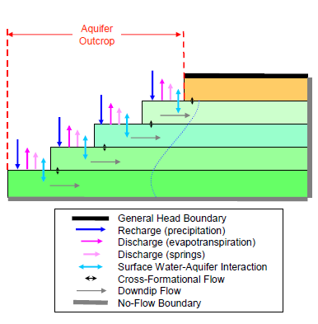
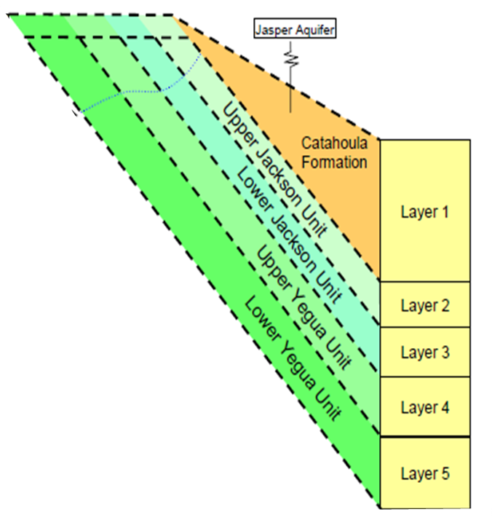
Model Layer in Yegua-Jackson GAM

Slide 30
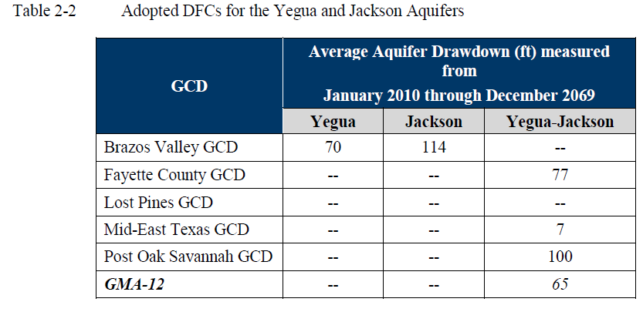
Current DFCs for Yegua-Jackson
Lost Pines GCD will declare Yegua-Jackson as a non-relevant aquifer.
Table from GMA 12 Explanatory Report (Donnelly and others, 2018)

Slide 31
ReRun of the TWDB MAG Run
GCD | Existing DFC |  |  | New DFC with ReRun
 | Yegua | Jackson | Yegua-Jackson | Area | Saturated Thickness | Entire Volume
Brazos Valley | 70 | 114 | -- | 73 | 102 | 95
Fayette County | -- | -- | 77 | 77 | 94 | 89
Lost Pines | -- | -- | -- | 42 | 49 | 44
Mid-East Texas | -- | -- | 7 | 7 | 8 | 7
Post Oak Savannah | -- | -- | 100 | 100 | 123 | 118

Slide 32
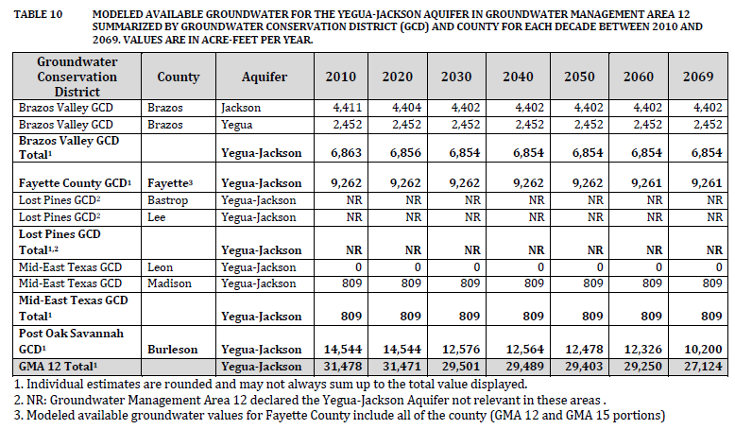
Current MAGs for Yegua-Jackson

Slide 33
Summary
Calculated DFCs are sensitive to method used to weight the different layers
Current DFCs are based on weighting all layers by area covered
Analysis reproduced current DFCs from 2016 planning cycle
MAGs will be very close to those provided by TWDB during the 2016 planning cycle

Slide 34
Questions???

